Slide 1
Section 11: Comparing Java and C
Data representations in Java
Pointers and references
Method calls
Virtual machines and runtime environment

Slide 2
Implementing Programming Languages
Many choices in how to implement programming models
We’ve talked about compilation, can also interpret
  Execute line by line in original source code
  Less work for compiler – all work done at run-time
  Easier to debug – less translation
  Easier to run on different architectures – runs in a simulated environment that exists only inside the interpreter process
Interpreting languages has a long history
  Lisp – one of the first programming languages, was interpreted
Interpreted implementations are very much with us today
  Python, Javascript, Ruby, Matlab, PHP, Perl, …

Slide 3
Interpreted vs. Compiled
Really a continuum, a choice to be made
  More or less work done by interpreter/compiler
Java programs are usually run by a virtual machine
  VMs interpret an intermediate, “partly compiled” language called bytecode
Java can also be compiled ahead of time (just as a C program is) or at runtime by a just-in-time (JIT) compiler
Compiled
C
Java
Lisp
Interpreted
Notes:
http://en.wikipedia.org/wiki/Just-in-time_compilation

Slide 4
Virtual Machine Model
High-Level Language Program
Bytecode
compiler
Ahead-of-time
compiler
Virtual Machine Language
Virtual machine
(interpreter)
JIT
compiler
Native Machine Language

Slide 5
Java Virtual Machine
Holds pointer ‘this’
Makes Java machine-independent
Provides strong protections
Stack-based execution model
There are many JVMs
  Some interpret
  Some compile into assembly
  Usually implemented in C
Other arguments to method
Other local variables
0
1
2
3
4
n
variable table
operand stack
constant
pool

Slide 6
JVM Operand Stack Example
‘i’ stands for integer,
‘a’ for reference,
‘b’ for byte,
‘c’ for char,
‘d’ for double, …
No knowledge
of registers or
memory locations
(each instruction
is 1 byte – bytecode)
iload 1 // push 1st argument from table onto stack
iload 2 // push 2nd argument from table onto stack
iadd // pop top 2 elements from stack, add together, and
// push result back onto stack
istore 3 // pop result and put it into third slot in table
mov 0x8001, %eax
mov 0x8002, %edx
add %edx, %eax
mov %eax, 0x8003

Slide 7
A Simple Java Method
Method java.lang.String getEmployeeName()
0 aload 0 // "this" object is stored at 0 in the var table
1 getfield #5 <Field java.lang.String name> // takes 3 bytes
// pop an element from top of stack, retrieve its
// specified field and push the value onto stack.
// "name" field is the fifth field of the class
4 areturn // Returns object at top of stack
0
1
4
aload_0
getfield
00
05
areturn
In the .class file:
2A
B4
00
05
B0
http://en.wikipedia.org/wiki/Java_bytecode_instruction_listings
Notes:
a prefix on aload, areturn indicates reference (see previous slide).
getfield is the bytecode instruction to get a field’s value for a particular object; to get a static value for a particular class, the getstatic bytecode instruction is used.

Slide 8
Class File Format
Every class in Java source code is compiled to its own class file
10 sections in the Java class file structure:
  Magic number: 0xCAFEBABE (legible hex from James Gosling – Java’s inventor)
  Version of class file format: the minor and major versions of the class file
  Constant pool: set of constant values for the class
  Access flags: for example whether the class is abstract, static, etc.
  This class: The name of the current class
  Super class: The name of the super class
  Interfaces: Any interfaces in the class
  Fields: Any fields in the class
  Methods: Any methods in the class
  Attributes: Any attributes of the class (for example the name of the source file, etc.)
A .jar file collects together all of the class files needed for the program, plus any additional resources (e.g. images)
Notes:
http://en.wikipedia.org/wiki/Java_class_file#Sections

Slide 9
Other languages for JVMs
JVMs run on so many computers that compilers have been built to translate many other languages to Java bytecode:
  AspectJ, an aspect-oriented extension of Java
  ColdFusion, a scripting language compiled to Java
  Clojure, a functional Lisp dialect
  Groovy, a scripting language
  JavaFX Script, a scripting language targeting the Rich Internet Application domain
  JRuby, an implementation of Ruby
  Jython, an implementation of Python
  Rhino, an implementation of JavaScript
  Scala, an object-oriented and functional programming language
  And many others, even including C
Notes:
http://en.wikipedia.org/wiki/List_of_JVM_languages

Slide 10
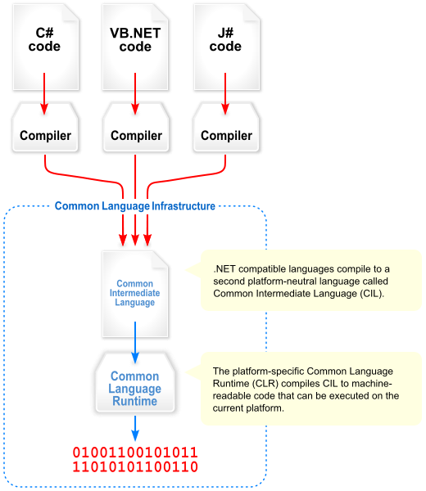
Microsoft’s C# and .NET Framework
C# has similar motivations as Java
Virtual machine is called the Common Language Runtime; Common Intermediate Language is the bytecode for C# and other languages in the .NET framework

