Slide 1
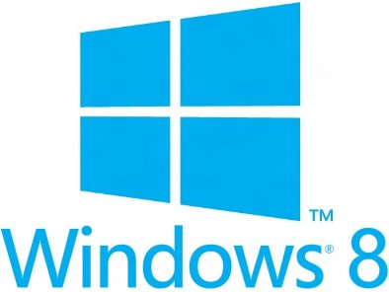


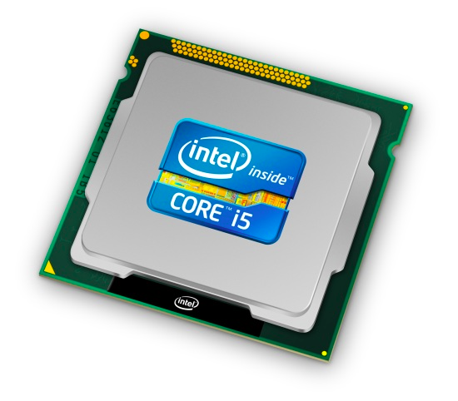
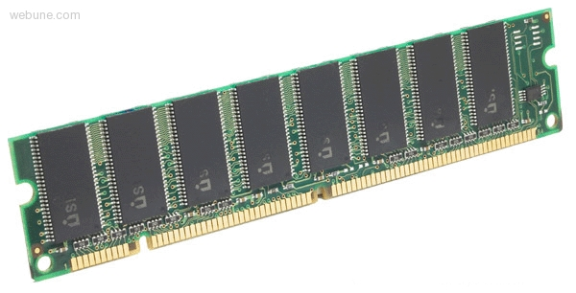
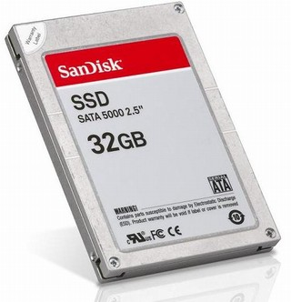
Roadmap
Memory & data
Integers & floats
Machine code & C
x86 assembly
Procedures & stacks
Arrays & structs
Memory & caches
Processes
Virtual memory
Memory allocation
Java vs. C
C:
Java:
car *c = malloc(sizeof(car));
c->miles = 100;
c->gals = 17;
float mpg = get_mpg(c);
free(c);
Car c = new Car();
c.setMiles(100);
c.setGals(17);
float mpg =
c.getMPG();
Assembly language:
get_mpg:
pushq %rbp
movq %rsp, %rbp
...
popq %rbp
ret
OS:
Machine code:
0111010000011000
100011010000010000000010
1000100111000010
110000011111101000011111
Computer system:

Slide 2
Section 11: Comparing Java and C
Data representations in Java
Pointers and references
Method calls
Virtual machines and runtime environment
We’ve learned about the above in C,
this section is about how it all works in Java
But you have a lot more background now,
so this tour will be much faster

Slide 3
Meta-point to this lecture
None of the data representations we are going to talk about are guaranteed by Java
In fact, the language simply provides an abstraction
We can't easily tell how things are really represented
But it is important to understand an implementation of the lower levels – useful in thinking about your program

Slide 4
Data in Java
Integers, floats, doubles, pointers – same as C
  Yes, Java has pointers – they are called ‘references’ – however, Java references are much more constrained than C’s general pointers
Null is typically represented as 0
Characters and strings
Arrays
Objects

Slide 5
Data in Java
Characters and strings
  Two-byte Unicode instead of ASCII
    Represents most of the world’s alphabets
  String not bounded by a ‘\0’ (null character)
    Bounded by hidden length field at beginning of string
the string ‘CSE351’:
43
53
45
33
35
31
\0
C: ASCII
0
1
4
7
16
6
00
43
00
53
00
45
00
33
00
35
00
31
Java: Unicode

Slide 6
Data in Java
Arrays
  Every element initialized to 0
  Bounds specified in hidden fields at start of array (int – 4 bytes)
    array.length returns value of this field
    Hmm, since it has this info, what can it do?
int array[5]:
??
??
??
??
??
C
0
4
20
24
5
00
00
00
00
00
Java

Slide 7
Data in Java
Arrays
  Every element initialized to 0
  Bounds specified in hidden fields at start of array (int – 4 bytes)
    array.length returns value of this field
  Every access triggers a bounds-check
    Code is added to ensure the index is within bounds
    Exception if out-of-bounds
int array[5]:
??
??
??
??
??
C
0
4
20
24
5
00
00
00
00
00
Java

Slide 8
Data structures (objects) in Java
Objects (structs) can only include primitive data types
  Include complex data types (arrays, other objects, etc.) using references
C
Java
struct rec {
int i;
int a[3];
struct rec *p;
};
class Rec {
int i;
int[] a = new int[3];
Rec p;
…
};
struct rec *r = malloc(...);
struct rec r2;
r->i = val;
r->a[2] = val;
r->p = &r2;
r = new Rec;
r2 = new Rec;
r.i = val;
r.a[2] = val;
r.p = r2;
i
a
p
i
a
p
3
int[3]
0
4
16
20
0
4
8
12
0
4
16

Slide 9
Pointers/References
Pointers in C can point to any memory address
References in Java can only point to an object
  And only to its first element – not to the middle of it
Java
struct rec {
int i;
int a[3];
struct rec *p;
};
some_fn(&(r.a[1])) //ptr
class Rec {
int i;
int[] a = new int[3];
Rec p;
…
};
some_fn(r.a, 1) //ref & index
C

i
a
p
i
a
p
0
4
16
20
3
int[3]
0
4
8
12
0
4
16
Notes:
http://programmers.stackexchange.com/questions/141834/how-is-a-java-reference-different-from-a-c-pointer

