Slide 1



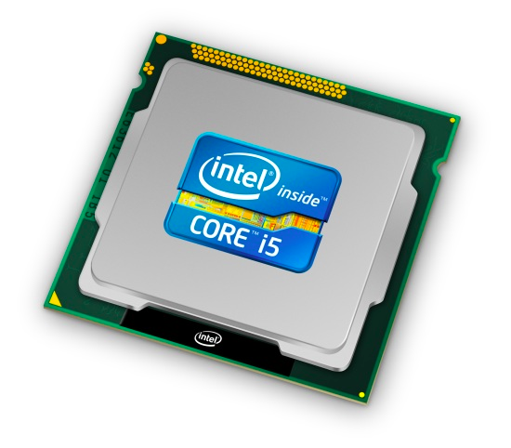
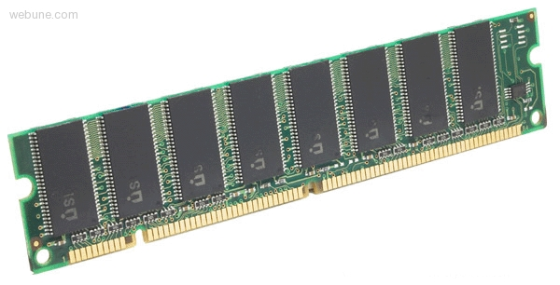

Roadmap
Memory & data
Integers & floats
Machine code & C
x86 assembly
Procedures & stacks
Arrays & structs
Memory & caches
Processes
Virtual memory
Memory allocation
Java vs. C
C:
Java:
car *c = malloc(sizeof(car));
c->miles = 100;
c->gals = 17;
float mpg = get_mpg(c);
free(c);
Car c = new Car();
c.setMiles(100);
c.setGals(17);
float mpg =
c.getMPG();
Assembly language:
get_mpg:
pushq %rbp
movq %rsp, %rbp
...
popq %rbp
ret
OS:
Machine code:
0111010000011000
100011010000010000000010
1000100111000010
110000011111101000011111
Computer system:

Slide 2
Section 8: Processes
What is a process
Creating processes
Fork-Exec

Slide 3
What is a process?
Why are we learning about processes?
  Processes are another abstraction in our computer system – the process abstraction provides an interface between the program and the underlying CPU + memory.
What do processes have to do with exceptional control flow?
  Exceptional control flow is the mechanism that the OS uses to enable multiple processes to run on the same system.
What is a program? A processor? A process?

Slide 4
Processes
Definition: A process is an instance of a running program
  One of the most important ideas in computer science
  Not the same as “program” or “processor”
Process provides each program with two key abstractions:
  Logical control flow
    Each process seems to have exclusive use of the CPU
  Private virtual address space
    Each process seems to have exclusive use of main memory
Why are these illusions important?
How are these illusions maintained?
  Process executions interleaved (multi-tasking)
  Address spaces managed by virtual memory system – next course topic
Notes:
http://en.wikipedia.org/wiki/Computer_multitasking

Slide 5
Concurrent Processes
Two processes run concurrently (are concurrent) if their instruction executions (flows) overlap in time
Otherwise, they are sequential
Examples:
  Concurrent: A & B, A & C
  Sequential: B & C
Process A
Process B
Process C
time

Slide 6
User View of Concurrent Processes
Control flows for concurrent processes are physically disjoint in time
  CPU only executes instructions for one process at a time
However, we can think of concurrent processes as executing in parallel
Process A
Process B
Process C
time

Slide 7
Context Switching
Processes are managed by a shared chunk of OS code
called the kernel
  Important: the kernel is not a separate process, but rather runs as part of a user process
Control flow passes from one process to another via a context switch… (how?)
Process A
Process B
user code
kernel code
context switch
time
user code
kernel code
context switch
user code

