Slide 1



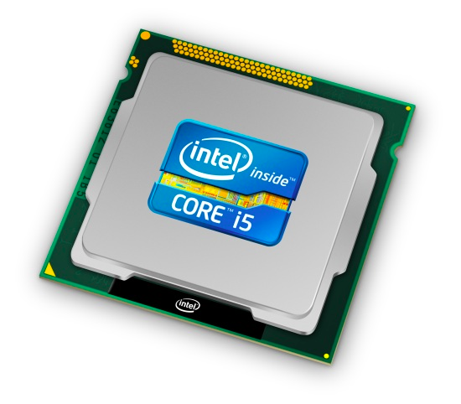
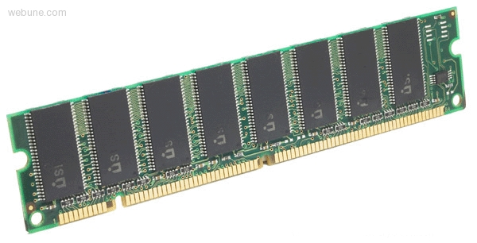
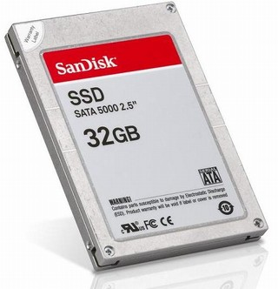
Roadmap
Memory & data
Integers & floats
Machine code & C
x86 assembly
Procedures & stacks
Arrays & structs
Memory & caches
Processes
Virtual memory
Memory allocation
Java vs. C
C:
Java:
car *c = malloc(sizeof(car));
c->miles = 100;
c->gals = 17;
float mpg = get_mpg(c);
free(c);
Car c = new Car();
c.setMiles(100);
c.setGals(17);
float mpg =
c.getMPG();
Assembly language:
get_mpg:
pushq %rbp
movq %rsp, %rbp
...
popq %rbp
ret
OS:
Machine code:
0111010000011000
100011010000010000000010
1000100111000010
110000011111101000011111
Computer system:

Slide 2
Section 7: Memory and Caches
Cache basics
Principle of locality
Memory hierarchies
Cache organization
Program optimizations that consider caches

Slide 3
How does execution time grow with SIZE?
int array[SIZE];
int A = 0;
for (int i = 0 ; i < 200000 ; ++ i) {
for (int j = 0 ; j < SIZE ; ++ j) {
A += array[j];
}
}
TIME
Plot
SIZE

Slide 4
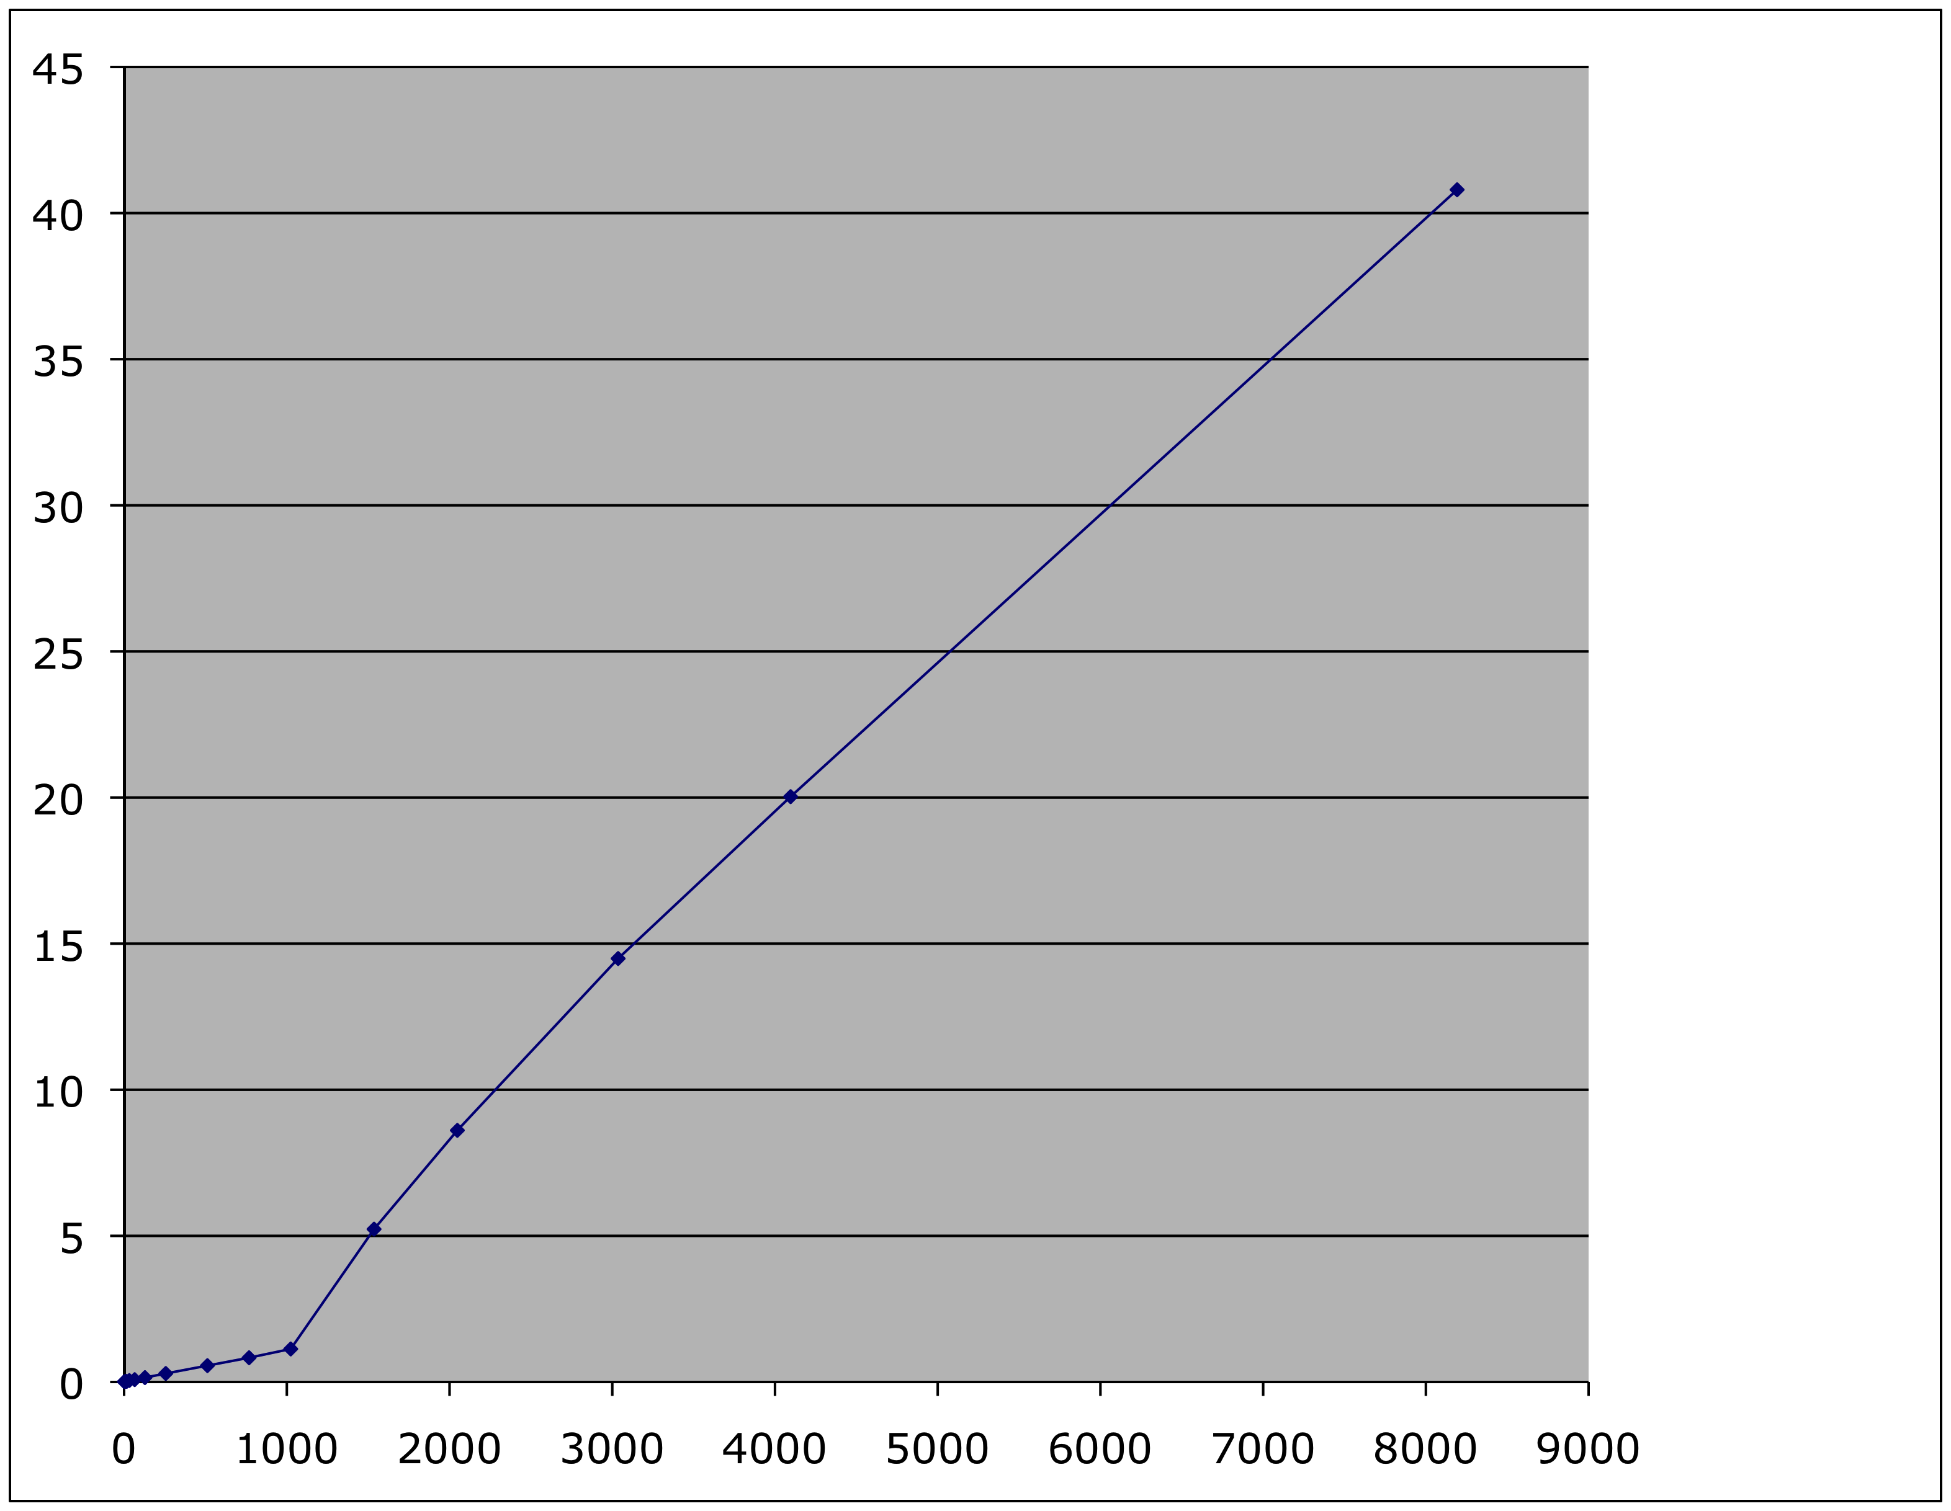
Actual Data
Time
SIZE

Slide 5
Problem: Processor-Memory Bottleneck
Processor performance
doubled about
every 18 months
Bus bandwidth
evolved much slower
Main Memory
CPU
Reg
Core 2 Duo:
Can process at least
256 Bytes/cycle
Core 2 Duo:
Bandwidth
2 Bytes/cycle
Latency
100 cycles
Problem: lots of waiting on memory

Slide 6
Problem: Processor-Memory Bottleneck
Processor performance
doubled about
every 18 months
Bus bandwidth
evolved much slower
Main Memory
CPU
Reg
Cache
Core 2 Duo:
Can process at least
256 Bytes/cycle
Core 2 Duo:
Bandwidth
2 Bytes/cycle
Latency
100 cycles
Solution: caches

Slide 7
Cache
English definition: a hidden storage space for provisions, weapons, and/or treasures
CSE definition: computer memory with short access time used for the storage of frequently or recently used instructions or data (i-cache and d-cache)
more generally,
used to optimize data transfers between system elements with different characteristics (network interface cache, I/O cache, etc.)

Slide 8
General Cache Mechanics
Smaller, faster, more expensive
memory caches a subset of
the blocks
Cache
8
9
14
3
Data is copied in block-sized transfer units
Larger, slower, cheaper memory
viewed as partitioned into “blocks”
Memory
0
1
2
3
4
5
6
7
8
9
10
11
12
13
14
15

Slide 9
General Cache Concepts: Hit
Request: 14
Data in block b is needed
Block b is in cache:
Hit!
Cache
8
9
14
3
14
Memory
0
1
2
3
4
5
6
7
8
9
10
11
12
13
14
15

Slide 10
General Cache Concepts: Miss
Request: 12
Data in block b is needed
Block b is not in cache:
Miss!
Cache
8
9
14
3
12
Block b is fetched from
memory
12
Request: 12
Block b is stored in cache
Placement policy:
determines where b goes
Replacement policy:
determines which block
gets evicted (victim)
Memory
0
1
2
3
4
5
6
7
8
9
10
11
12
12
13
14
15

Slide 11
Not to forget…
CPU
A little of super
fast memory (cache$)
Lots of
slower Mem

