Slide 1



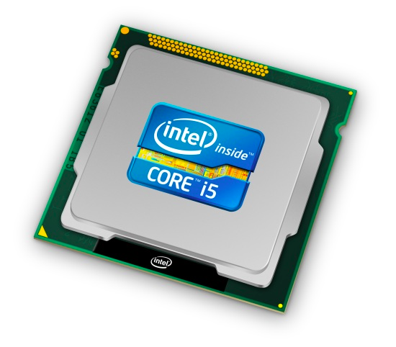
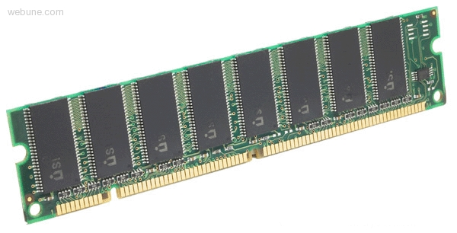
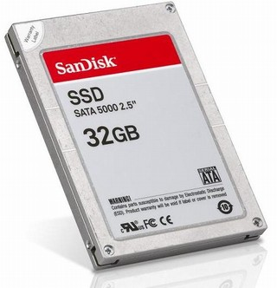
Roadmap
Memory & data
Integers & floats
Machine code & C
x86 assembly
Procedures & stacks
Arrays & structs
Memory & caches
Processes
Virtual memory
Memory allocation
Java vs. C
C:
Java:
car *c = malloc(sizeof(car));
c->miles = 100;
c->gals = 17;
float mpg = get_mpg(c);
free(c);
Car c = new Car();
c.setMiles(100);
c.setGals(17);
float mpg =
c.getMPG();
Assembly language:
get_mpg:
pushq %rbp
movq %rsp, %rbp
...
popq %rbp
ret
OS:
Machine code:
0111010000011000
100011010000010000000010
1000100111000010
110000011111101000011111
Computer system:

Slide 2
Section 5: Arrays & Other Data Structures
Array allocation and access in memory
Multi-dimensional or nested arrays
Multi-level arrays
Other structures in memory
Data structures and alignment

Slide 3
Array Allocation
Basic Principle
  T A[N];
  Array of data type T and length N
  Contiguously allocated region of N * sizeof(T) bytes
char string[12];
x
x + 12
int val[5];
x
x + 4
x + 8
x + 12
x + 16
x + 20
double a[3];
x
x + 8
x + 16
x + 24
char* p[3];
(or char *p[3];)
IA32
x
x + 4
x + 8
x + 12
x86-64
x
x + 8
x + 16
x + 24

Slide 4
Array Access
Basic Principle
  T A[N];
  Array of data type T and length N
  Identifier A can be used as a pointer to array element 0: Type T*
Reference Type Value
  val[4] int
  val int *
  val+1 int *
  &val[2] int *
  val[5] int
  *(val+1) int
  val + i int *
int val[5];
9
8
1
9
5
x
x + 4
x + 8
x + 12
x + 16
x + 20
5
x
x + 4
x + 8
?? (whatever is in memory at address x + 20)
8
x + 4*i

Slide 5
Array Example
typedef int zip_dig[5];
zip_dig cmu = { 1, 5, 2, 1, 3 };
zip_dig uw = { 9, 8, 1, 9, 5 };
zip_dig ucb = { 9, 4, 7, 2, 0 };

Slide 6
Array Example
typedef int zip_dig[5];
zip_dig cmu = { 1, 5, 2, 1, 3 };
zip_dig uw = { 9, 8, 1, 9, 5 };
zip_dig ucb = { 9, 4, 7, 2, 0 };
zip_dig cmu;
1
5
2
1
3
16
20
24
28
32
36
zip_dig uw ;
9
8
1
9
5
36
40
44
48
52
56
zip_dig ucb;
9
4
7
2
0
56
60
64
68
72
76
Declaration “zip_dig uw” equivalent to “int uw[5]”
Example arrays were allocated in successive 20 byte blocks
  Not guaranteed to happen in general

Slide 7
Array Accessing Example
zip_dig uw;
9
8
1
9
5
36
40
44
48
52
56
int get_digit
(zip_dig z, int dig)
{
return z[dig];
}
Register %edx contains starting address of array
Register %eax contains
array index
Desired digit at
4*%eax + %edx
Use memory reference (%edx,%eax,4)
IA32
# %edx = z
# %eax = dig
movl (%edx,%eax,4),%eax # z[dig]

Slide 8
Referencing Examples
zip_dig cmu;
1
5
2
1
3
16
20
24
28
32
36
zip_dig uw;
9
8
1
9
5
36
40
44
48
52
56
zip_dig ucb;
9
4
7
2
0
56
60
64
68
72
76
Reference Address Value Guaranteed?
  uw[3]
  uw[6]
  uw[-1]
  cmu[15]
  No bounds checking
  Location of each separate array in memory is not guaranteed
36 + 4* 3 = 48 9 Yes
36 + 4* 6 = 60 4 No
36 + 4*-1 = 32 3 No
16 + 4*15 = 76 ?? No

Slide 9
Array Loop Example
int zd2int(zip_dig z)
{
int i;
int zi = 0;
for (i = 0; i < 5; i++) {
zi = 10 * zi + z[i];
}
return zi;
}

Slide 10
Array Loop Example
int zd2int(zip_dig z)
{
int i;
int zi = 0;
for (i = 0; i < 5; i++) {
zi = 10 * zi + z[i];
}
return zi;
}
Original
Transformed
  Eliminate loop variable i,
  use pointer zend instead
  Convert array code to
  pointer code
    Pointer arithmetic on z
  Express in do-while form
  (no test at entrance)
int zd2int(zip_dig z)
{
int zi = 0;
int *zend = z + 4;
do {
zi = 10 * zi + *z;
z++;
} while (z <= zend);
return zi;
}

Slide 11
Array Loop Implementation (IA32)
int zd2int(zip_dig z)
{
int zi = 0;
int *zend = z + 4;
do {
zi = 10 * zi + *z;
z++;
} while(z <= zend);
return zi;
}
int zd2int(zip_dig z)
{
int zi = 0;
int *zend = z + 4;
do {
zi = 10 * zi + *z;
z++;
} while(z <= zend);
return zi;
}
int zd2int(zip_dig z)
{
int zi = 0;
int *zend = z + 4;
do {
zi = 10 * zi + *z;
z++;
} while(z <= zend);
return zi;
}
int zd2int(zip_dig z)
{
int zi = 0;
int *zend = z + 4;
do {
zi = 10 * zi + *z;
z++;
} while(z <= zend);
return zi;
}
Registers
  %ecx z
  %eax zi
  %ebx zend
Computations
  10*zi + *z implemented as *z + 2*(5*zi)
  z++ increments by 4
int zd2int(zip_dig z)
{
int zi = 0;
int *zend = z + 4;
do {
zi = 10 * zi + *z;
z++;
} while(z <= zend);
return zi;
}
# %ecx = z
xorl %eax,%eax # zi = 0
leal 16(%ecx),%ebx # zend = z+4
.L59:
leal (%eax,%eax,4),%edx # zi + 4*zi = 5*zi movl (%ecx),%eax # *z
addl $4,%ecx # z++
leal (%eax,%edx,2),%eax # zi = *z + 2*(5*zi)
cmpl %ebx,%ecx # z : zend
jle .L59 # if <= goto loop
# %ecx = z
xorl %eax,%eax # zi = 0
leal 16(%ecx),%ebx # zend = z+4
.L59:
leal (%eax,%eax,4),%edx # zi + 4*zi = 5*zi movl (%ecx),%eax # *z
addl $4,%ecx # z++
leal (%eax,%edx,2),%eax # zi = *z + 2*(5*zi)
cmpl %ebx,%ecx # z : zend
jle .L59 # if <= goto loop
# %ecx = z
xorl %eax,%eax # zi = 0
leal 16(%ecx),%ebx # zend = z+4
.L59:
leal (%eax,%eax,4),%edx # zi + 4*zi = 5*zi movl (%ecx),%eax # *z
addl $4,%ecx # z++
leal (%eax,%edx,2),%eax # zi = *z + 2*(5*zi)
cmpl %ebx,%ecx # z : zend
jle .L59 # if <= goto loop
# %ecx = z
xorl %eax,%eax # zi = 0
leal 16(%ecx),%ebx # zend = z+4
.L59:
leal (%eax,%eax,4),%edx # zi + 4*zi = 5*zi movl (%ecx),%eax # *z
addl $4,%ecx # z++
leal (%eax,%edx,2),%eax # zi = *z + 2*(5*zi)
cmpl %ebx,%ecx # z : zend
jle .L59 # if <= goto loop
# %ecx = z
xorl %eax,%eax # zi = 0
leal 16(%ecx),%ebx # zend = z+4
.L59:
leal (%eax,%eax,4),%edx # zi + 4*zi = 5*zi
movl (%ecx),%eax # *z
addl $4,%ecx # z++
leal (%eax,%edx,2),%eax # zi = *z + 2*(5*zi)
cmpl %ebx,%ecx # z : zend
jle .L59 # if <= goto loop

