Slide 1



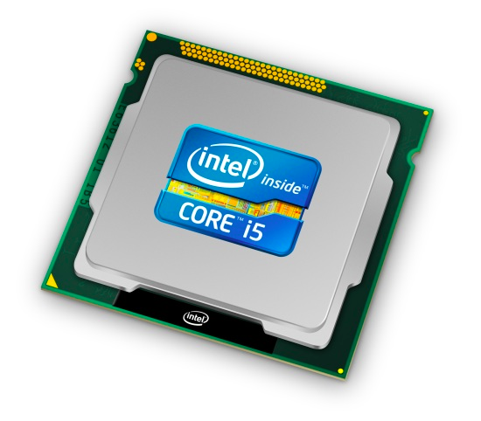
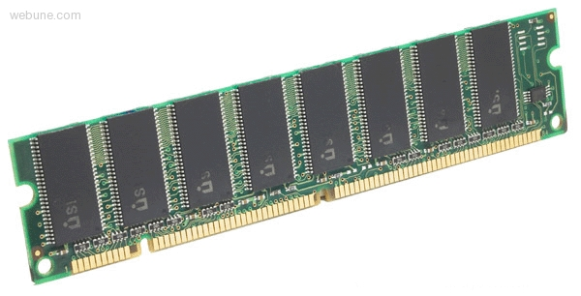

Roadmap
Memory & data
Integers & floats
Machine code & C
x86 assembly
Procedures & stacks
Arrays & structs
Memory & caches
Processes
Virtual memory
Memory allocation
Java vs. C
C:
Java:
car *c = malloc(sizeof(car));
c->miles = 100;
c->gals = 17;
float mpg = get_mpg(c);
free(c);
Car c = new Car();
c.setMiles(100);
c.setGals(17);
float mpg =
c.getMPG();
Assembly language:
get_mpg:
pushq %rbp
movq %rsp, %rbp
...
popq %rbp
ret
OS:
Machine code:
0111010000011000
100011010000010000000010
1000100111000010
110000011111101000011111
Computer system:

Slide 2
Section 4: x86 Assembly Programming
Move instructions, registers, and operands
Memory addressing modes
swap example: 32-bit vs. 64-bit
Arithmetic operations
Condition codes
Conditional and unconditional branches
Loops
Switch statements

Slide 3
Three Basic Kinds of Instructions
Transfer data between memory and register
  Load data from memory into register
    %reg = Mem[address]
  Store register data into memory
    Mem[address] = %reg
Perform arithmetic function on register or memory data
  c = a + b;
Transfer control
  Unconditional jumps to/from procedures
  Conditional branches
    Remember: memory is indexed just like an array[]!

Slide 4
Moving Data: IA32
%eax
%ecx
Moving Data
  movx Source, Dest
  x is one of {b, w, l}
  movl Source, Dest:
  Move 4-byte “long word”
  movw Source, Dest:
  Move 2-byte “word”
  movb Source, Dest:
  Move 1-byte “byte”
Lots of these in typical code
%edx
%ebx
%esi
%edi
%esp
%ebp

Slide 5
Moving Data: IA32
%eax
%ecx
Moving Data
  movl Source, Dest:
Operand Types
  Immediate: Constant integer data
    Example: $0x400, $-533
    Like C constant, but prefixed with ‘$’
    Encoded with 1, 2, or 4 bytes
  Register: One of 8 integer registers
    Example: %eax, %edx
    But %esp and %ebp reserved for special use
    Others have special uses for particular instructions
  Memory: 4 consecutive bytes of memory at address given by register
    Simplest example: (%eax)
    Various other “address modes”
%edx
%ebx
%esi
%edi
%esp
%ebp

Slide 6
movl Operand Combinations
Source
Dest
Src,Dest
C Analog
Reg
movl $0x4,%eax
var_a = 0x4;
Imm
Mem
movl $-147,(%eax)
*p_a = -147;
Reg
movl %eax,%edx
var_d = var_a;
movl
Reg
Mem
movl %eax,(%edx)
*p_d = var_a;
Mem
Reg
movl (%eax),%edx
var_d = *p_a;
Cannot do memory-memory transfer with a single instruction.

Slide 7
Memory Addressing Modes: Basic
Indirect (R) Mem[Reg[R]]
  Register R specifies the memory address
  movl (%ecx),%eax
Displacement D(R) Mem[Reg[R]+D]
  Register R specifies a memory address
    (e.g. the start of some memory region)
  Constant displacement D specifies the offset from that address
  movl 8(%ebp),%edx

Slide 8
Using Basic Addressing Modes
swap:
pushl %ebp
movl %esp,%ebp
pushl %ebx
movl 12(%ebp),%ecx
movl 8(%ebp),%edx
movl (%ecx),%eax
movl (%edx),%ebx
movl %eax,(%edx)
movl %ebx,(%ecx)
movl -4(%ebp),%ebx
movl %ebp,%esp
popl %ebp
ret
Set
Up
void swap(int *xp, int *yp)
{
int t0 = *xp;
int t1 = *yp;
*xp = t1;
*yp = t0;
}
Body
Finish

Slide 9
Understanding Swap
•
•
•
void swap(int *xp, int *yp)
{
int t0 = *xp;
int t1 = *yp;
*xp = t1;
*yp = t0;
}
Stack
(in memory)
Offset
12
yp
8
xp
4
Rtn adr
0
Old %ebp
%ebp
-4
Old %ebx
Register Value
%ecx yp
%edx xp
%eax t1
%ebx t0
movl 12(%ebp),%ecx # ecx = yp
movl 8(%ebp),%edx # edx = xp
movl (%ecx),%eax # eax = *yp (t1)
movl (%edx),%ebx # ebx = *xp (t0)
movl %eax,(%edx) # *xp = eax
movl %ebx,(%ecx) # *yp = ebx

Slide 10
Understanding Swap
Address
123
0x124
456
0x120
0x11c
%eax
0x118
%edx
Offset
0x114
%ecx
yp
12
0x120
0x110
xp
8
0x124
0x10c
%ebx
4
Rtn adr
0x108
%esi
%ebp
0
0x104
%edi
-4
0x100
%esp
movl 12(%ebp),%ecx # ecx = yp
movl 8(%ebp),%edx # edx = xp
movl (%ecx),%eax # eax = *yp (t1)
movl (%edx),%ebx # ebx = *xp (t0)
movl %eax,(%edx) # *xp = eax
movl %ebx,(%ecx) # *yp = ebx
%ebp
0x104

Slide 11
Understanding Swap
Address
123
0x124
456
0x120
0x11c
%eax
0x118
%edx
Offset
0x114
yp
12
0x120
%ecx
0x120
0x120
0x110
xp
8
0x124
0x10c
%ebx
4
Rtn adr
0x108
%esi
%ebp
0
0x104
%edi
-4
0x100
%esp
movl 12(%ebp),%ecx # ecx = yp
movl 8(%ebp),%edx # edx = xp
movl (%ecx),%eax # eax = *yp (t1)
movl (%edx),%ebx # ebx = *xp (t0)
movl %eax,(%edx) # *xp = eax
movl %ebx,(%ecx) # *yp = ebx
%ebp
0x104

Slide 12
Understanding Swap
Address
123
0x124
456
0x120
0x11c
%eax
0x118
%edx
0x124
Offset
0x114
%ecx
0x120
yp
12
0x120
0x110
xp
8
0x124
0x124
0x10c
%ebx
4
Rtn adr
0x108
%esi
%ebp
0
0x104
%edi
-4
0x100
%esp
movl 12(%ebp),%ecx # ecx = yp
movl 8(%ebp),%edx # edx = xp
movl (%ecx),%eax # eax = *yp (t1)
movl (%edx),%ebx # ebx = *xp (t0)
movl %eax,(%edx) # *xp = eax
movl %ebx,(%ecx) # *yp = ebx
%ebp
0x104

Slide 13
Understanding Swap
Address
123
0x124
456
456
0x120
0x11c
%eax
456
0x118
%edx
0x124
Offset
0x114
%ecx
0x120
yp
12
0x120
0x110
xp
8
0x124
0x10c
%ebx
4
Rtn adr
0x108
%esi
%ebp
0
0x104
%edi
-4
0x100
%esp
movl 12(%ebp),%ecx # ecx = yp
movl 8(%ebp),%edx # edx = xp
movl (%ecx),%eax # eax = *yp (t1)
movl (%edx),%ebx # ebx = *xp (t0)
movl %eax,(%edx) # *xp = eax
movl %ebx,(%ecx) # *yp = ebx
%ebp
0x104

Slide 14
Understanding Swap
Address
123
123
0x124
456
0x120
0x11c
%eax
456
0x118
%edx
0x124
Offset
0x114
%ecx
0x120
yp
12
0x120
0x110
xp
8
0x124
0x10c
%ebx
123
4
Rtn adr
0x108
%esi
%ebp
0
0x104
%edi
-4
0x100
%esp
movl 12(%ebp),%ecx # ecx = yp
movl 8(%ebp),%edx # edx = xp
movl (%ecx),%eax # eax = *yp (t1)
movl (%edx),%ebx # ebx = *xp (t0)
movl %eax,(%edx) # *xp = eax
movl %ebx,(%ecx) # *yp = ebx
%ebp
0x104

Slide 15
Understanding Swap
Address
456
0x124
456
0x120
0x11c
%eax
456
456
0x118
%edx
0x124
Offset
0x114
%ecx
0x120
yp
12
0x120
0x110
xp
8
0x124
0x10c
%ebx
123
123
4
Rtn adr
0x108
%esi
%ebp
0
0x104
%edi
-4
0x100
%esp
movl 12(%ebp),%ecx # ecx = yp
movl 8(%ebp),%edx # edx = xp
movl (%ecx),%eax # eax = *yp (t1)
movl (%edx),%ebx # ebx = *xp (t0)
movl %eax,(%edx) # *xp = eax
movl %ebx,(%ecx) # *yp = ebx
%ebp
0x104

Slide 16
Understanding Swap
Address
456
0x124
123
0x120
0x11c
%eax
456
0x118
%edx
0x124
Offset
0x114
%ecx
0x120
yp
12
0x120
0x110
xp
8
0x124
0x10c
%ebx
123
123
4
Rtn adr
0x108
%esi
%ebp
0
0x104
%edi
-4
0x100
%esp
movl 12(%ebp),%ecx # ecx = yp
movl 8(%ebp),%edx # edx = xp
movl (%ecx),%eax # eax = *yp (t1)
movl (%edx),%ebx # ebx = *xp (t0)
movl %eax,(%edx) # *xp = eax
movl %ebx,(%ecx) # *yp = ebx
%ebp
0x104

