Slide 1
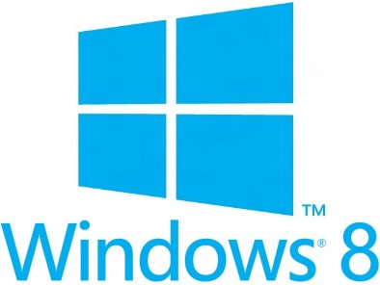


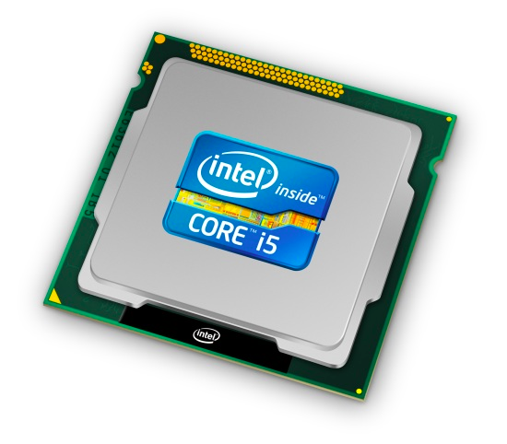
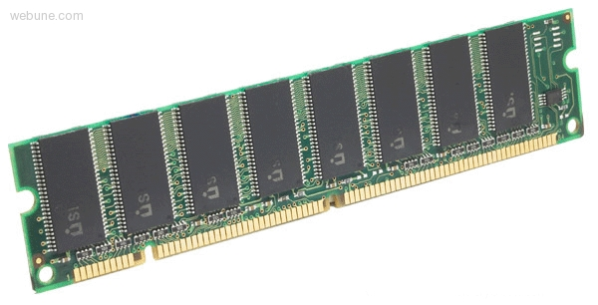
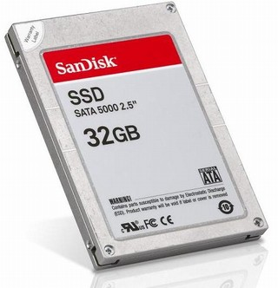
Roadmap
Memory & data
Integers & floats
Machine code & C
x86 assembly
Procedures & stacks
Arrays & structs
Memory & caches
Processes
Virtual memory
Memory allocation
Java vs. C
C:
Java:
car *c = malloc(sizeof(car));
c->miles = 100;
c->gals = 17;
float mpg = get_mpg(c);
free(c);
Car c = new Car();
c.setMiles(100);
c.setGals(17);
float mpg =
c.getMPG();
Assembly language:
get_mpg:
pushq %rbp
movq %rsp, %rbp
...
popq %rbp
ret
OS:
Machine code:
0111010000011000
100011010000010000000010
1000100111000010
110000011111101000011111
Computer system:

Slide 2
Section 2: Integer & Floating Point Numbers
Representation of integers: unsigned and signed
Unsigned and signed integers in C
Arithmetic and shifting
Sign extension
Background: fractional binary numbers
IEEE floating-point standard
Floating-point operations and rounding
Floating-point in C
Notes:
2

Slide 3
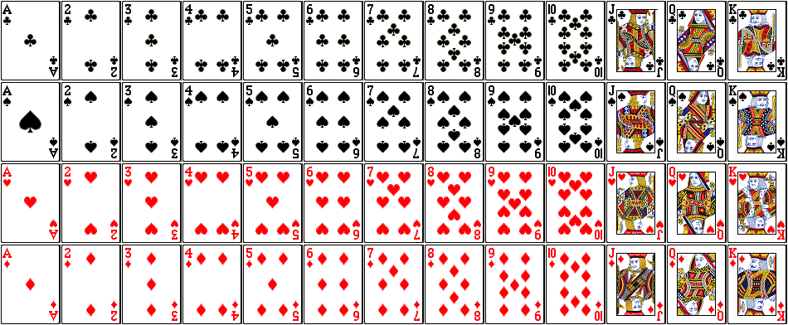
But before we get to integers….
How about encoding a standard deck of playing cards?
52 cards in 4 suits
  How do we encode suits, face cards?
What operations do we want to make easy to implement?
  Which is the higher value card?
  Are they the same suit?

Slide 4
Two possible representations
52 cards – 52 bits with bit corresponding to card set to 1
  “One-hot” encoding
  Drawbacks:
    Hard to compare values and suits
    Large number of bits required
4 bits for suit, 13 bits for card value – 17 bits with two set to 1
  “Two-hot” encoding
  Easier to compare suits and values
    Still an excessive number of bits
low-order 52 bits of 64-bit word

Slide 5
Two better representations
Binary encoding of all 52 cards – only 6 bits needed
  Fits in one byte
  Smaller than one-hot or two-hot encoding, but how can we make value and suit comparisons easier?
Binary encoding of suit (2 bits) and value (4 bits) separately
  Also fits in one byte, and easy to do comparisons
low-order 6 bits of a byte
suit
value

Slide 6
Some basic operations
Checking if two cards have the same suit:
  #define SUIT_MASK 0x30
  char array[5]; // represents a 5 card hand
  char card1, card2; // two cards to compare
  card1 = array[0];
  card2 = array[1];
  ...
  if sameSuitP(card1, card2) {
  ...
  bool sameSuitP(char card1, char card2) {
  return (! (card1 & SUIT_MASK) ^ (card2 & SUIT_MASK));
  //return (card1 & SUIT_MASK) == (card2 & SUIT_MASK);
  }
SUIT_MASK = 0x30;
0
0
1
1
0
0
0
0
suit
value

Slide 7
Some basic operations
Comparing the values of two cards:
  #define SUIT_MASK 0x30
  #define VALUE_MASK 0x0F
  char array[5]; // represents a 5 card hand
  char card1, card2; // two cards to compare
  card1 = array[0];
  card2 = array[1];
  ...
  if greaterValue(card1, card2) {
  ...
  bool greaterValue(char card1, char card2) {
  return ((unsigned int)(card1 & VALUE_MASK) >
  (unsigned int)(card2 & VALUE_MASK));
  }
VALUE_MASK = 0x0F;
0
0
0
0
1
1
1
1
suit
value

