Slide 1



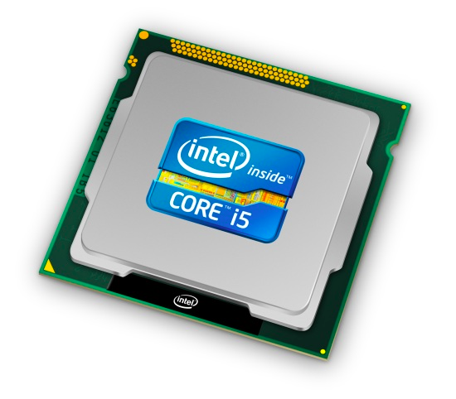
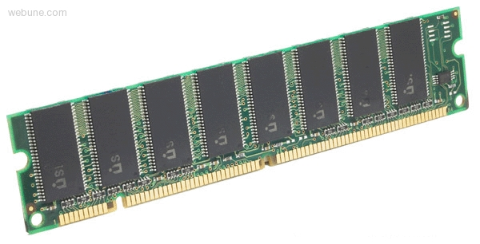
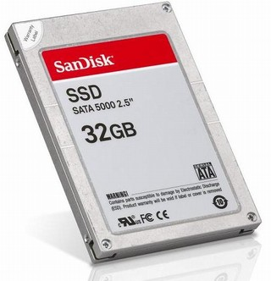
Roadmap
Memory & data
Integers & floats
Machine code & C
x86 assembly
Procedures & stacks
Arrays & structs
Memory & caches
Processes
Virtual memory
Memory allocation
Java vs. C
C:
Java:
car *c = malloc(sizeof(car));
c->miles = 100;
c->gals = 17;
float mpg = get_mpg(c);
free(c);
Car c = new Car();
c.setMiles(100);
c.setGals(17);
float mpg =
c.getMPG();
Assembly language:
get_mpg:
pushq %rbp
movq %rsp, %rbp
...
popq %rbp
ret
OS:
Machine code:
0111010000011000
100011010000010000000010
1000100111000010
110000011111101000011111
Computer system:

Slide 2
Section 1: Memory, Data, and Addressing
Preliminaries
Representing information as bits and bytes
Organizing and addressing data in memory
Manipulating data in memory using C
Boolean algebra and bit-level manipulations

Slide 3
Hardware: Logical View
Memory
CPU
Bus
Disks
Net
USB
Etc.

Slide 4
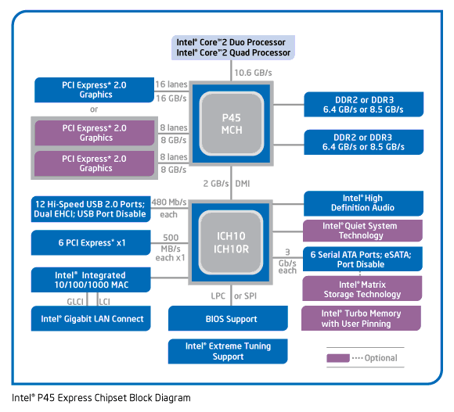
Hardware: Semi-Logical View

Slide 5
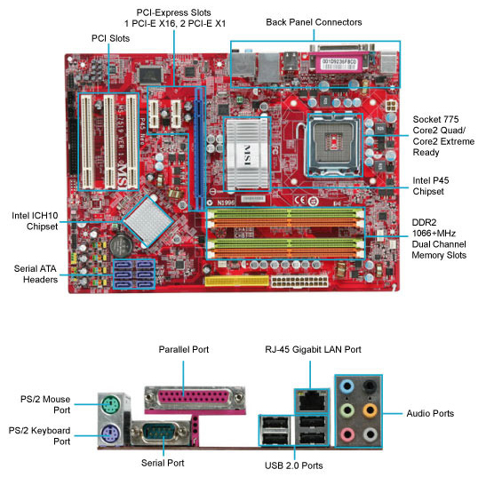
Hardware: Physical View

Slide 6
CPU “Memory”: Registers and Instruction Cache
Transparent
(hardware-controlled)
instruction caching
Memory
Registers
Instruction
Cache
Program-controlled
data movement
CPU
There are a fixed number of registers in the CPU
  Registers hold data
There is an I-cache in the CPU that holds recently fetched instructions
  If you execute a loop that fits in the cache, the CPU goes to memory for
  those instructions only once, then executes them out of its cache
This slide is just an introduction.
We'll see a fuller explanation later in the course.

Slide 7
Performance: It's Not Just CPU Speed
Data and instructions reside in memory
  To execute an instruction, it must be fetched into the CPU
  Next, the data on the which the instruction operates must be fetched from memory and brought to the CPU
CPU ←→ Memory bandwidth can limit performance
  Improving performance 1: hardware improvements to increase memory bandwidth (e.g., DDR → DDR2 → DDR3)
  Improving performance 2: move less data into/out of the CPU
    Put some “memory” in the CPU chip itself (this is “cache” memory)

Slide 8
Binary Representations
Base 2 number representation
  Represent 351₁₀ as 0000000101011111₂ or 101011111₂
Electronic implementation
  Easy to store with bi-stable elements
  Reliably transmitted on noisy and inaccurate wires
0
1
0
3.3V
2.8V
0.5V
0.0V

