Slide 1
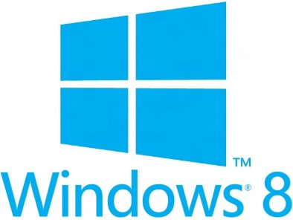


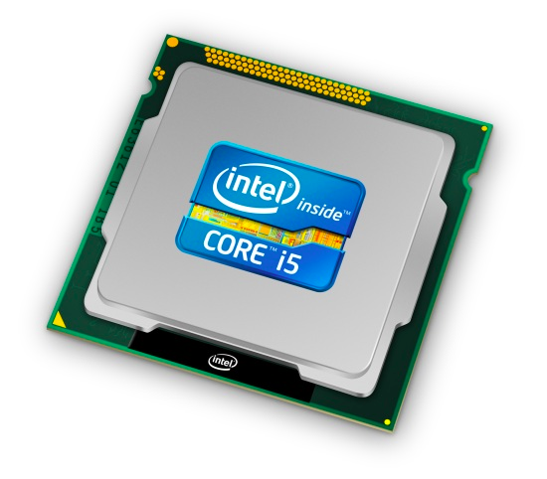
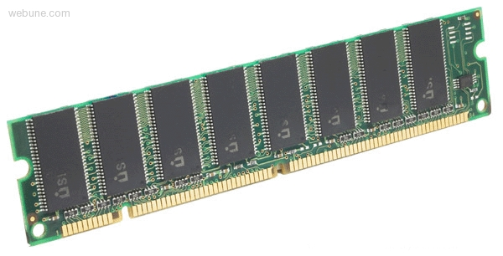
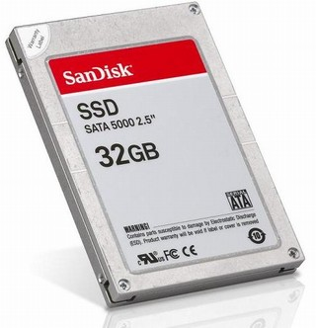
Roadmap
Memory & data
Integers & floats
Machine code & C
x86 assembly
Procedures & stacks
Arrays & structs
Memory & caches
Processes
Virtual memory
Memory allocation
Java vs. C
C:
Java:
car *c = malloc(sizeof(car));
c->miles = 100;
c->gals = 17;
float mpg = get_mpg(c);
free(c);
Car c = new Car();
c.setMiles(100);
c.setGals(17);
float mpg =
c.getMPG();
Assembly language:
get_mpg:
pushq %rbp
movq %rsp, %rbp
...
popq %rbp
ret
OS:
Machine code:
0111010000011000
100011010000010000000010
1000100111000010
110000011111101000011111
Computer system:
Notes:
Memory & data
Integers & floats
Machine code & C
x86 assembly programming
Procedures & stacks
Arrays & structs
Memory & caches
Processes
Virtual memory
Memory allocation
Java vs. C
get_mpg:
.LFB0:
.cfi_startproc
pushq %rbp
.cfi_def_cfa_offset 16
.cfi_offset 6, -16
movq %rsp, %rbp
.cfi_def_cfa_register 6
movq %rdi, -24(%rbp)
movq -24(%rbp), %rax
movl (%rax), %eax
cvtsi2ss %eax, %xmm0
movq -24(%rbp), %rax
movl 4(%rax), %eax
cvtsi2ss %eax, %xmm1
divss %xmm1, %xmm0
movss %xmm0, -4(%rbp)
movl -4(%rbp), %eax
movl %eax, -28(%rbp)
movss -28(%rbp), %xmm0
popq %rbp
.cfi_def_cfa 7, 8
ret

Slide 2
Little Theme 1: Representation
All digital systems represent everything as 0s and 1s
  The 0 and 1 are really two different voltage ranges in the electronics
Everything includes:
  Numbers – integers and floating point
  Characters – the building blocks of strings
  Instructions – the directives to the CPU that make up a program
  Pointers – addresses of data objects stored away in memory
These encodings are stored throughout a computer system
  In registers, caches, memories, disks, etc.
They all need addresses
  A way to find them
  Find a new place to put a new item
  Reclaim the place in memory when data no longer needed

Slide 3
Little Theme 2: Translation
There is a big gap between how we think about programs and data and the 0s and 1s of computers
Need languages to describe what we mean
Languages need to be translated one step at a time
  Word-by-word
  Phrase structures
  Grammar
We know Java as a programming language
  Have to work our way down to the 0s and 1s of computers
  Try not to lose anything in translation!
  We’ll encounter Java byte-codes, C language, assembly language, and machine code (for the X86 family of CPU architectures)

Slide 4
Little Theme 3: Control Flow
How do computers orchestrate the many things they are doing – seemingly in parallel
What do we have to keep track of when we call a method, and then another, and then another, and so on
How do we know what to do upon “return”
How do we run multiple user programs and let them share a single computer and memory

