Slide 1
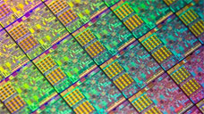
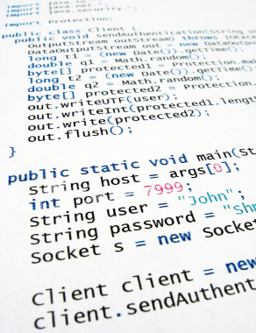
What is this class about?
What is hardware? software?
What is a hardware/software interface?
Why do we need to understand this interface?
HW/SW Interface

Slide 2
C/Java, assembly, and machine code
if (x != 0) y = (y+z)/x;
cmpl $0, -4(%ebp)
je .L2
movl -12(%ebp), %eax
movl -8(%ebp), %edx
leal (%edx, %eax), %eax
movl %eax, %edx
sarl $31, %edx
idivl -4(%ebp)
movl %eax, -8(%ebp)
1000001101111100001001000001110000000000
0111010000011000
10001011010001000010010000010100
10001011010001100010010100010100
100011010000010000000010
1000100111000010
110000011111101000011111
11110111011111000010010000011100
10001001010001000010010000011000

Slide 3
C/Java, assembly, and machine code
if (x != 0) y = (y+z)/x;
⬇
cmpl $0, -4(%ebp)
je .L2
movl -12(%ebp), %eax
movl -8(%ebp), %edx
leal (%edx, %eax), %eax
movl %eax, %edx
sarl $31, %edx
idivl -4(%ebp)
movl %eax, -8(%ebp)
1000001101111100001001000001110000000000
0111010000011000
10001011010001000010010000010100
10001011010001100010010100010100
100011010000010000000010
1000100111000010
110000011111101000011111
11110111011111000010010000011100
10001001010001000010010000011000
➔
⬅
The three program fragments are equivalent
You'd would rather write C! – a more human-friendly language
The hardware likes bit strings! – 0 and 1 as low or high voltages
  The machine instructions are actually much shorter than the number of bits we would need to represent the characters in the assembly language

Slide 4
HW/SW Interface: The Historical Perspective
Hardware started out quite primitive
  Hardware designs were expensive  instructions had to be very simple – e.g., a single instruction for adding two integers
Software was also very primitive
  Software primitives reflected the hardware pretty closely
Architecture Specification (Interface)
Hardware

Slide 5
HW/SW Interface: Assemblers
Life was made a lot better by assemblers
  1 assembly instruction = 1 machine instruction, but...
  different syntax: assembly instructions are character strings, not bit strings, a lot easier to read/write by humans
  can use symbolic names
Assembler specification
User
program
in
asm
Hardware
Assembler

Slide 6
HW/SW Interface: Higher-Level Languages
Higher level of abstraction:
  1 line of a high-level language is compiled into many (sometimes very many) lines of assembly language
C language specification
User
program
in C
Hardware
C
compiler
Assembler

Slide 7
HW/SW Interface: Code / Compile / Run Times
Code Time
Compile Time
Run Time
User
program
in C
Hardware
C
compiler
Assembler
.c file
.exe file
Note: The compiler and assembler are just programs, developed using
this same process.

Slide 8
The Big Theme
THE HARDWARE/SOFTWARE INTERFACE
How does the hardware (0s and 1s, processor executing instructions) relate to the software (Java programs)?
Computing is about abstractions (but we can’t forget reality)
What are the abstractions that we use?
What do YOU need to know about them?
  When do they break down and you have to peek under the hood?
  What bugs can they cause and how do you find them?
Become a better programmer and begin to understand the important concepts that have evolved in building ever more complex computer systems

