Slide 1


Welcome to
The Hardware/Software Interface
Instructors:
Gaetano Borriello and Luis Ceze

Slide 2

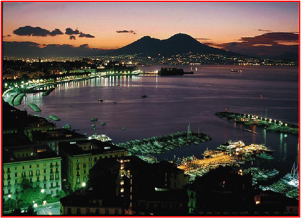
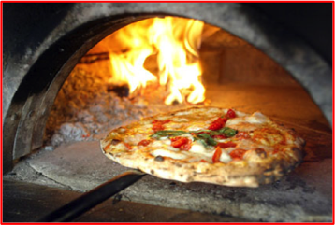
Gaetano Borriello
At UW since 1988
  PhD at UC Berkeley
  MS at Stanford
  BS at NYU Poly
Research trajectory:
  Integrated circuits
  Computer-aided design
  Reconfigurable hardware
  Embedded systems
  Networked sensors
  Ubiquitous computing
  Mobile systems
  Applications in developing world
costruzioni.net
espresso.repubblica.it

Slide 3


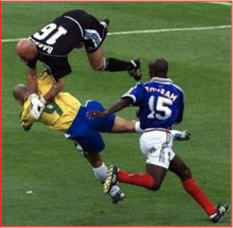
Luis Ceze
At UW since 2007
  PhD at U Illinois
  MEng at U São Paulo
  BEng at U São Paulo
Research areas:
  Architecture
  Multiprocessors
  Parallelism
  Compilers

Slide 4
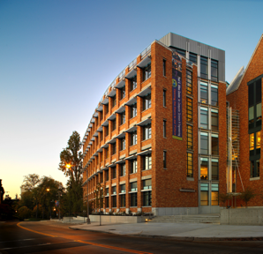
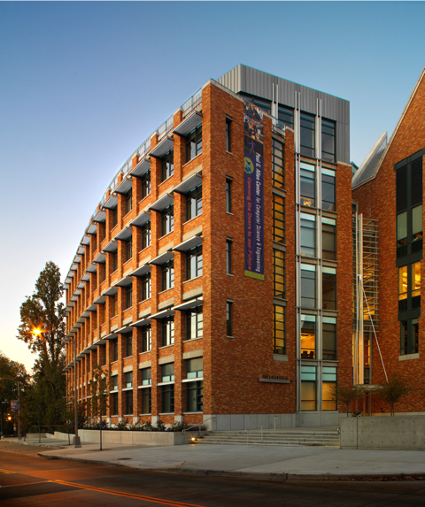
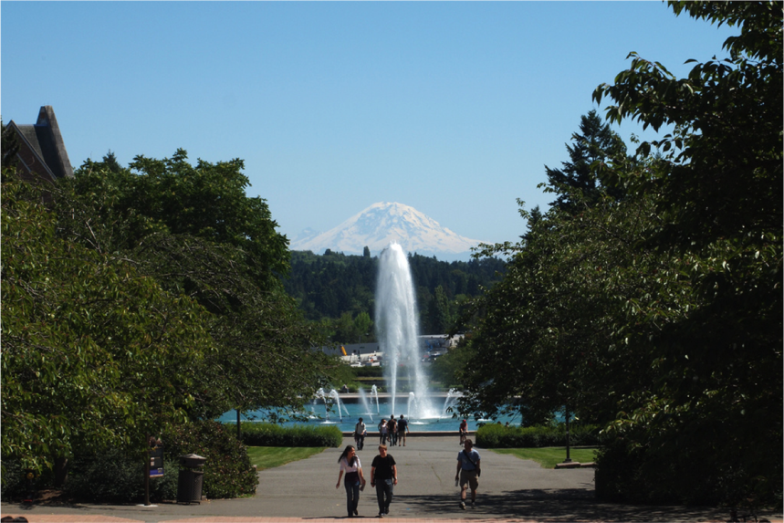

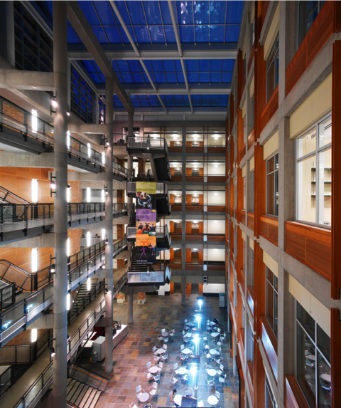
UW Computer Science & Engineering

Slide 5
Who are you?
There are literally thousands of you
We do not get to meet you face to face ☹
But please fill our the course on-line survey so that we get to know a few things about you
We’ll report aggregate statistics at the end of the course

Slide 6
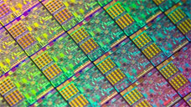
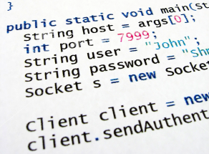
What is this class about?
What is hardware? software?
What is a hardware/software interface?
Why do we need to understand this interface?
HW/SW Interface

Slide 7
Recommended prerequisites
What we expect you to know
  Basics of binary numbers
    1001₂ + 0001₂ = 1010₂
  Binary logic operators: AND, OR, and NOT
    A AND B is true if and only if A is true and B is true and false otherwise
  Introductory programming in Java (or C)
    if statements, loops, procedures/methods
What we expect you to have
  Access to a modern personal computer (Windows, MacOS, or Linux)
  on which you can install some software

Slide 8
Course outcomes
Foundation: basics of computer programming (Java)
Understanding of some of the abstractions that exist between programs and the hardware they run on, why they exist, and how they build upon each other
Knowledge of some of the implementation details of these underlying abstractions
Become more effective programmers
  More efficient at finding and eliminating bugs
  Understand some of the many factors that influence program performance
  Facility with a couple more of the many languages that we use to describe programs and data
Prepare for later classes in computing

Slide 9
What we will have you do
Five programming assignments
  1 to 2 weeks each
Some recommended pencil/paper problems
We’ll also point you to relevant sections of a textbook
  We are hoping to make the lectures self-contained
  View the textbook as supplementary material for a second point-of-view

Slide 10
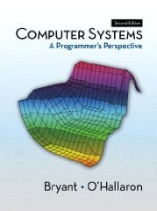
Reference texts
Computer Systems:
A Programmer’s Perspective, 2nd Edition
  Randal E. Bryant and David R. O’Hallaron
  Prentice-Hall, 2010
  http://csapp.cs.cmu.edu
  Purchase direct from Pearson:
  http://www.mypearsonstore.com/bookstore/computer-systems-a-programmers-perspective-9780136108047
  Purchase eBook from CourseSmart:
  http://www.coursesmart.com/0132130661/?a=1773944
  Purchase print or Kindle edition from Amazon.com:
  http://www.amazon.com/Computer-Systems-Programmers-Perspective-2nd/dp/0136108040
A good C reference – any will do – lots of info on the web
  The C Programming Language (Kernighan and Ritchie)
  C: A Reference Manual (Harbison and Steele)

Slide 11
Acknowledgments
The many TAs behind the scenes
The previous Coursera instructors at UW for sharing their experiences with us
The many instructors for the subject of this course who have shared their lecture notes – they deserve a lot of the credit, the errors are all ours
  CMU: Randy Bryant, David O’Hallaron, Gregory Kesden, Markus Püschel
  Harvard: Matt Welsh (now at Google-Seattle)
  UW: Peter Hornyack, Hal Perkins, John Zahorjan

