Slide 1
Community finding vs. other approaches
Social and other networks have a natural community structure
We want to discover this structure rather than impose a certain size of community or fix the number of communities
Without “looking”, can we discover community structure in an automated way?

Slide 2
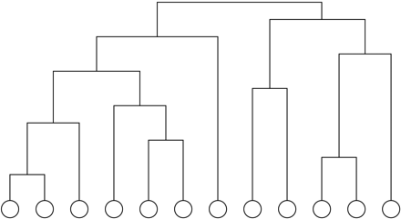
Hierarchical clustering
Process:
  after calculating the “distances” for all pairs of vertices
  start with all n vertices disconnected
  add edges between pairs one by one in order of decreasing weight
  result: nested components, where one can take a ‘slice’ at any level of the tree

Slide 3
Hierarchical clustering
Process:
  after calculating the weights W for all pairs of vertices
  start with all n vertices disconnected
  add edges between pairs one by one in order of decreasing weight
  Efficient and successful implementation in Pajek…

Slide 4
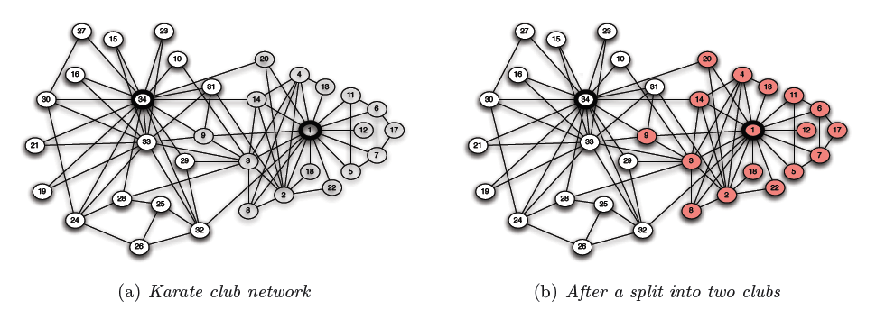
Zachary Karate Club
source:Easley/Kleinberg

Slide 5
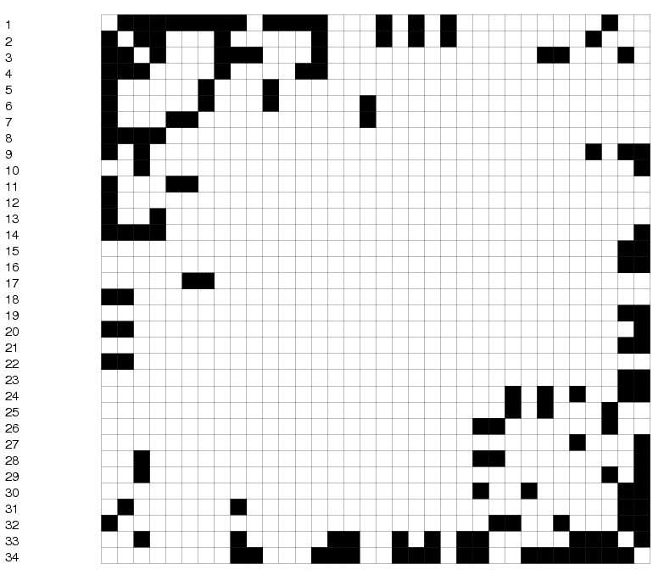
original matrix

Slide 6
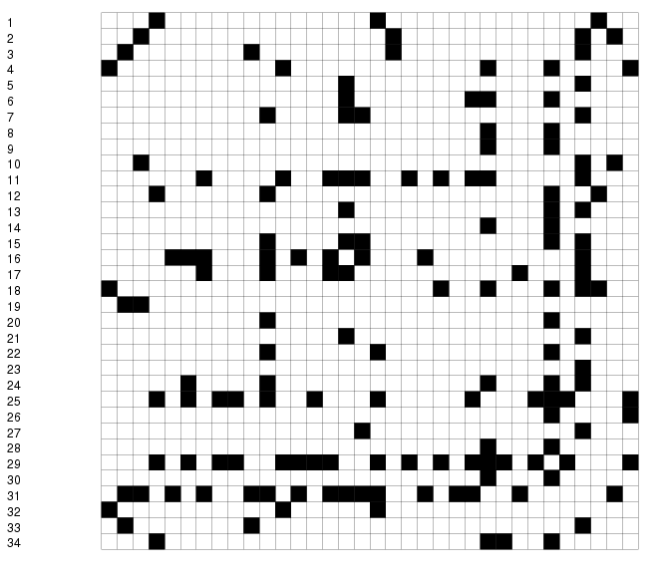
randomized karate club matrix

Slide 7
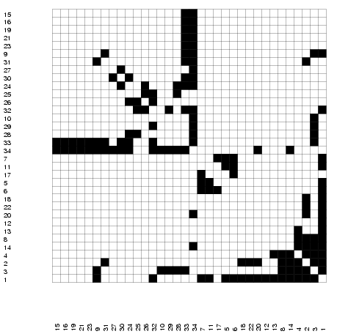
permuted matrix

Slide 8
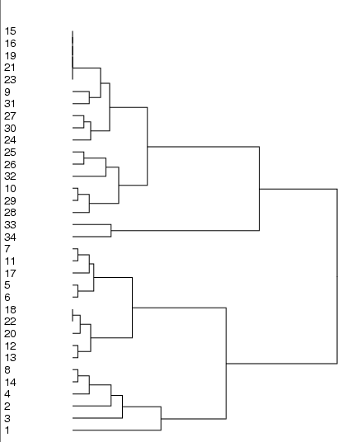
dendrogram

Slide 9
betweenness clustering
Algorithm
  compute the betweenness of all edges
  while (betweenness of any edge > threshold):
    remove edge with highest betweenness
    recalculate betweenness
Betweenness needs to be recalculated at each step
  removal of an edge can impact the betweenness of another edge
  very expensive: all pairs shortest path – O(N³)
  may need to repeat up to N times
  does not scale to more than a few hundred nodes, even with the fastest algorithms

Slide 10
betweenness clustering algorithm

Slide 11
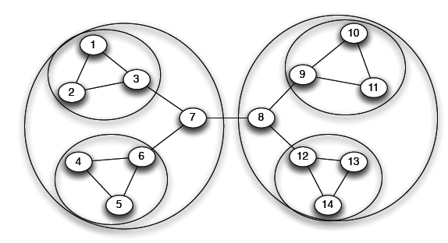
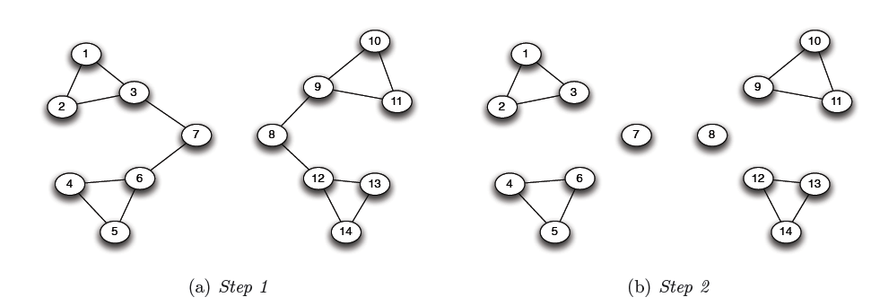
betweenness clustering:
successively remove edges of highest betweenness (the bridges, or local bridges), breaking up the network into separate components

Slide 12
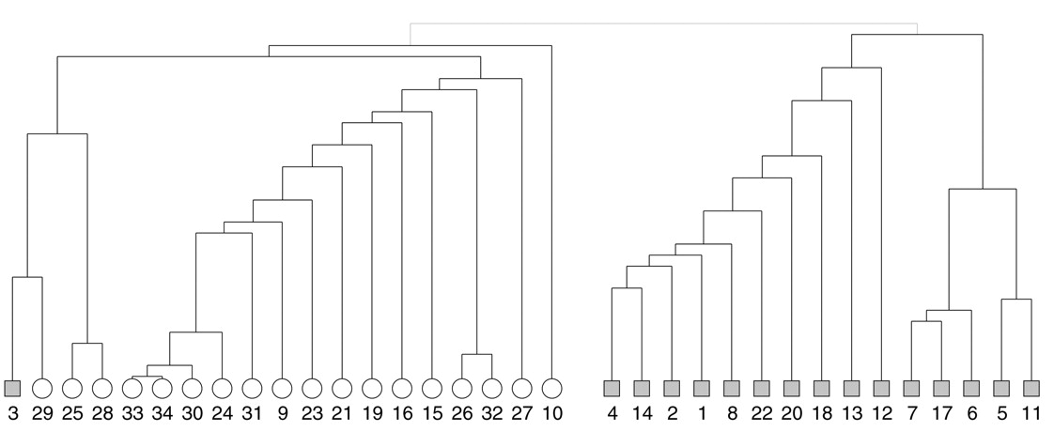
betweenness clustering algorithm & the karate club data set
source: Girvan and Newman, PNAS June 11, 2002 99(12):7821-7826

Slide 13
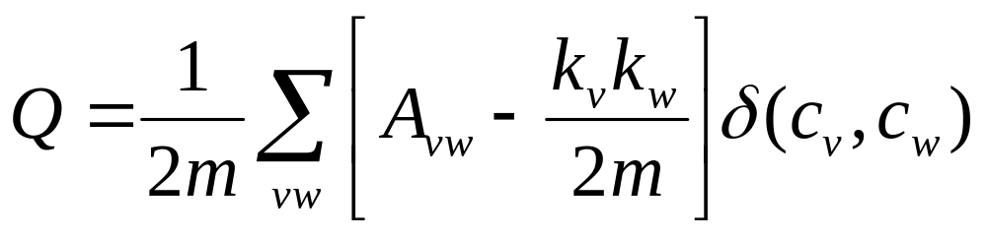
Modularity
Consider edges that fall within a community or between a community and the rest of the network
Define modularity:
if vertices are in the same community
probability of an edge between
two vertices is proportional to their degrees
adjacency matrix
For a random network, Q = 0
  the number of edges within a community is no different from what you would expect
Finding community structure in very large networks
Authors: Aaron Clauset, M. E. J. Newman, Cristopher Moore 2004

Slide 14
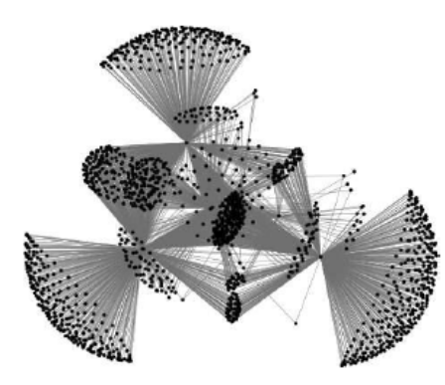
Modularity
Algorithm
  start with all vertices as isolates
  follow a greedy strategy:
    successively join clusters with the greatest increase ΔQ in modularity
    stop when the maximum possible ΔQ <= 0 from joining any two
  successfully used to find community structure in a graph with > 400,000 nodes with > 2 million edges
    Amazon’s people who bought this also bought that…
  alternatives to achieving optimum ΔQ:
    simulated annealing rather than greedy search

Slide 15
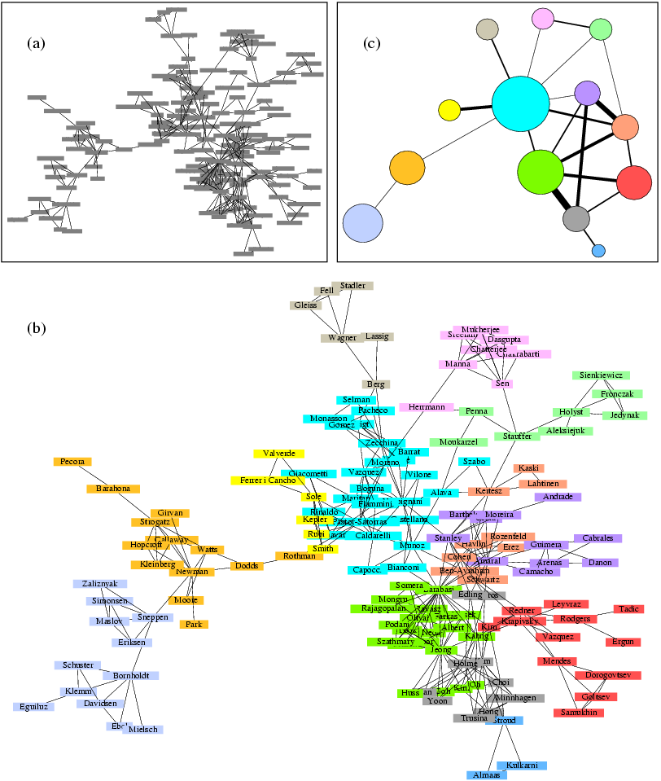
Reminder of how modularity can help us visualize large networks

Slide 16
What if communities overlap?
Recent research has found that for communities such as Orkut and FlickR, community finding algorithms cannot identify communities of more than ~100 nodes
Statistical Properties of Community Structure in Large Social and Information Networks by J. Leskovec, K. Lang, A. Dasgupta, M. Mahoney. International World Wide Web Conference (WWW), 2008. [Video]

Slide 17
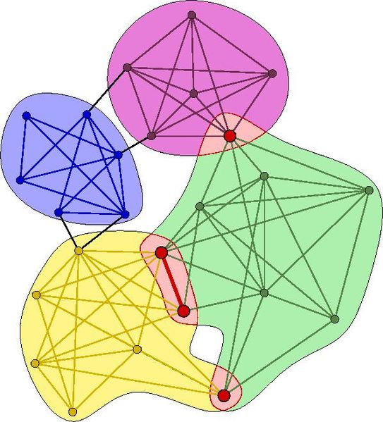
Clique finder
http://cfinder.org
Uncovering the overlapping community structure of complex networks in nature and society G. Palla, I. Derényi, I. Farkas, and T. Vicsek: Nature 435, 814–818 (2005)

Slide 18
wrap up
  community structure is a way of ‘x-raying’ the network, finding out what it’s made of
  you can look for specific structures
    k-cliques, k-cores, etc.
  but most popular is to discover the “natural” community boundaries

Slide 19
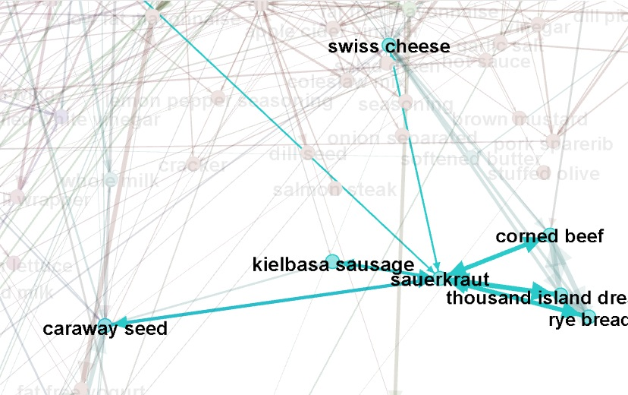
For your assignment: community finding & ingredients ☺

Slide 20
An information theoretic approach
How to most concisely describe a random walk on the network using huffman codes? Prefixes become communities…
http://www.pnas.org/content/105/4/1118 http://www.mapequation.org/mapgenerator/index.html

