Slide 1
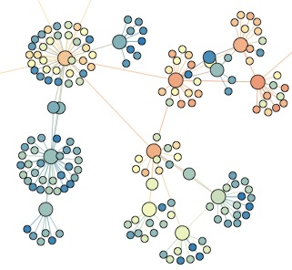

SNA 3D: Power laws
Lada Adamic

Slide 2
Heavy tails: right skew
Right skew
  normal distribution (not heavy tailed)
    e.g. heights of human males: centered around 180cm (5’11’’)
  Zipf’s or power-law distribution (heavy tailed)
    e.g. city population sizes: NYC 8 million, but many, many small towns

Slide 3
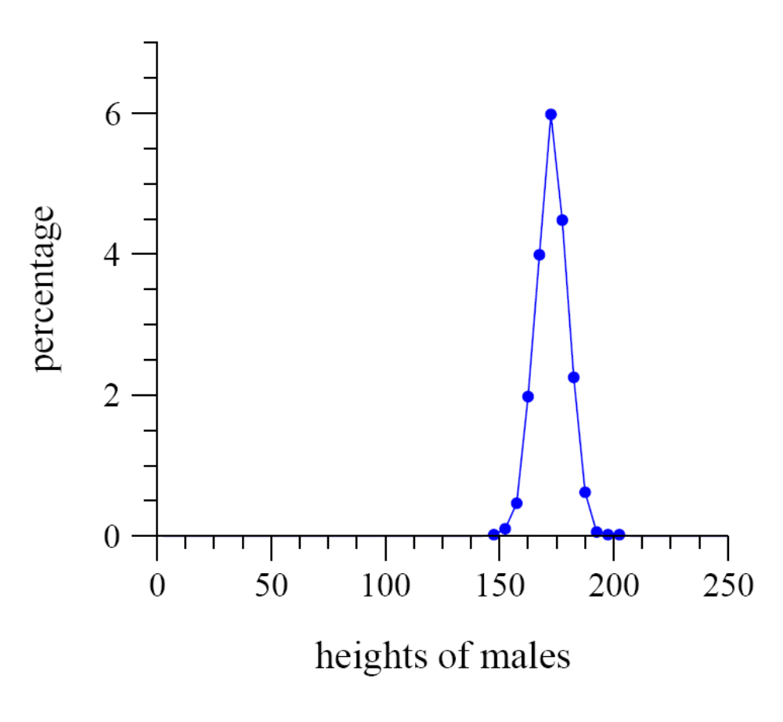
Normal distribution (human heights)
average value close to
most typical
distribution close to
symmetric around
average value

Slide 4
Heavy tails: max to min ratio
High ratio of max to min
  human heights
    tallest man: 272cm (8’11”), shortest man: (1’10”) ratio: 4.8
    from the Guinness Book of world records
  city sizes
    NYC: pop. 8 million, Duffield, Virginia pop. 52, ratio: 150,000

Slide 5
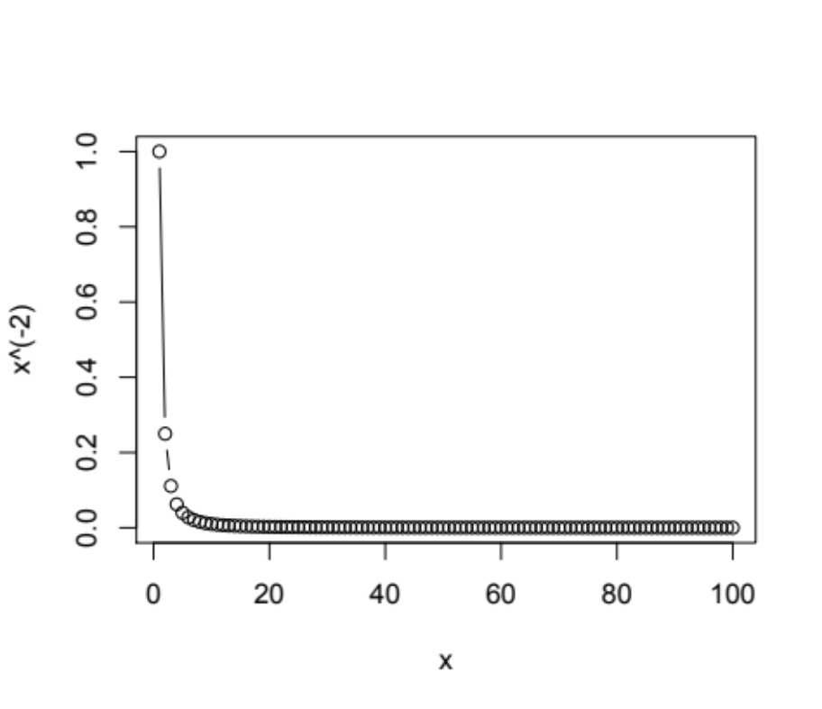
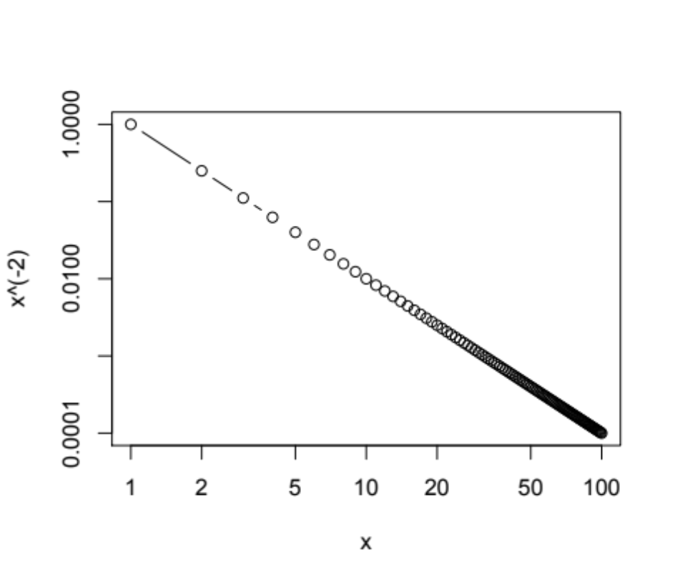
Power-law distribution
linear scale
log-log scale
high skew (asymmetry)
straight line on a log-log plot

Slide 6
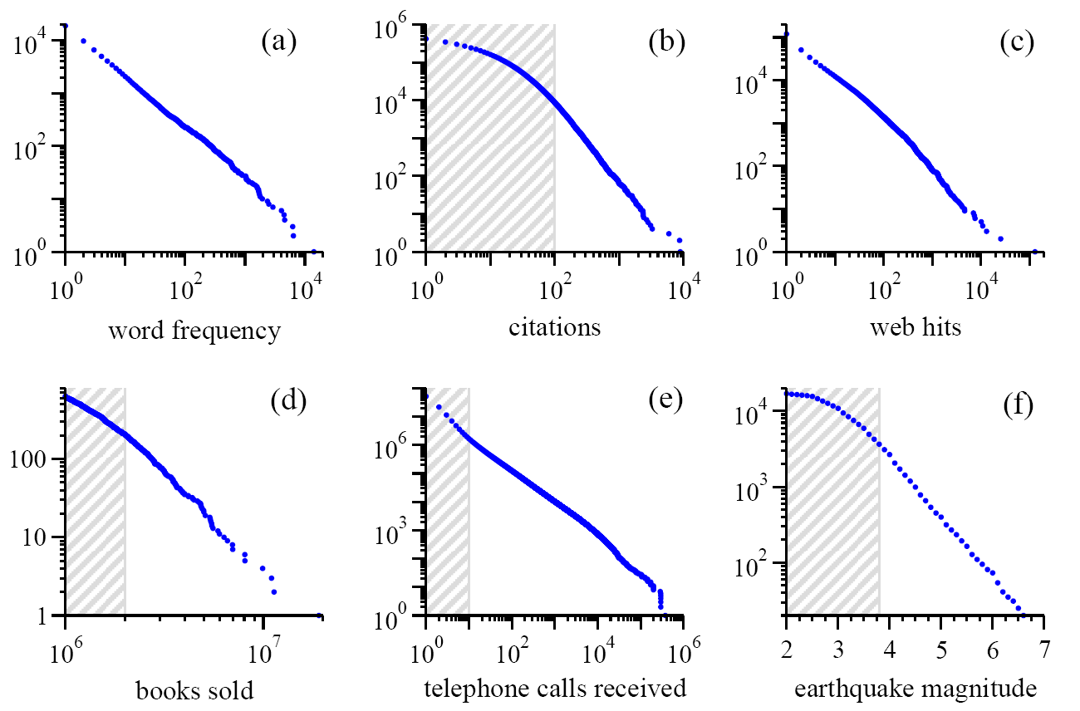
Power laws are seemingly everywhere note: these are cumulative distributions, more about this in a bit…
Moby Dick
scientific papers 1981-1997
AOL users visiting sites ‘97
bestsellers 1895-1965
AT&T customers on 1 day
California 1910-1992
Source:MEJ Newman, ’Power laws, Pareto distributions and Zipf’s law’, Contemporary Physics 46, 323–351 (2005)

Slide 7
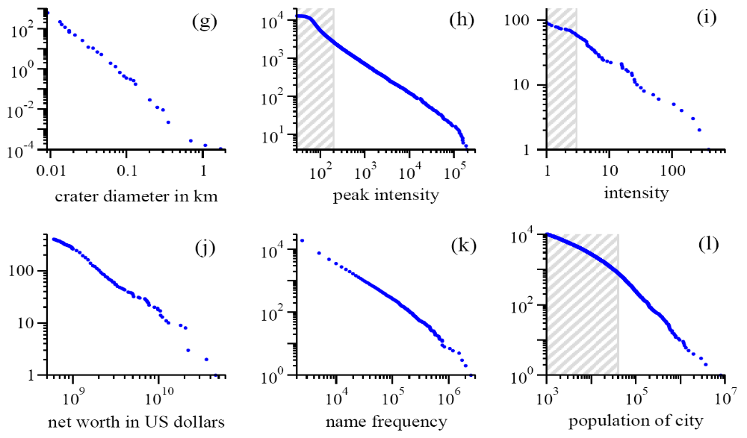
Yet more power laws
Moon
Solar flares
wars (1816-1980)
richest individuals 2003
US family names 1990
US cities 2003
Source:MEJ Newman, ’Power laws, Pareto distributions and Zipf’s law’, Contemporary Physics 46, 323–351 (2005)

Slide 8
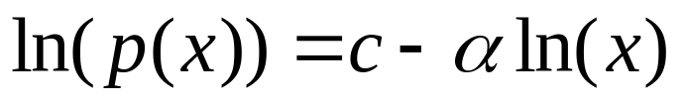
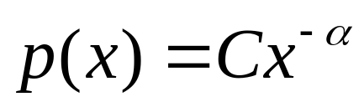
Power law distribution
Straight line on a log-log plot
Exponentiate both sides to get that p(x), the
probability of observing an item of size ‘x’ is given by
normalization
constant (probabilities over all x must sum to 1)
power law exponent α

Slide 9
What does it mean to be scale free?
A power law looks the same no mater what scale we look at it on (2 to 50 or 200 to 5000)
Only true of a power-law distribution!
p(bx) = g(b) p(x) – shape of the distribution is unchanged except for a multiplicative constant
p(bx) = (bx)^{−α} = b^{−α} x^{−α}
x →b*x
log(p(x))
log(x)

Slide 10
Fitting power-law distributions
Most common and not very accurate method:
  Bin the different values of x and create a frequency histogram
ln(x) is the natural
logarithm of x,
but any other base of the logarithm will give the same exponent of α because
log₁₀(x) = ln(x)/ln(10)
ln(# of times
x occurred)
ln(x)
x can represent various quantities, the indegree of a node, the magnitude of an earthquake, the frequency of a word in text

Slide 11
Example on an artificially generated data set
Take 1 million random numbers from a distribution with α = 2.5
Can be generated using the so-called
‘transformation method’
Generate random numbers r on the unit interval
0≤r<1
then x = (1-r)^{−1/(α−1)} is a random power law distributed real number in the range 1 ≤ x < ∞

Slide 12
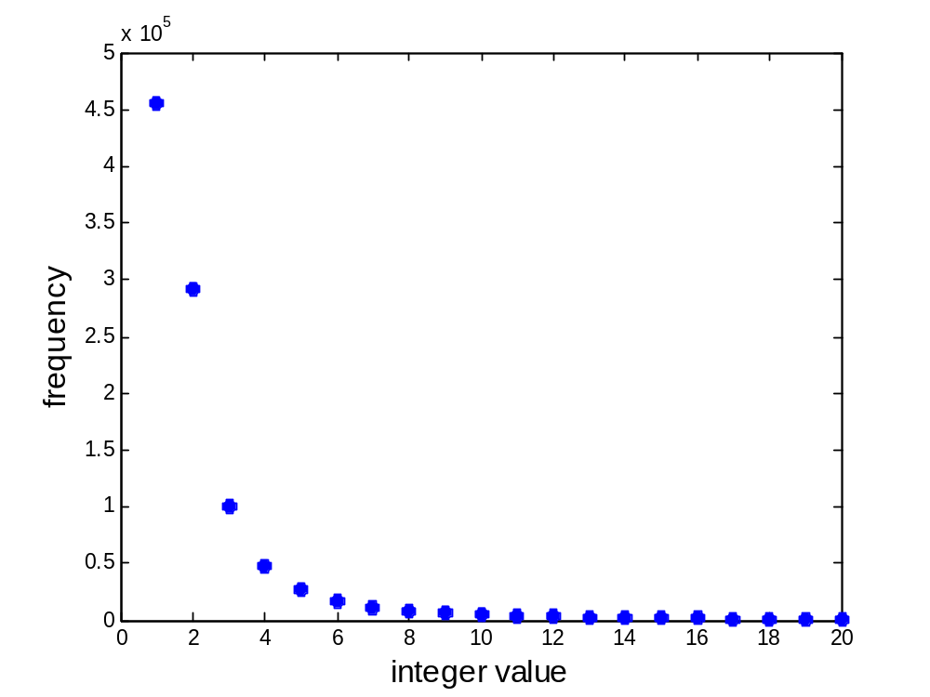
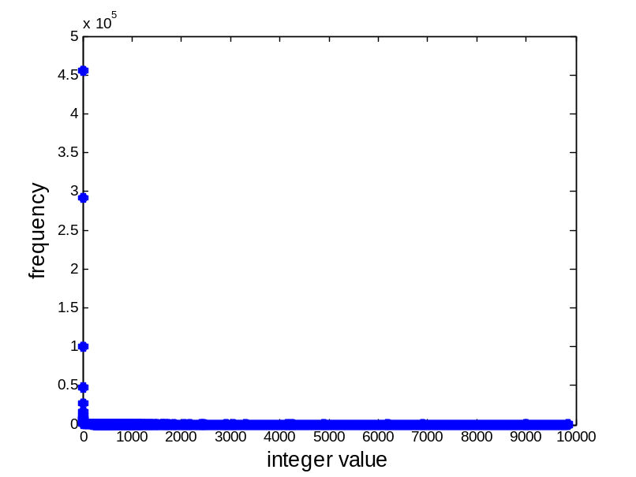
Linear scale plot of straight bin of the data
Number of times 1 or 3843 or 99723 occured
Power-law relationship not as apparent
Only makes sense to look at smallest bins
whole range
first few bins

Slide 13
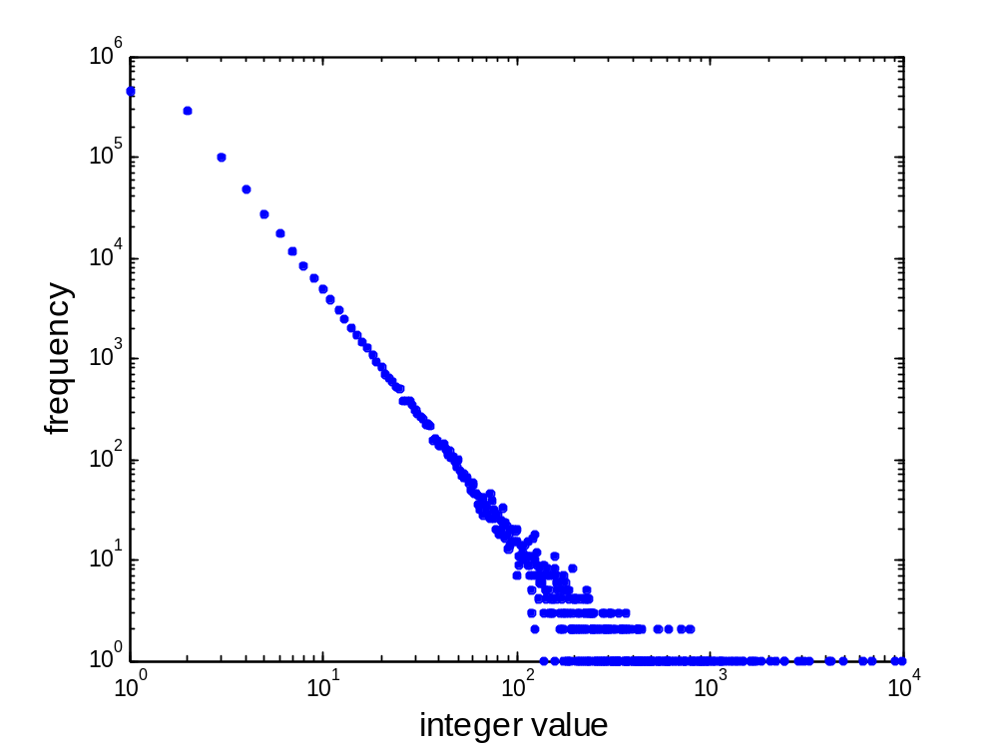
Log-log scale plot of simple binning of the data
Same bins, but plotted on a log-log scale
here we have tens of thousands of observations
when x < 10
Noise in the tail:
Here we have 0, 1 or 2 observations
of values of x when x > 500
Actually don’t see all the zero
values because log(0) = ∞

Slide 14
Log-log scale plot of straight binning of the data
Fitting a straight line to it via least squares regression will give values of the exponent α that are too low
fitted α
true α

Slide 15
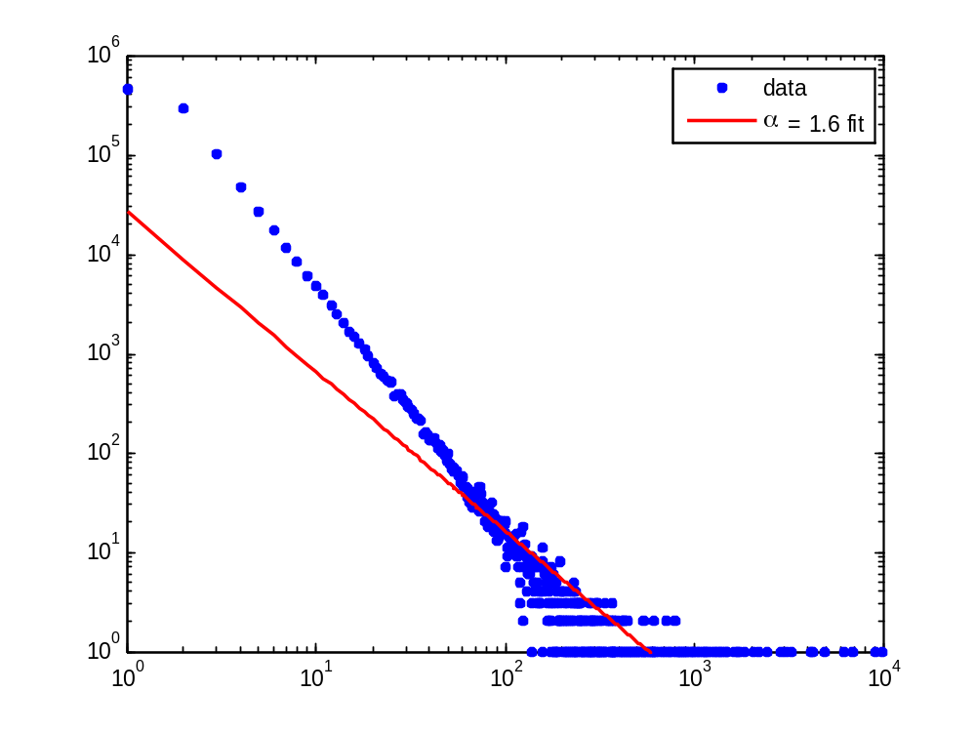
What goes wrong with straightforward binning
Noise in the tail skews the regression result
have few bins
here
have many more bins here

Slide 16
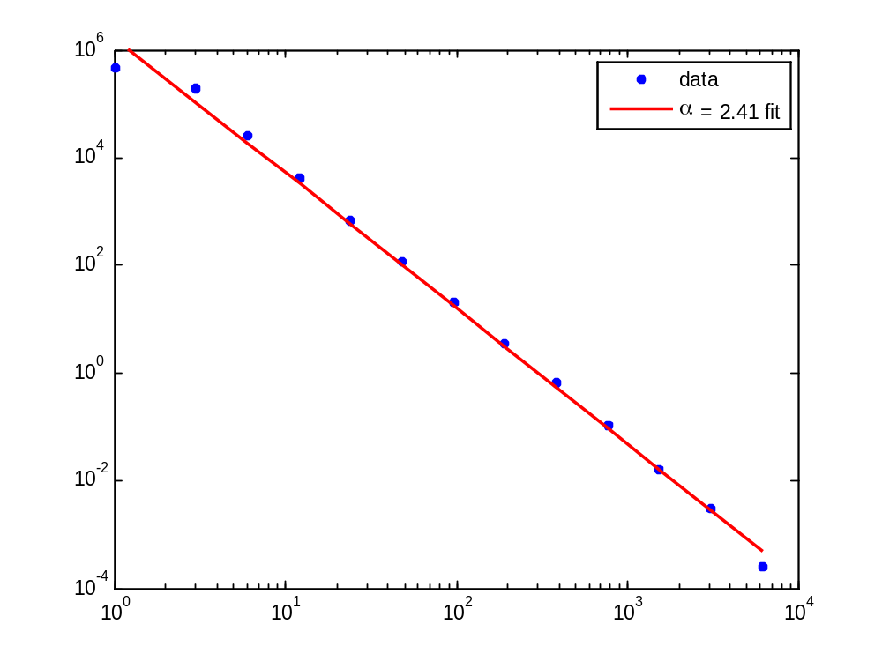
First solution: logarithmic binning
bin data into exponentially wider bins:
  1, 2, 4, 8, 16, 32, …
normalize by the width of the bin
evenly
spaced
datapoints
less noise
in the tail
of the
distribution
disadvantage: binning smoothes out data but also loses information

Slide 17
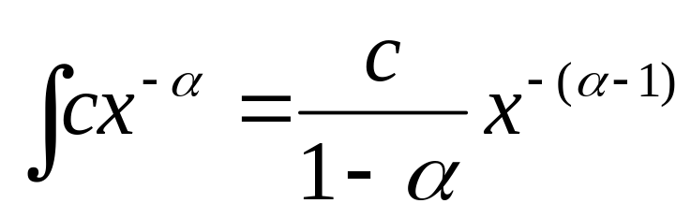
Second solution: cumulative binning
No loss of information
  No need to bin, has value at each observed value of x
But now have cumulative distribution
  i.e. how many of the values of x are at least X
  The cumulative probability of a power law probability distribution is also power law but with an exponent α - 1

Slide 18
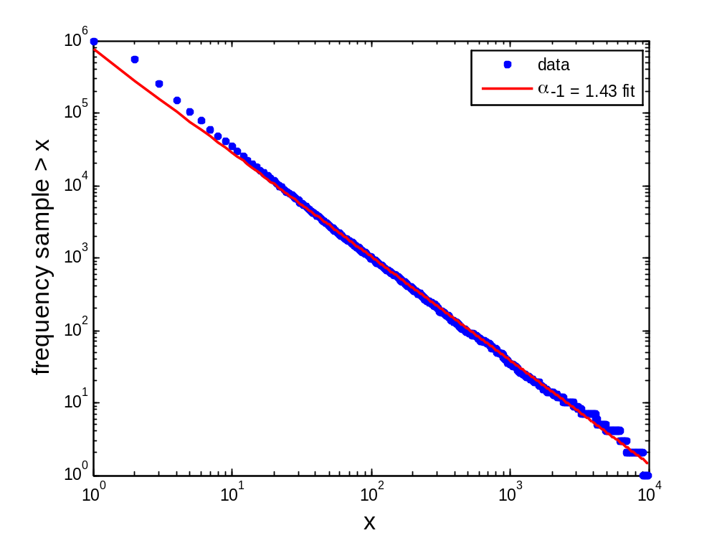
Fitting via regression to the cumulative distribution
fitted exponent (2.43) much closer to actual (2.5)

Slide 19
Where to start fitting?
some data exhibit a power law only in the tail
after binning or taking the cumulative distribution you can fit to the tail
so need to select an x_{min} the value of x where you think the power-law starts
certainly x_{min} needs to be greater than 0, because x^{−α} is infinite at x = 0

Slide 20
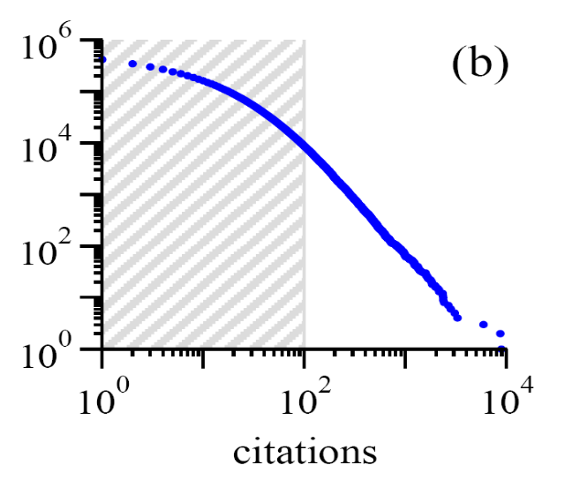
Example:
Distribution of citations to papers
power law is evident only in the tail (x_{min} > 100 citations)
x_{min}
Source:MEJ Newman, ’Power laws, Pareto distributions and Zipf’s law’, Contemporary Physics 46, 323–351 (2005)

Slide 21
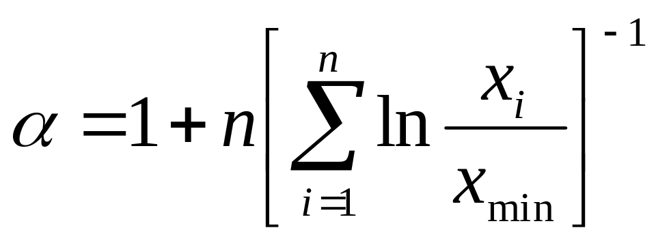
Maximum likelihood fitting – best
You have to be sure you have a power-law distribution (this will just give you an exponent but not a goodness of fit)
x_{i} are all your datapoints, and you have n of them
for our data set we get α = 2.503 – pretty close!

Slide 22
Some exponents for real world data
 | x_{min} | exponent α
frequency of use of words | 1 | 2.20
number of citations to papers | 100 | 3.04
number of hits on web sites | 1 | 2.40
copies of books sold in the US | 2 000 000 | 3.51
telephone calls received | 10 | 2.22
magnitude of earthquakes | 3.8 | 3.04
diameter of moon craters | 0.01 | 3.14
intensity of solar flares | 200 | 1.83
intensity of wars | 3 | 1.80
net worth of Americans | $600m | 2.09
frequency of family names | 10 000 | 1.94
population of US cities | 40 000 | 2.30

Slide 23
Many real world networks are power law
 | exponent α (in/out degree)
film actors | 2.3
telephone call graph | 2.1
email networks | 1.5/2.0
sexual contacts | 3.2
WWW | 2.3/2.7
internet | 2.5
peer-to-peer | 2.1
metabolic network | 2.2
protein interactions | 2.4

Slide 24
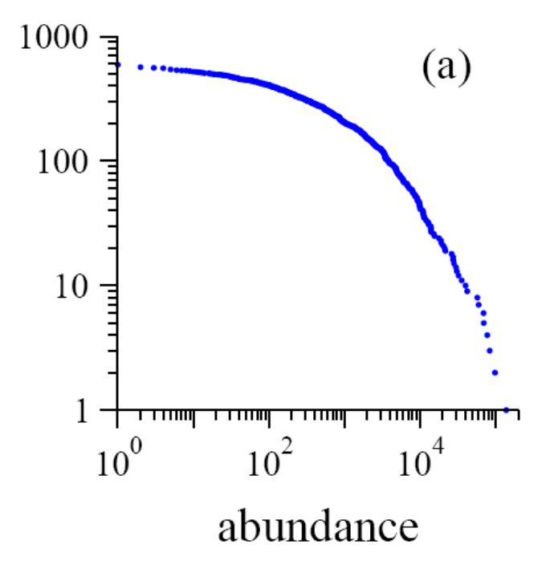
Hey, not everything is a power law
number of sightings of 591 bird species in the North American Bird survey in 2003.
cumulative
distribution
another example:
  size of wildfires (in acres)
Source:MEJ Newman, ’Power laws, Pareto distributions and Zipf’s law’, Contemporary Physics 46, 323–351 (2005)

Slide 25
Not every network is power law distributed
reciprocal, frequent email communication
power grid
Roget’s thesaurus
company directors…

Slide 26
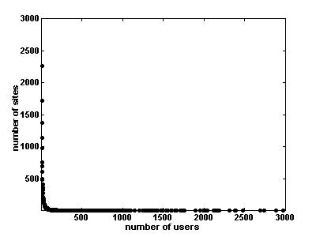
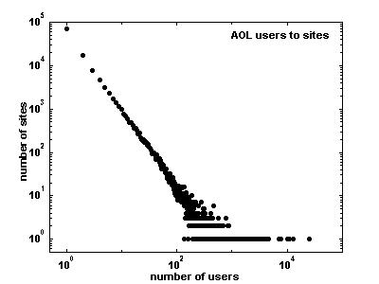
Example on a real data set: number of AOL visitors to different websites back in 1997
simple binning on a linear
scale
simple binning on a log-log scale

Slide 27
trying to fit directly…
direct fit is too shallow: α = 1.17…

Slide 28
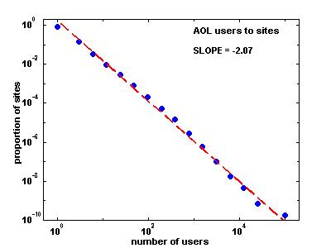
Binning the data logarithmically helps
select exponentially wider bins
  1, 2, 4, 8, 16, 32, ….

Slide 29
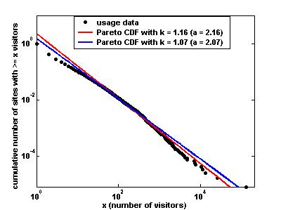
Or we can try fitting the cumulative distribution
Shows perhaps 2 separate power-law regimes that were obscured by the exponential binning
Power-law tail may be closer to 2.4

Slide 30
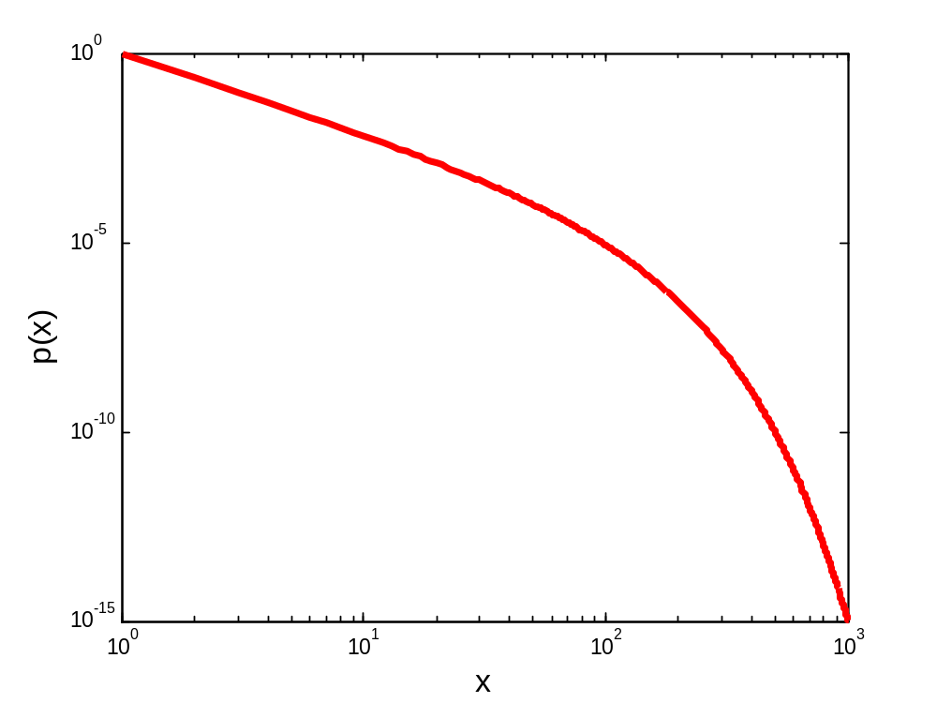
Another common distribution: power-law with an exponential cutoff
p(x) ~ x^{-a} e^{-x/κ}
starts out as a power law
ends up as an exponential
but could also be a lognormal or double exponential…

Slide 31
Zipf &Pareto: what they have to do with power-laws
Zipf
  George Kingsley Zipf, a Harvard linguistics professor, sought to determine the 'size' of the 3rd or 8th or 100th most common word.
  Size here denotes the frequency of use of the word in English text, and not the length of the word itself.
  Zipf's law states that the size of the r'th largest occurrence of the event is inversely proportional to its rank:
  y ~ r ^{-β} , with β close to unity.

Slide 32
So how do we go from Zipf to Pareto?
The phrase "The r th largest city has n inhabitants" is equivalent to saying "r cities have n or more inhabitants".
This is exactly the definition of the Pareto distribution, except the x and y axes are flipped. Whereas for Zipf, r is on the x-axis and n is on the y-axis, for Pareto, r is on the y-axis and n is on the x-axis.
Simply inverting the axes, we get that if the rank exponent is β, i.e.
n ~ r^{−β} for Zipf, (n = income, r = rank of person with income n)
then the Pareto exponent is 1/β so that
r ~ n^{-1/β} (n = income, r = number of people whose income is n or higher)

Slide 33
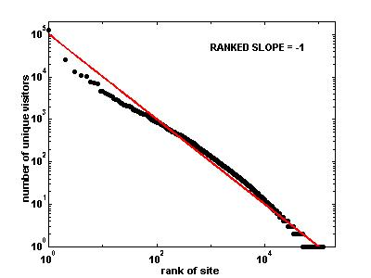
Zipf’s law & AOL site visits
Deviation from Zipf’s law
  slightly too few websites with large numbers of visitors:

Slide 34


Zipf’s Law and city sizes (~1930) [2]
Rank(k) | City | Population (1990) | Zips’s Law | Modified Zipf’s law: (Mandelbrot)
1 | Now York | 7,322,564 | 10,000,000 | 7,334,265
7 | Detroit | 1,027,974 | 1,428,571 | 1,214,261
13 | Baltimore | 736,014 | 769,231 | 747,693
19 | Washington DC | 606,900 | 526,316 | 558,258
25 | New Orleans | 496,938 | 400,000 | 452,656
31 | Kansas City | 434,829 | 322,581 | 384,308
37 | Virgina Beach | 393,089 | 270,270 | 336,015
49 | Toledo | 332,943 | 204,082 | 271,639
61 | Arlington | 261,721 | 163,932 | 230,205
73 | Baton Rouge | 219,531 | 136,986 | 201,033
85 | Hialeah | 188,008 | 117,647 | 179,243
97 | Bakersfield | 174,820 | 103,270 | 162,270
not any more
slide: Luciano Pietronero

Slide 35
80/20 rule
The fraction W of the wealth in the hands of the richest P of the the population is given by
W = P^{(α−2)/(α−1)}
Example: US wealth: α = 2.1
  richest 20% of the population holds 86% of the wealth

Slide 36
What does it mean to be scale free?
A power law looks the same no mater what scale we look at it on (2 to 50 or 200 to 5000)
Only true of a power-law distribution!
p(bx) = g(b) p(x) – shape of the distribution is unchanged except for a multiplicative constant
p(bx) = (bx)^{−α} = b^{−α} x^{−α}
log(p(x))
x →b*x
log(x)

Slide 37
Wrap up on power-laws
Power-laws are cool and intriguing
But make sure your data is actually power-law before boasting

