Slide 1
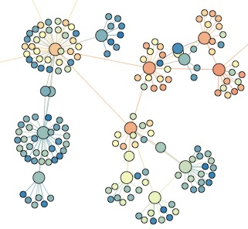

SNA 3C: Applications of network centrality
Lada Adamic

Slide 2
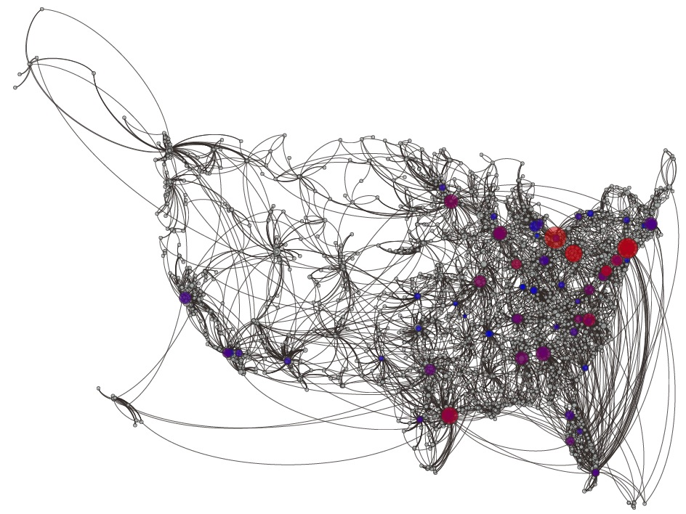
Hospital patient transfer network

Slide 3
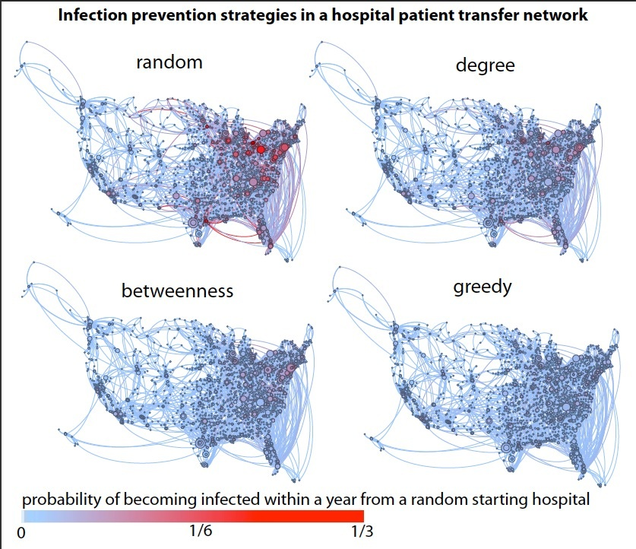
simulation results

Slide 4
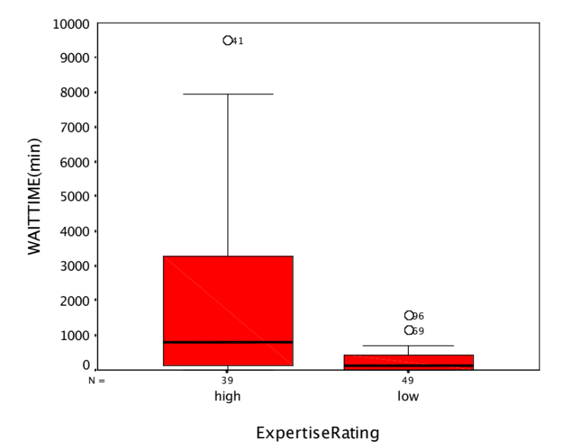
Identifying expertise
The Response Time Gap
The Expertise Gap
Difficult to infer reliability of answers
Automatically ranking expertise may be helpful.

Slide 5

Java Forum
87 sub-forums
1,438,053 messages
community expertise network constructed:
  196,191 users
  796,270 edges

Slide 6
Constructing an expertise network
1
B
unweighted
A
1
A
B
C
C
1
B
weighted by # threads
A
Thread 1
Thread 2
2
C
weighted by shared credit
1/2
B
A
1+1//2
Thread 1: Large Data, binary search or hashtable? user A
Re: Large... user B
Re: Large... user C
Thread 2: Binary file with ASCII data user A
Re: File with... user C
C
weighted with backflow
0.9
B
A
0.1
C

Slide 7
Uneven participation
0
  ‘answer people’ may reply to thousands of others
  ‘question people’ are also uneven in the number of repliers to their posts, but to a lesser extent
10
α
= 1.87 fit, R
2
= 0.9730
10
-1
number of people one replied to
-2
cumulative probability
10
number of people one received replies from
10
-3
10
-4
10
0
10
1
10
2
10
3
degree (k)

Slide 8
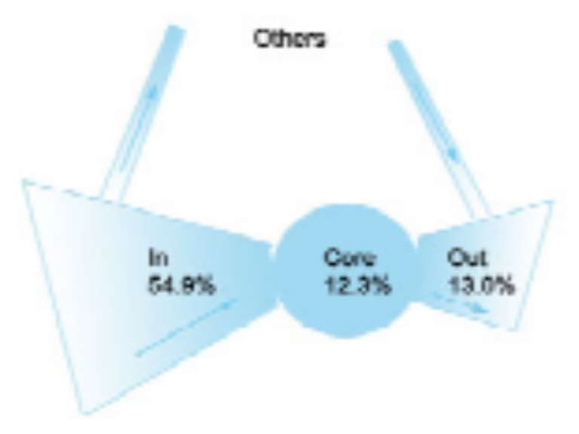
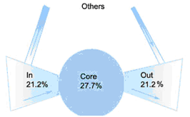
Not Everyone Asks/Replies
The Web is a bow tie
The Java Forum network is
an uneven bow tie
Core: A strongly connected component, in which everyone asks and answers
IN: Mostly askers.
OUT: Mostly Helpers

Slide 9
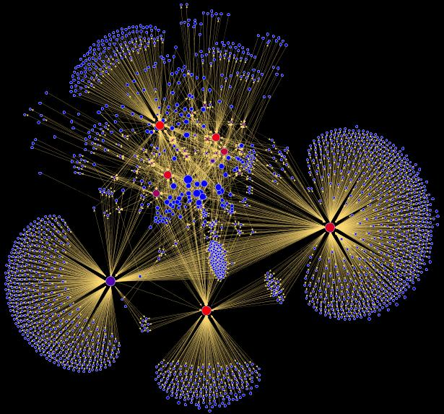
fragment of the Java Forum

Slide 10
Relating network structure to expertise
Human-rated expertise levels
    2 raters
    135 JavaForum users with >= 10 posts
    inter-rater agreement (τ = 0.74, ρ = 0.83)
    for evaluation of algorithms, omit users where raters disagreed by more than 1 level (τ = 0.80, ρ = 0.83)
L | Category | Description
5 | Top Java expert | Knows the core Java theory and related advanced topics deeply.
4 | Java professional | Can answer all or most of Java concept questions. Also knows one or some sub topics very well,
3 | Java user | Knows advanced Java concepts. Can program relatively well.
2 | Java learner | Knows basic concepts and can program, but is not good at advanced topics of Java.
1 | Newbie | Just starting to learn java.

Slide 11
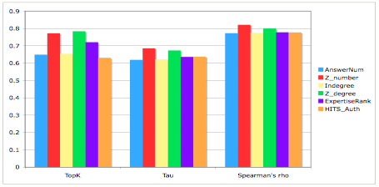
Algorithm Rankings vs. Human Ratings
0.9
0.8
0.7
0.6
0.5
0.4
0.3
0.2
0.1
0
# answers
z-score # answers
indegree
z-score indegree
PageRank
HITS authority
Top K
Kendall’s τ
Spearman’s ρ
simple local measures do as well (and better) than measures incorporating the wider network topology
Notes:
.

Slide 12
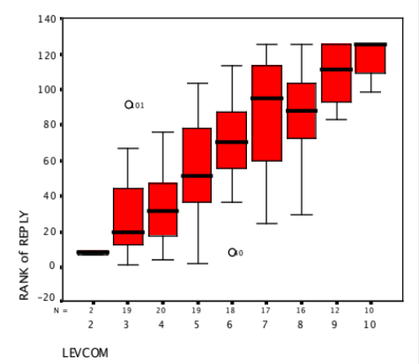
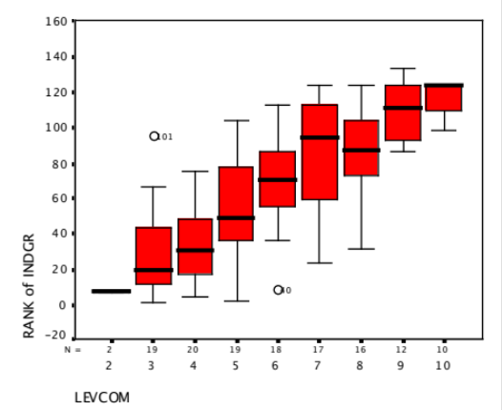
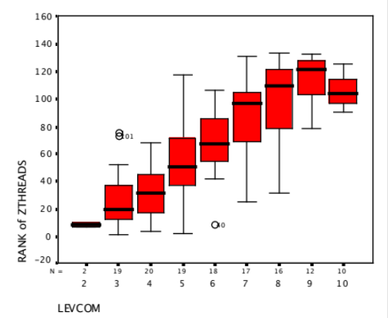
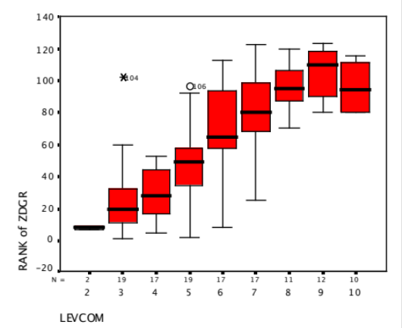
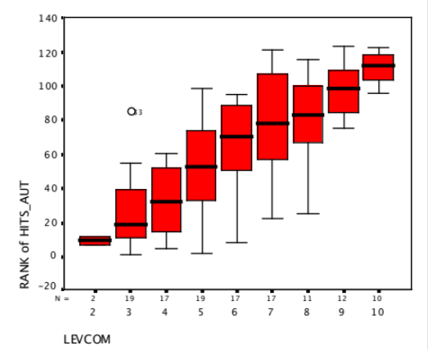
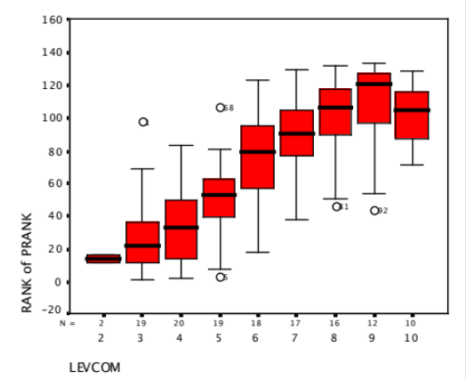
automated vs. human ratings
# answers
indegree
automated ranking
z # answers
z indegree
HITS authority
PageRank
human rating

Slide 13
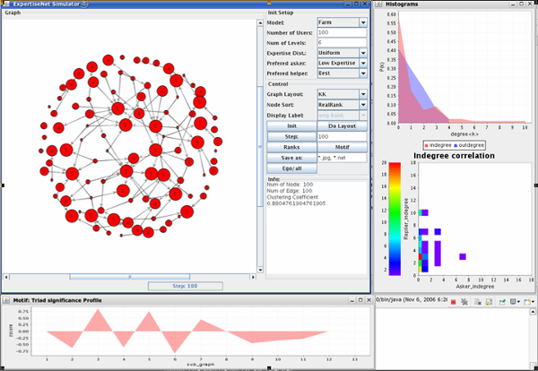
Modeling expertise network formation
  Control Parameters:
  Distribution of expertise
  Who asks questions most often?
  Who answers questions most often?
    best expert most likely
    someone a bit more expert
ExpertiseNet Simulator
Notes:
The evaluation result is a surprise to us. We thought the possible factors may be the noise replies that cannot indicate the replier has a better expertise than the asker, or the versions of PageRank we used, or the structure of the network. After tried different versions of PageRanks and try to decrease the impact of noise replies.
We decide to use simulations to see how the structure affect the performance of these ranking algorithms.

Slide 14
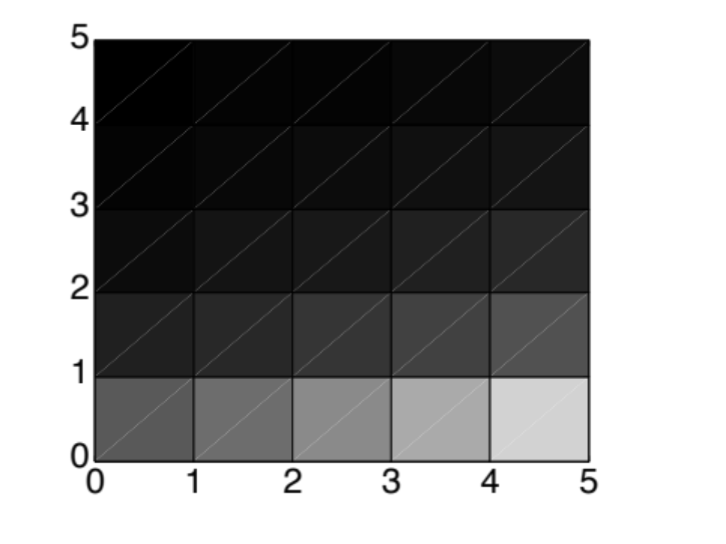
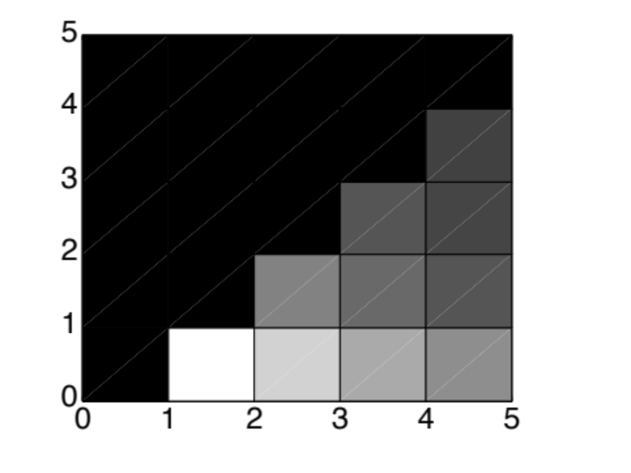
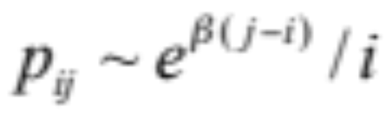
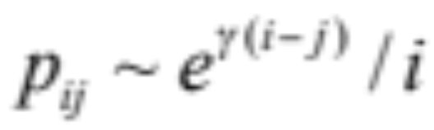
Simulating probability of expertise pairing
suppose:
expertise is uniformly distributed
probability of posing a question is inversely proportional to expertise
p_{ij} = probability a user with expertise j replies to a user with expertise i
2 models:
‘best’ preferred
‘just better’ preferred
j>i
Notes:
Here is an example how the simulator pair the expertise of users.
Let’s suppose that the community have a uniform distribution of users with different levels of expertise.
And Probability of a user posing a question is inversely proportional to his expertise level, thus, users with a lower expertise level are more likely to ask questions.
Then in the “best” preferred paring method, a question will be more likely to be answered by users with highest level of expertise.
The figure at the left side shows that in this situation, the highest frequency of asking-answering pairs happened between level 5 experts and level 1 newbies.
Note in the figure, the lighter the color is, the higher frequency of pair occurrences
In “just better” paring method, a question will more likely to be answered by users with just a little bit higher expertise than the asker. Thus, highest frequent pairing happens between
Level 1 and level 2 users.

Slide 15
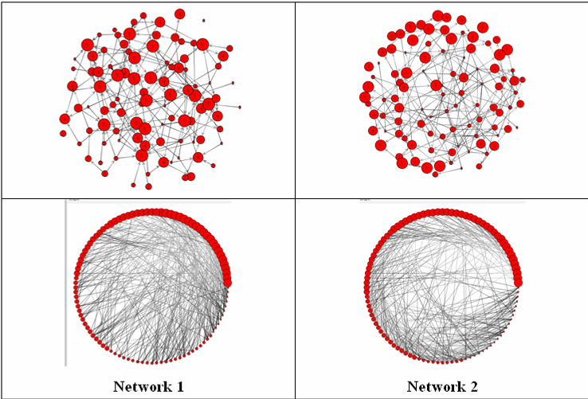
Visualization
Best “preferred”
just better
Notes:
These visualizations also shows the same result. Notice that the size of a node represents the user’s expertise level.

Slide 16
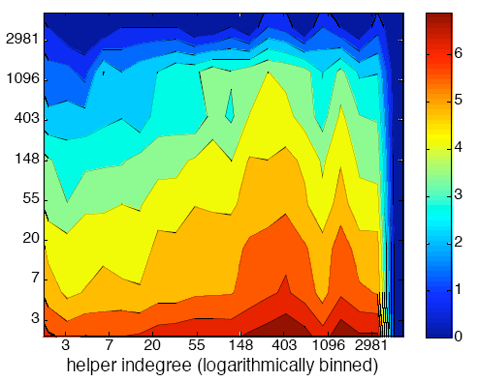
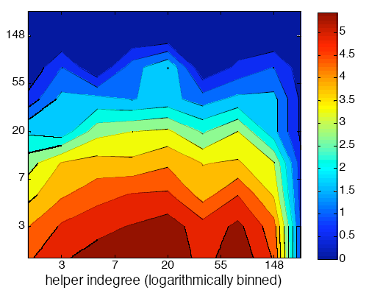
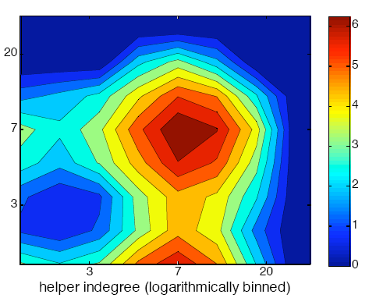
Degree correlation profiles
asker indegree
Java Forum Network
asker indegree
asker indegree
best preferred (simulation)
just better (simulation)
Notes:
We can see that the real network is still more similar to the “best preferred” simulated network. However, there may be some “just better” paring happens in the network, thus making the right area more warm colors.

Slide 17
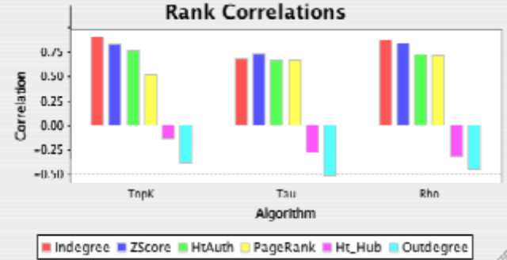
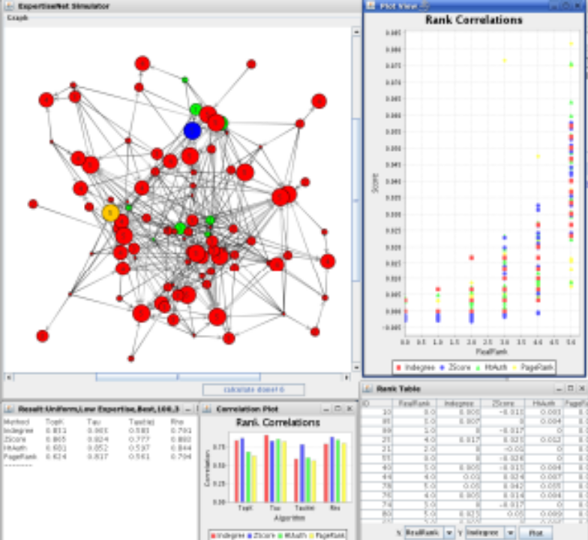
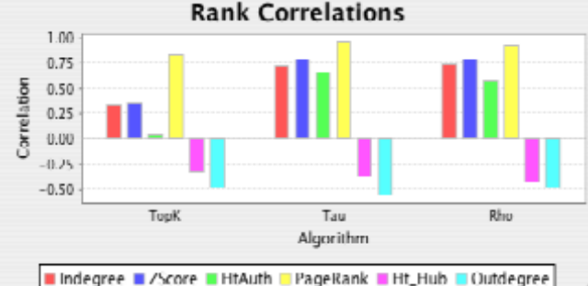
Algorithm selection
Preferred Helper: ‘best available’
Preferred Helper: ‘just better’

Slide 18
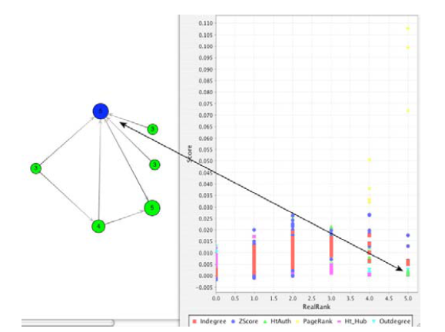
Algorithm evaluation
In the ‘just better’ model, a node is correctly ranked by PageRank but not by HITS
Notes:
The simulation can also help us look at the details of how various ranking algorithms differ.

