Slide 1
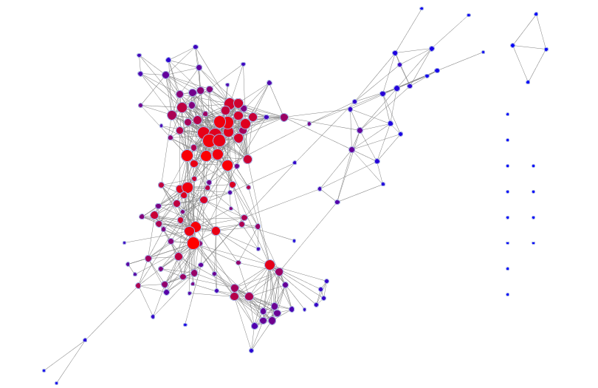
Closeness and Lada's fb network
degree (number of connections) denoted by size
closeness (length of shortest path to all others) denoted by color

Slide 2
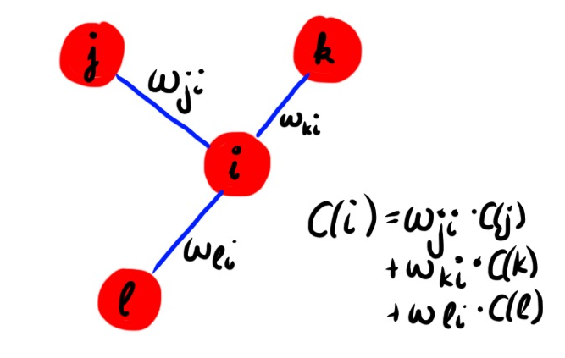
Eigenvector centrality
How central you are depends on how central your neighbors are

Slide 3
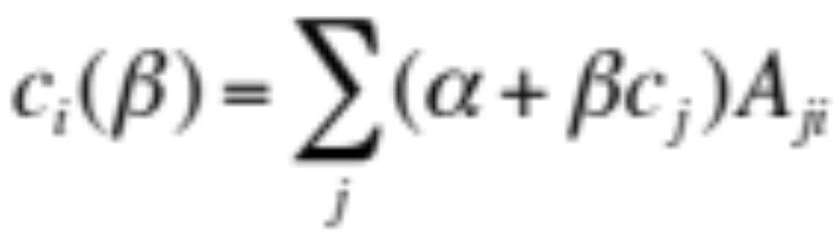
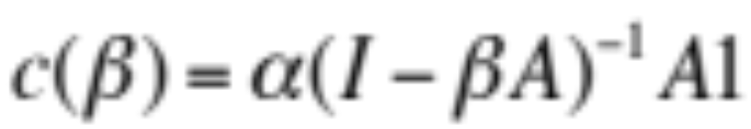
Bonacich eigenvector centrality
α is a normalization constant
β determines how important the centrality of your neighbors is
A is the adjacency matrix (can be weighted)
I is the identity matrix (1s down the diagonal, 0 off-diagonal)
1 is a matrix of all ones.

Slide 4
Bonacich Power Centrality: attenuation factor β
small β ➔ high attenuation
only your immediate friends matter, and their importance is factored in only a bit
high β ➔ low attenuation
global network structure matters (your friends, your friends' of friends etc.)
= 0 yields simple degree centrality

Slide 5
Bonacich Power Centrality: attenuation factor β
If β > 0, nodes have higher centrality when they have edges to other central nodes.
If β < 0, nodes have higher centrality when they have edges to less central nodes.

Slide 6


Bonacich Power Centrality: examples
β=.25
β=-.25
Why does the middle node have lower centrality than its
neighbors when β is negative?

Slide 7
Centrality in directed networks
WWW
food webs
population dynamics
influence
hereditary
citation
transcription regulation networks
neural networks

Slide 8
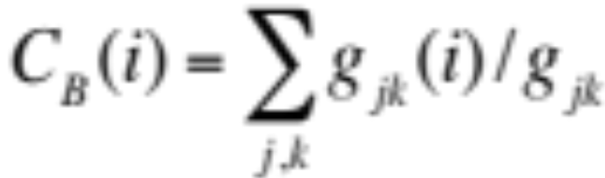
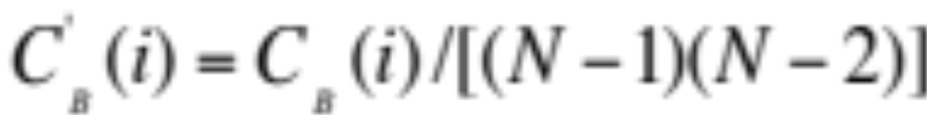
Betweenness centrality in directed networks
We now consider the fraction of all directed paths between any two vertices that pass through a node
paths between j and k that pass through i
betweenness of vertex i
all paths between j and k
Only modification: when normalizing, we have
(N-1)*(N-2) instead of (N-1)*(N-2)/2, because we have twice as many ordered pairs as unordered pairs

Slide 9
Directed geodesics
A node does not necessarily lie on a geodesic from j to k if it lies on a geodesic from k to j
j
k

Slide 10
Directed closeness centrality
choose a direction
  in-closeness (e.g. prestige in citation networks)
  out-closeness
usually consider only vertices from which the node i in question can be reached

Slide 11
Eigenvector centrality in directed networks
PageRank brings order to the Web:
  it's not just the pages that point to you, but how many pages point to those pages, etc.
  more difficult to artificially inflate centrality with a recursive definition
an important page, e.g. slashdot
Many webpages scattered
across the web
if a web page is
slashdotted, it gains attention

Slide 12
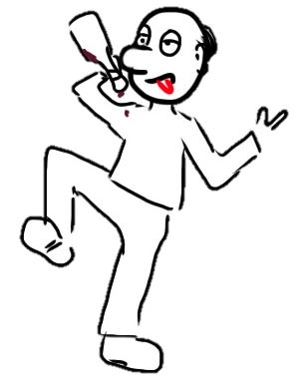
Ranking pages by tracking a drunk
A random walker following edges in a network for a very long time will spend a proportion of time at each node which can be used as a measure of importance

Slide 13
Trapping a drunk
Problem with pure random walk metric:
  Drunk can be “trapped” and end up going in circles

Slide 14

Ingenuity of the PageRank algorithm
Allow drunk to teleport with some probability
  e.g. random websurfer follows links for a while, but with some probability teleports to a “random” page (bookmarked page or uses a search engine to start anew)

Slide 15
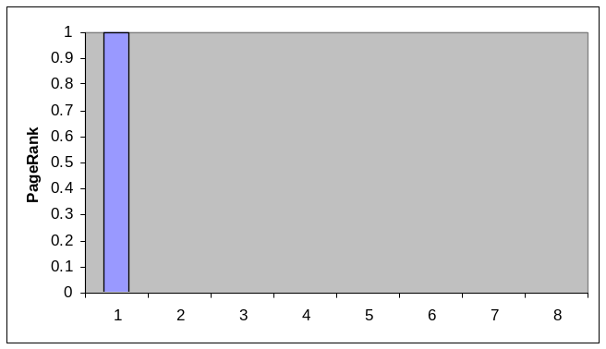
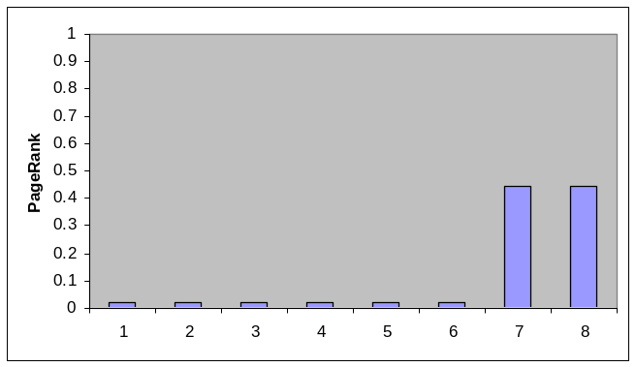
example: probable location of random walker after 1 step
20% teleportation probability
1
6
8
t=0
2
7
5
t=1
3
4
slide adapted from: Dragomir Radev

Slide 16
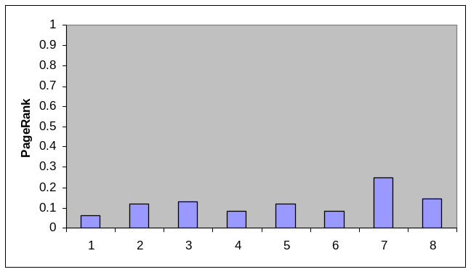
example: probable location of random walker after 10 steps
t=0
1
6
8
t=1
2
7
5
3
t=10
4
slide from: Dragomir Radev

Slide 17
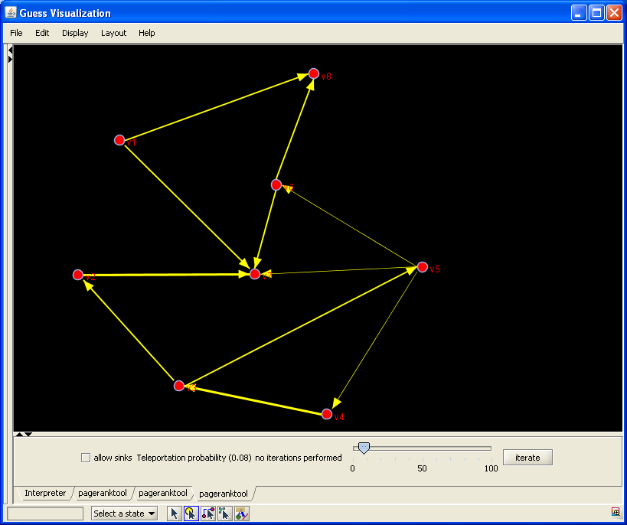
Quiz Q:
What happens to the relative PageRank scores of the nodes as you increase the teleportation probability?
  they equalize
  they diverge
  they are unchanged
GUESS PageRank demo
http://www.ladamic.com/netlearn/GUESS/pagerank.html

Slide 18
wrap up
Centrality
  many measures: degree, betweenness, closeness, eigenvector
  may be unevenly distributed
    measure via distributions and centralization
  in directed networks
    indegree, outdegree, PageRank
  consequences:
    benefits & risks (Baker & Faulkner)
    information flow & productivity (Aral & Van Alstyne)

