Slide 1
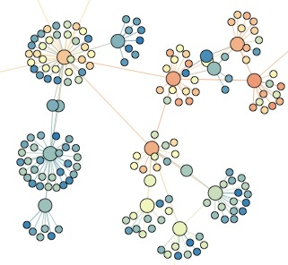

SNA 3A: Centrality
Lada Adamic

Slide 2
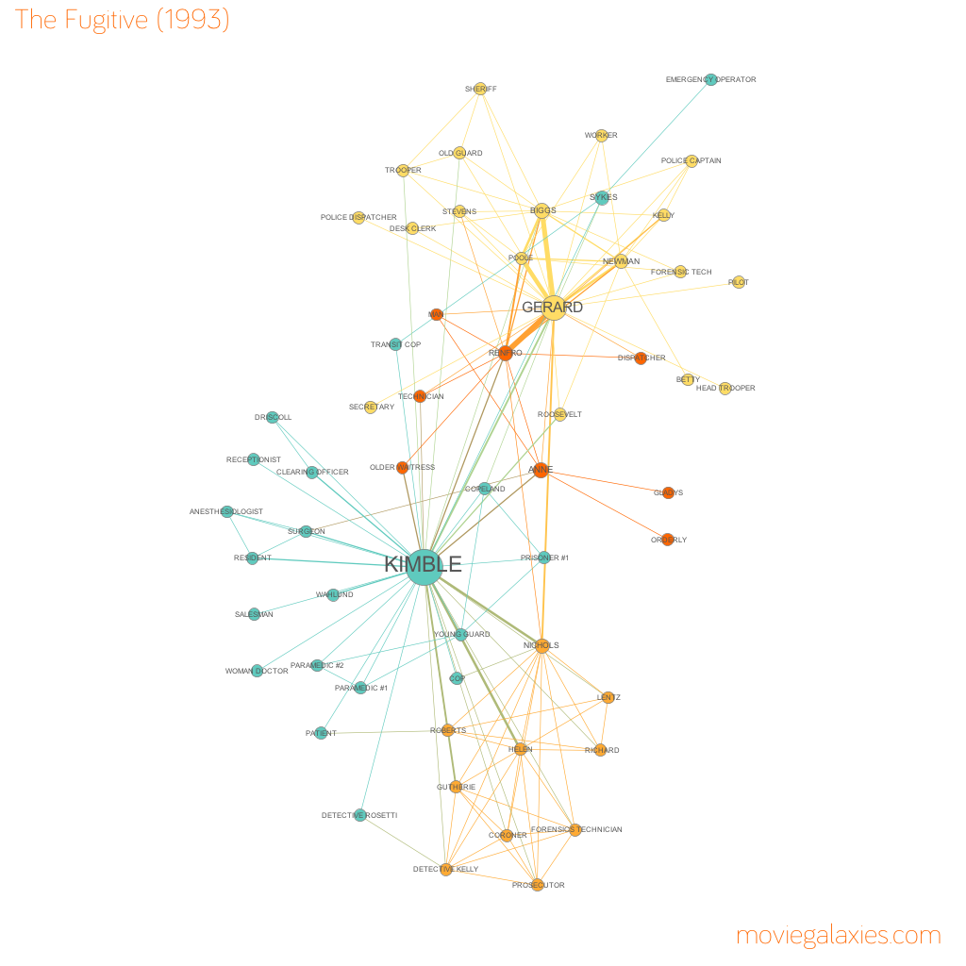

Slide 3
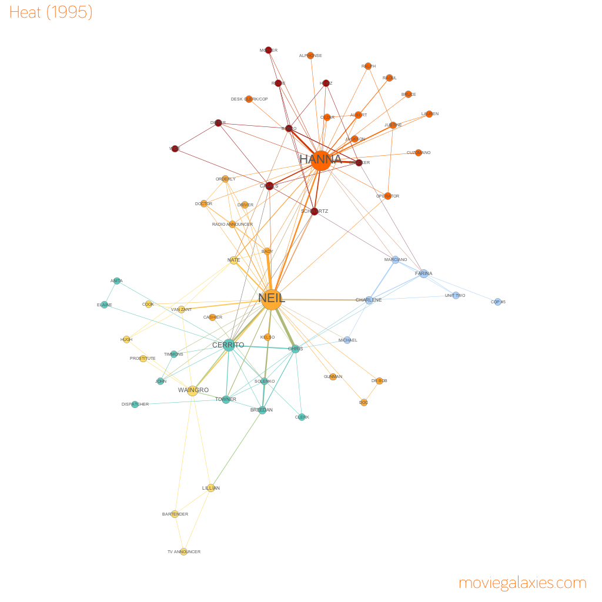

Slide 4
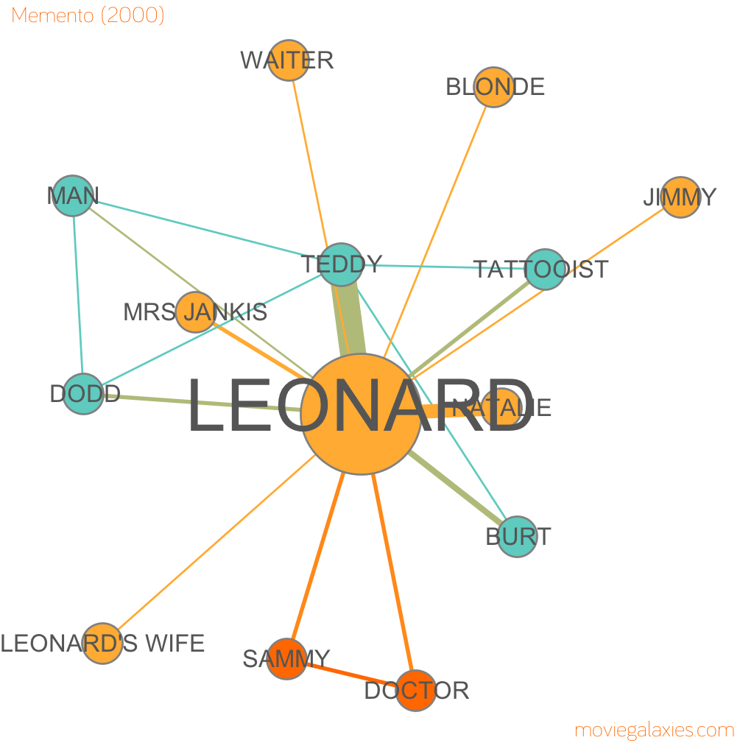

Slide 5
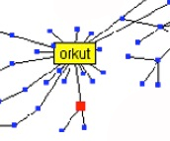
is counting the edges enough?

Slide 6
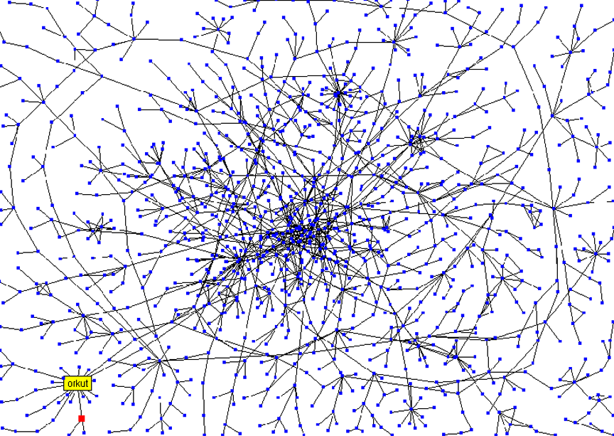
Stanford Social Web (ca. 1999)
network of personal homepages at Stanford

Slide 7
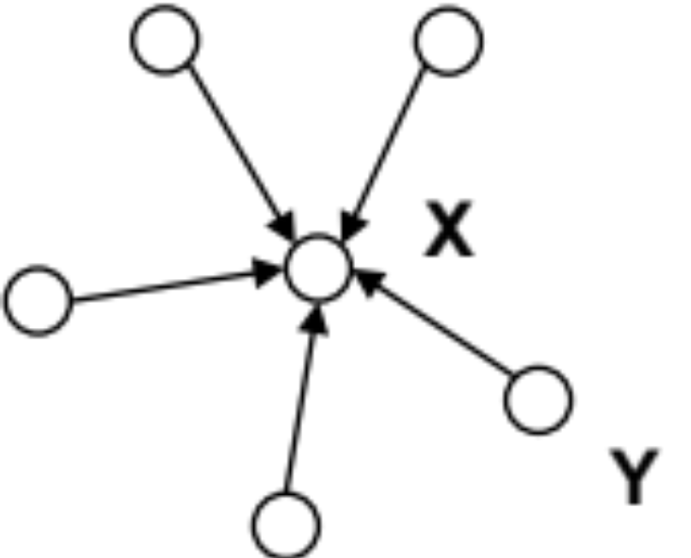
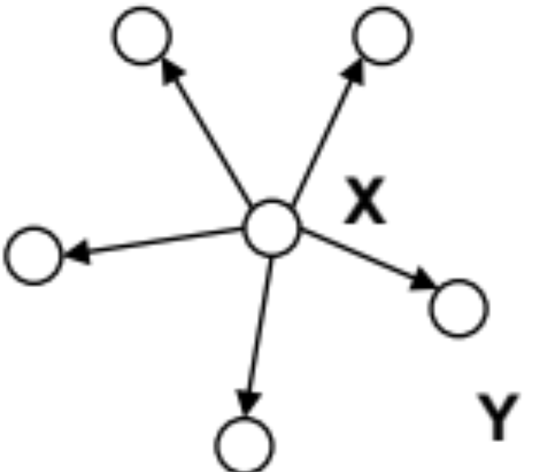
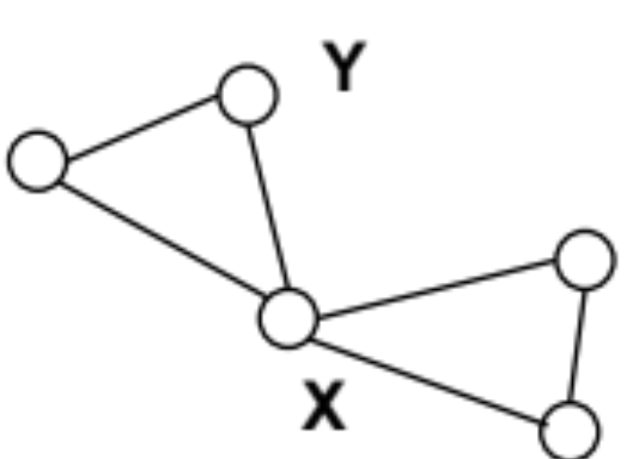
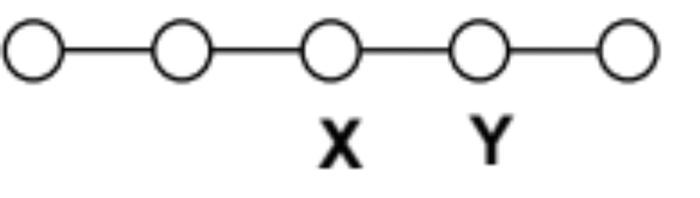
different notions of centrality
In each of the following networks, X has higher centrality than Y according to a particular measure
indegree
outdegree
betweenness
closeness

Slide 8
review: indegree

Slide 9
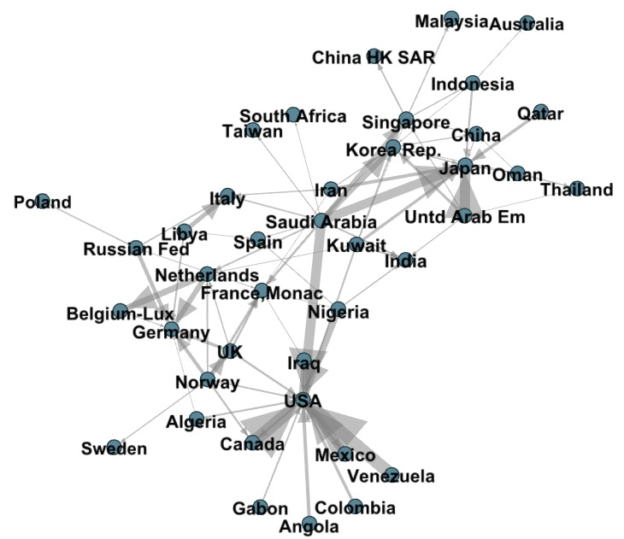
trade in petroleum and petroleum products, 1998, source: NBER-United Nations Trade Data

Slide 10
Quiz Q:
Which countries have high indegree (import petroleum and petroleum products from many others)
  Saudi Arabia
  Japan
  Iraq
  USA
  Venezuela

Slide 11
review: outdegree

Slide 12
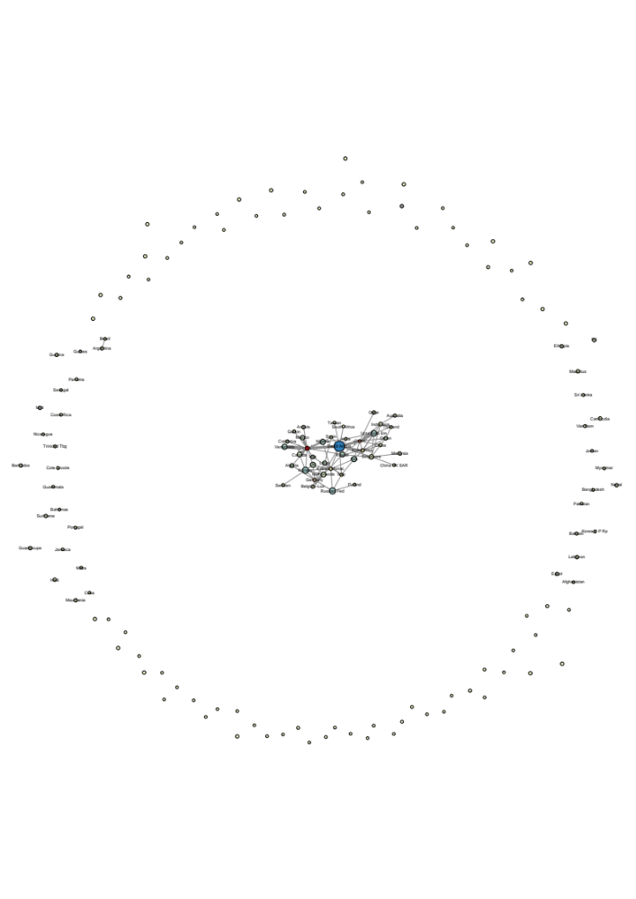
trade in petroleum and petroleum products, 1998, source: NBER-United Nations Trade Data

Slide 13
Quiz Q:
Which country has low outdegree but exports a significant quantity (thickness of the edges represents $$ value of export) of petroleum products
  Saudi Arabia
  Japan
  Iraq
  USA
  Venezuela

Slide 14
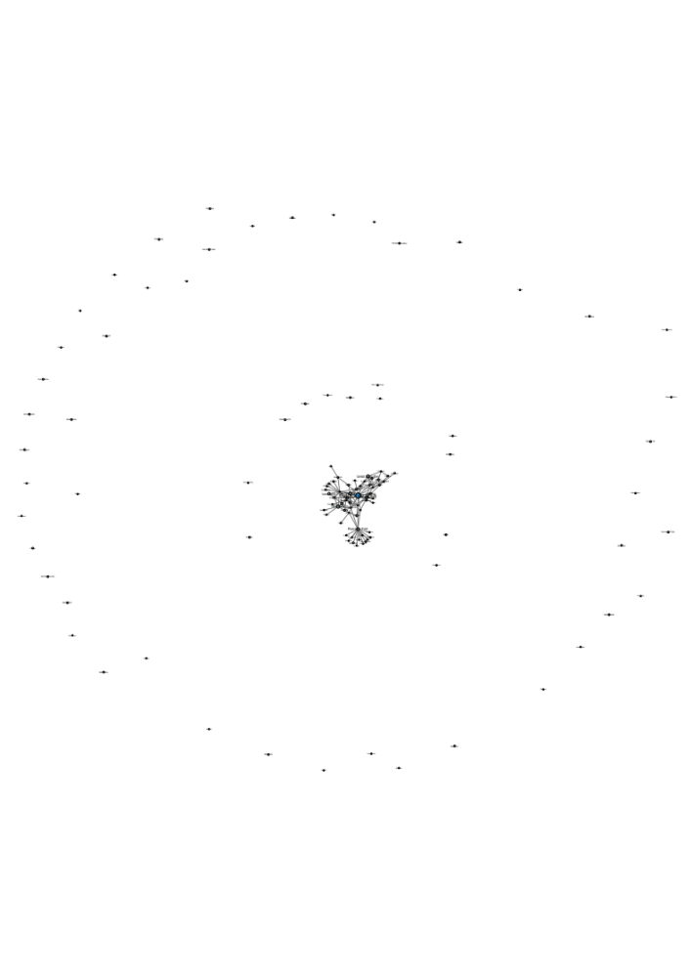
trade in crude petroleum and petroleum products, 1998, source: NBER-United Nations Trade Data

Slide 15
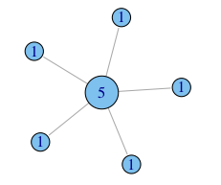
putting numbers to it
Undirected degree, e.g. nodes with more friends are more central.
Assumption: the connections that your friend has don't matter, it is what they can do directly that does (e.g. go have a beer with you, help you build a deck...)

Slide 16
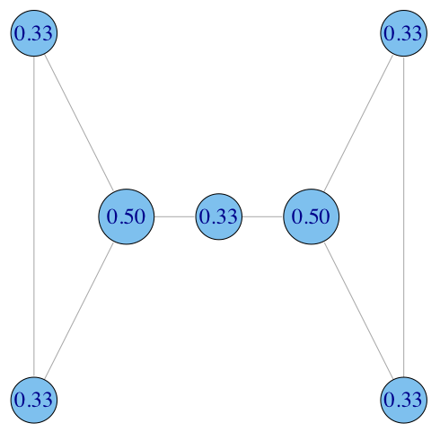
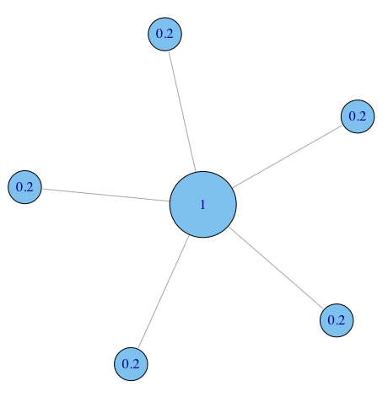

normalization
divide degree by the max. possible, i.e. (N-1)

Slide 17
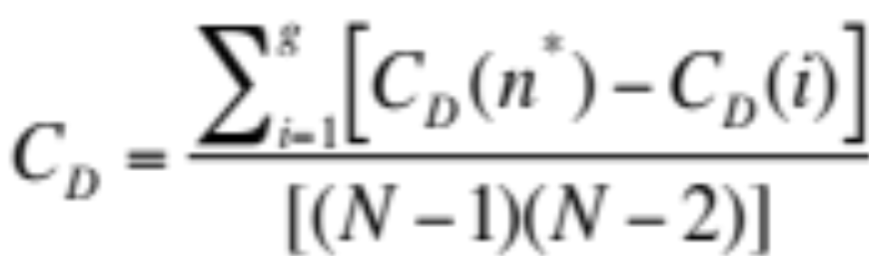
centralization: skew in distribution
How much variation is there in the centrality scores among the nodes?
Freeman’s general formula for centralization (can use other metrics, e.g. gini coefficient or standard deviation):
maximum value in the network

Slide 18
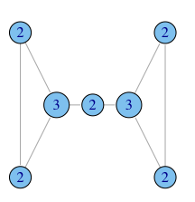
degree centralization examples
C_{D} = 0.167
C_{D} = 1.0
C_{D} = 0.167

Slide 19
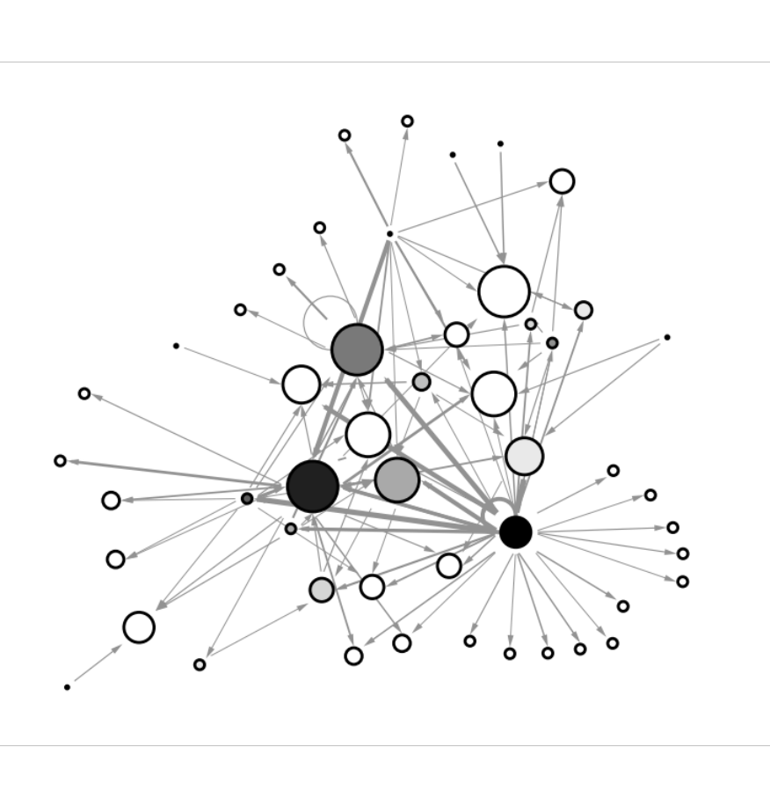
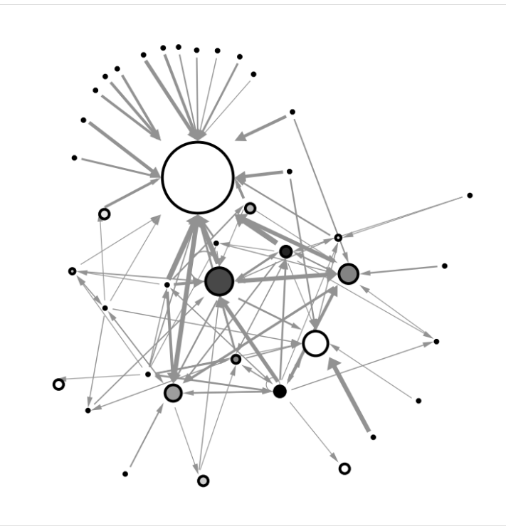
real-world examples
example financial trading networks
high in-centralization: one node buying from many others
low in-centralization: buying is more evenly distributed

Slide 20
what does degree not capture?
In what ways does degree fail to capture centrality in the following graphs?

Slide 21
Stanford Social Web (ca. 1999)
network of personal homepages at Stanford

Slide 22
Brokerage not captured by degree

Slide 23
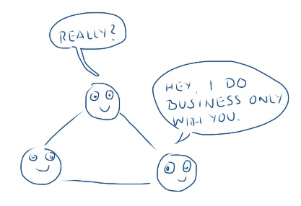
constraint

Slide 24
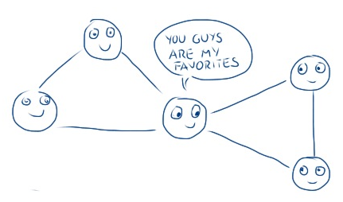
constraint

Slide 25

betweenness: capturing brokerage
intuition: how many pairs of individuals would have to go through you in order to reach one another in the minimum number of hops?

Slide 26
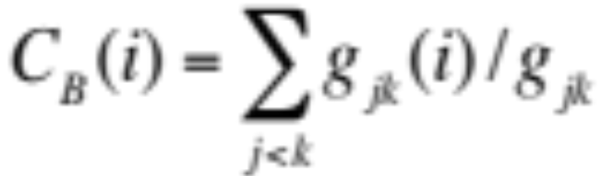
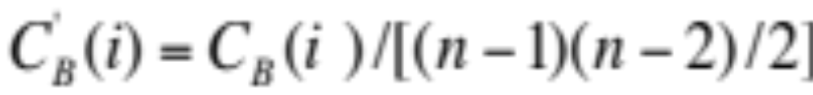
betweenness: definition
Where g_{jk} = the number of shortest paths connecting jk
g_{jk}(i) = the number that actor i is on.
Usually normalized by:
number of pairs of vertices excluding the vertex itself

Slide 27
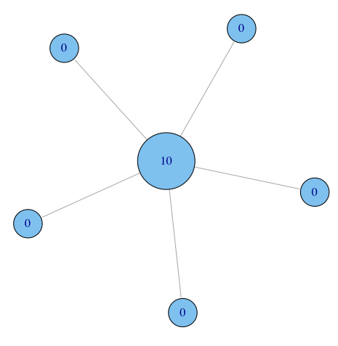
betweenness on toy networks
non-normalized version:

Slide 28

betweenness on toy networks
non-normalized version:
A
B
C
D
E
A lies between no two other vertices
B lies between A and 3 other vertices: C, D, and E
C lies between 4 pairs of vertices (A,D),(A,E),(B,D),(B,E)
note that there are no alternate paths for these pairs to take, so C gets full credit

Slide 29
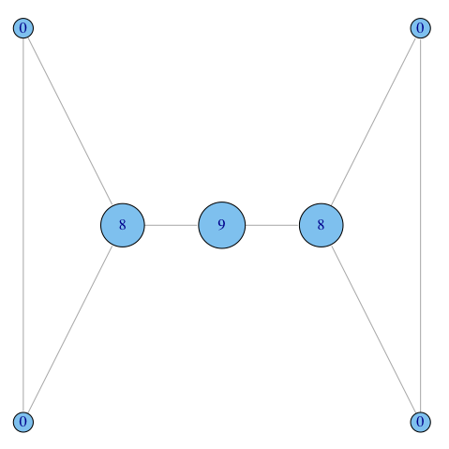
betweenness on toy networks
non-normalized version:

Slide 30
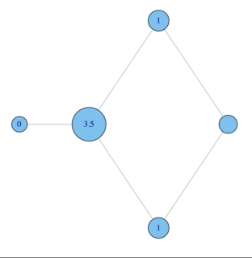
betweenness on toy networks
non-normalized version:
why do C and D each have betweenness 1?
They are both on shortest paths for pairs (A,E), and (B,E), and so must share credit:
  ½+½ = 1
C
A
B
E
D

Slide 31
Quiz Question
What is the betweenness of node E?
E

Slide 32
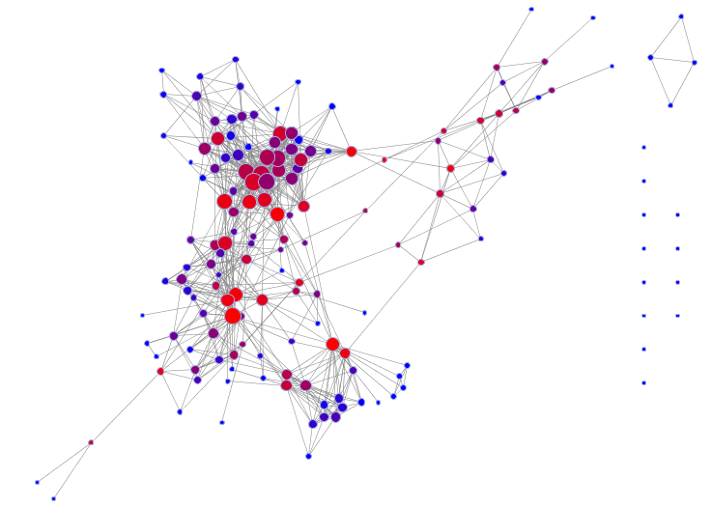
betweenness: example
Lada’s old Facebook network: nodes are sized by degree, and colored by betweenness.

Slide 33
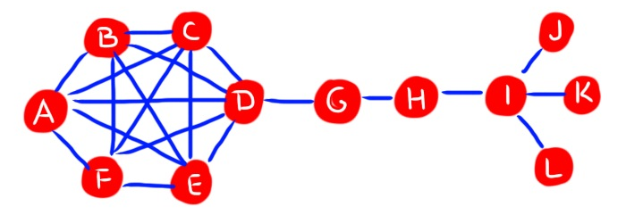
Quiz Q:
Find a node that has high betweenness but low degree

Slide 34
Quiz Q:
Find a node that has low betweenness but high degree

Slide 35
closeness
What if it’s not so important to have many direct friends?
Or be “between” others
But one still wants to be in the “middle” of things, not too far from the center

Slide 36
need not be in a brokerage position

Slide 37
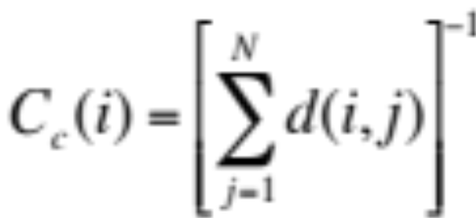
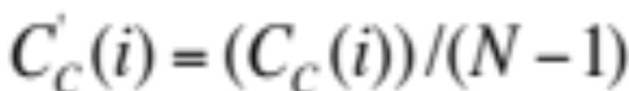
closeness: definition
Closeness is based on the length of the average shortest path between a node and all other nodes in the network
Closeness Centrality:
Normalized Closeness Centrality

Slide 38

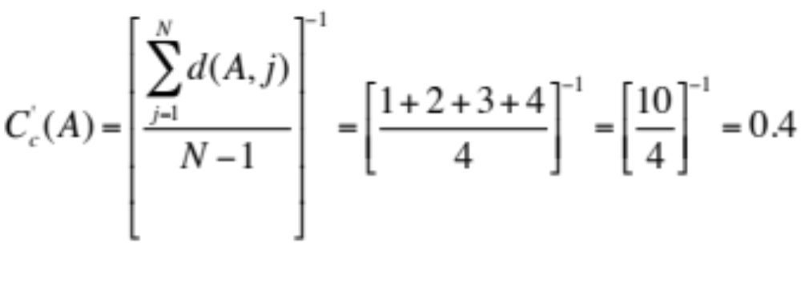
closeness: toy example
A
B
C
D
E

Slide 39
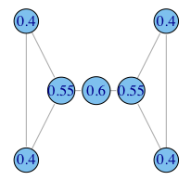
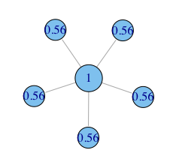
closeness: more toy examples

Slide 40
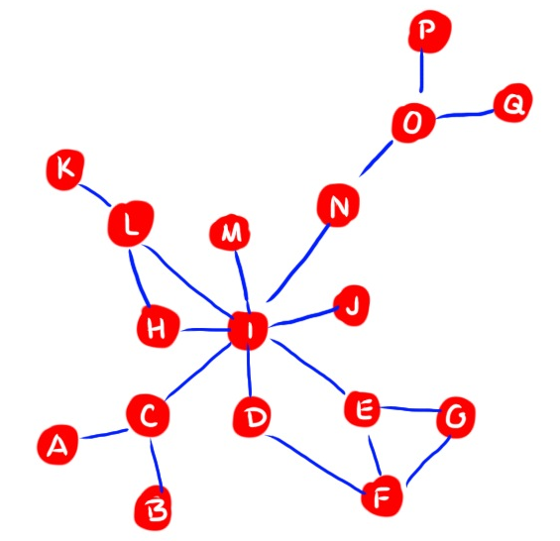
Quiz Q:
Which node has relatively high degree but low closeness?

