Slide 1
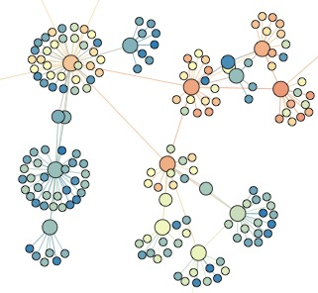

SNA L1B: software tools
Lada Adamic

Slide 2
In this class
Gephi (visualization and basic network metrics)
NetLogo (modeling network dynamics)
iGraph (for programming assignments)

Slide 3

Alternatives (User friendly)
Pajek
  http://pajek.imfm.si/doku.php
  very extensive functionality via drop-down menus
  free
  Windows-only

Slide 4
Alternatives (User friendly)
UCINet
  extensive, sociology-focused functionality
  Windows-only
  costs $$

Slide 5

Alternatives (User-friendly)
NodeXL http://nodexl.codeplex.com/
  SNA integrated into Excel
  Windows-only
  free
  beta

Slide 6
Alternatives (Python)
NetworkX
  extensive functionality
  scales to large networks by taking advantage of existing C, Fortran libraries for large matrix computations
  open source
  http://networkx.lanl.gov/

Slide 7
Alternatives (Specialized)
sna package for R
  extensive, statistics-heavy functionality
  http://cran.r-project.org/web/packages/sna/index.html
SoNIA - Social Network Image Animator
  http://www.stanford.edu/group/sonia/
  specialized for longitudinal analysis of networks

Slide 8
Gephi
Download from:
  http://gephi.org/
  download the datafile dining.gephi from Coursera
  let’s play

