Slide 1
Question Answering
Evaluating Summaries: ROUGE

Slide 2
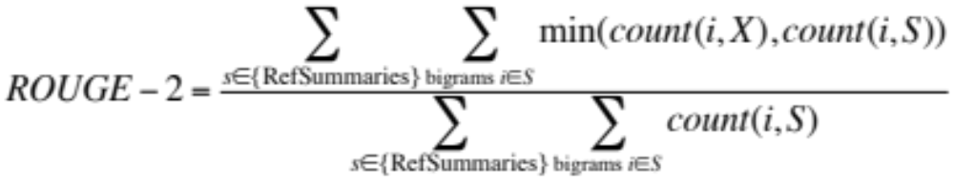
ROUGE (Recall Oriented Understudy for Gisting Evaluation)
Lin and Hovy 2003
Intrinsic metric for automatically evaluating summaries
  Based on BLEU (a metric used for machine translation)
  Not as good as human evaluation (“Did this answer the user’s question?”)
  But much more convenient
Given a document D, and an automatic summary X:
  Have N humans produce a set of reference summaries of D
  Run system, giving automatic summary X
  What percentage of the bigrams from the reference summaries appear in X?

Slide 3
A ROUGE example:
Q: “What is water spinach?”
Human 1: Water spinach is a green leafy vegetable grown in the tropics.
Human 2: Water spinach is a semi-aquatic tropical plant grown as a vegetable.
Human 3: Water spinach is a commonly eaten leaf vegetable of Asia.
System answer: Water spinach is a leaf vegetable commonly eaten in tropical areas of Asia.
ROUGE-2 =
3 + 3 + 6
= 12/28 = .43
10 + 9 + 9

Slide 4
Question Answering
Evaluating Summaries: ROUGE

