Slide 1
Question Answering
Summarization in Question Answering

Slide 2
Text Summarization
Goal: produce an abridged version of a text that contains information that is important or relevant to a user.
Summarization Applications
  outlines or abstracts of any document, article, etc
  summaries of email threads
  action items from a meeting
  simplifying text by compressing sentences

Slide 3
What to summarize?
Single vs. multiple documents
Single-document summarization
  Given a single document, produce
    abstract
    outline
    headline
Multiple-document summarization
  Given a group of documents, produce a gist of the content:
    a series of news stories on the same event
    a set of web pages about some topic or question

Slide 4
Query-focused Summarization
& Generic Summarization
Generic summarization:
  Summarize the content of a document
Query-focused summarization:
  summarize a document with respect to an information need expressed in a user query.
  a kind of complex question answering:
    Answer a question by summarizing a document that has the information to construct the answer

Slide 5
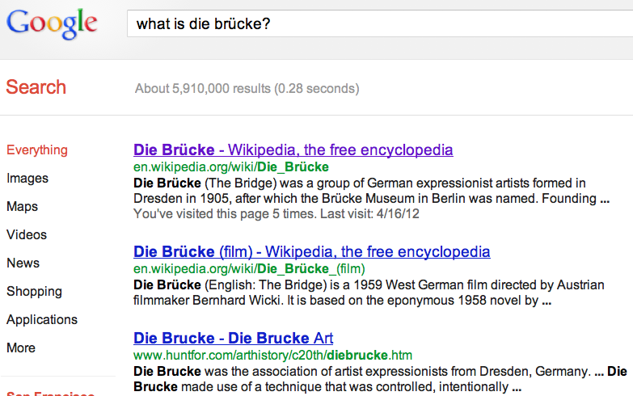
Summarization for Question Answering: Snippets
Create snippets summarizing a web page for a query
  Google: 156 characters (about 26 words) plus title and link

Slide 6
Summarization for Question Answering: Multiple documents
Create answers to complex questions summarizing multiple documents.
  Instead of giving a snippet for each document
  Create a cohesive answer that combines information from each document

Slide 7
Extractive summarization &
Abstractive summarization
Extractive summarization:
  create the summary from phrases or sentences in the source document(s)
Abstractive summarization:
  express the ideas in the source documents using (at least in part) different words

Slide 8
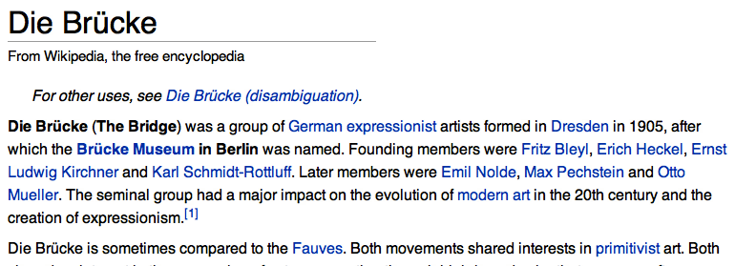
Simple baseline: take the first sentence

Slide 9
Question Answering
Summarization in Question Answering

