Slide 1
Language Modeling
Interpolation, Backoff, and Web-Scale LMs

Slide 2
Backoff and Interpolation
Sometimes it helps to use less context
  Condition on less context for contexts you haven’t learned much about
Backoff:
  use trigram if you have good evidence,
  otherwise bigram, otherwise unigram
Interpolation:
  mix unigram, bigram, trigram
Interpolation works better

Slide 3
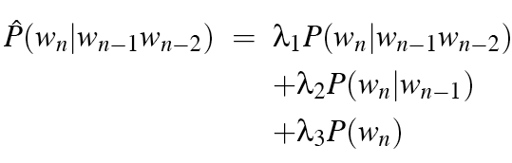

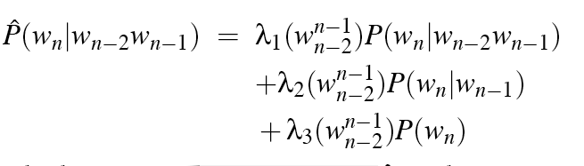
Linear Interpolation
Simple interpolation
Lambdas conditional on context:

Slide 4
How to set the lambdas?
Use a held-out corpus
Choose λs to maximize the probability of held-out data:
  Fix the N-gram probabilities (on the training data)
  Then search for λs that give largest probability to held-out set:
Training Data
Held-Out Data
Test
Data

Slide 5
Unknown words: Open versus closed vocabulary tasks
If we know all the words in advanced
  Vocabulary V is fixed
  Closed vocabulary task
Often we don’t know this
  Out Of Vocabulary = OOV words
  Open vocabulary task
Instead: create an unknown word token <UNK>
  Training of <UNK> probabilities
    Create a fixed lexicon L of size V
    At text normalization phase, any training word not in L changed to <UNK>
    Now we train its probabilities like a normal word
  At decoding time
    If text input: Use UNK probabilities for any word not in training

Slide 6
Huge web-scale n-grams
How to deal with, e.g., Google N-gram corpus
Pruning
  Only store N-grams with count > threshold.
    Remove singletons of higher-order n-grams
  Entropy-based pruning
Efficiency
  Efficient data structures like tries
  Bloom filters: approximate language models
  Store words as indexes, not strings
    Use Huffman coding to fit large numbers of words into two bytes
  Quantize probabilities (4-8 bits instead of 8-byte float)

Slide 7
Smoothing for Web-scale N-grams
“Stupid backoff” (Brants et al. 2007)
No discounting, just use relative frequencies

Slide 8
N-gram Smoothing Summary
Add-1 smoothing:
  OK for text categorization, not for language modeling
The most commonly used method:
  Extended Interpolated Kneser-Ney
For very large N-grams like the Web:
  Stupid backoff

Slide 9
Advanced Language Modeling
Discriminative models:
  choose n-gram weights to improve a task, not to fit the training set
Parsing-based models
Caching Models
  Recently used words are more likely to appear
  These perform very poorly for speech recognition (why?)

Slide 10
Language Modeling
Interpolation, Backoff, and Web-Scale LMs

