Slide 1
Model Thinking
Scott E Page

Slide 2
Prisoners’ Dilemma
Colonel Blotto

Slide 3
Colonel Blotto

Slide 4
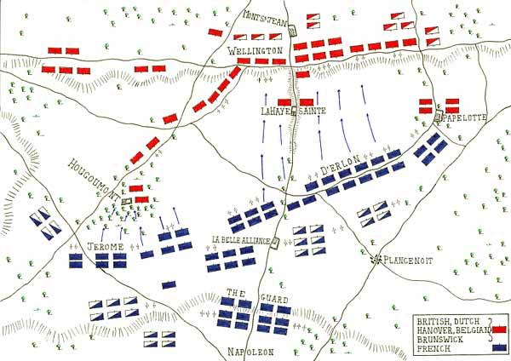
www.wikimedia.org

Slide 5
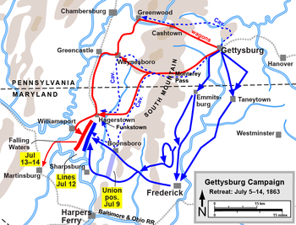
www.wikimedia.org

Slide 6
Basic Game

Slide 7
Give One Side Advantage

Slide 8
Competition

Slide 9
Model Thinking
Scott E Page

