Slide 1
Model Thinking
Scott E Page

Slide 2
Function

Slide 3
Emergent

Slide 4
Six Degrees

Slide 5
Six Degrees (1)
Stanley Milgram asked 296 people from Nebraska to get a letter to a stockbroker outside Boston. Could only send the letter to someone they knew on a first name basis

Slide 6
Six Degrees (2)
Duncan Watts did an email experiment with 48,000 senders and 19 targets in 57 countries. The average number of connections was six.

Slide 7
Random Clique Network
Each person has
C clique friends
R random friends.

Slide 9
K - Neighbor
All nodes that are of path length K to a node but not of any shorter path length

Slide 10
1 - Neighbors
1-neighbor

Slide 11
2 - Neighbors
2-neighbor

Slide 12
1-Neighbors
R + C

Slide 13
2- Neighbors
CR + RR + RC

Slide 14
3 - Neighbors
RRR + RRC + RCR + CRR + CRC
RCC = RC, CCR = CR and CCC = C.

Slide 15
C = 140 R = 10

Slide 16
People get jobs, find friends, partners, etc… through weak ties.
Granovetter (1973) “The Strength of Weak Ties”

Slide 17
Roommate’s brother’s friend
Mother’s coworker’s daughter
High school friend’s college roommate’s dad.

Slide 18
1-Neighbors: 150
2-Neighbors: 1900
3-Neighbors: 229,000
Notes:
Even if each 3-neighbors are 10% as likely to help you as a 2-neighbor, the collection of 3-neighbors is still nine times more likely than the collection of 2-neighbors.

Slide 19
Emergence

Slide 20
Emergent Phenomenon: A functionality that emerges at the micro level that does not hold at the micro level. Often the functionality was not intended.

Slide 21
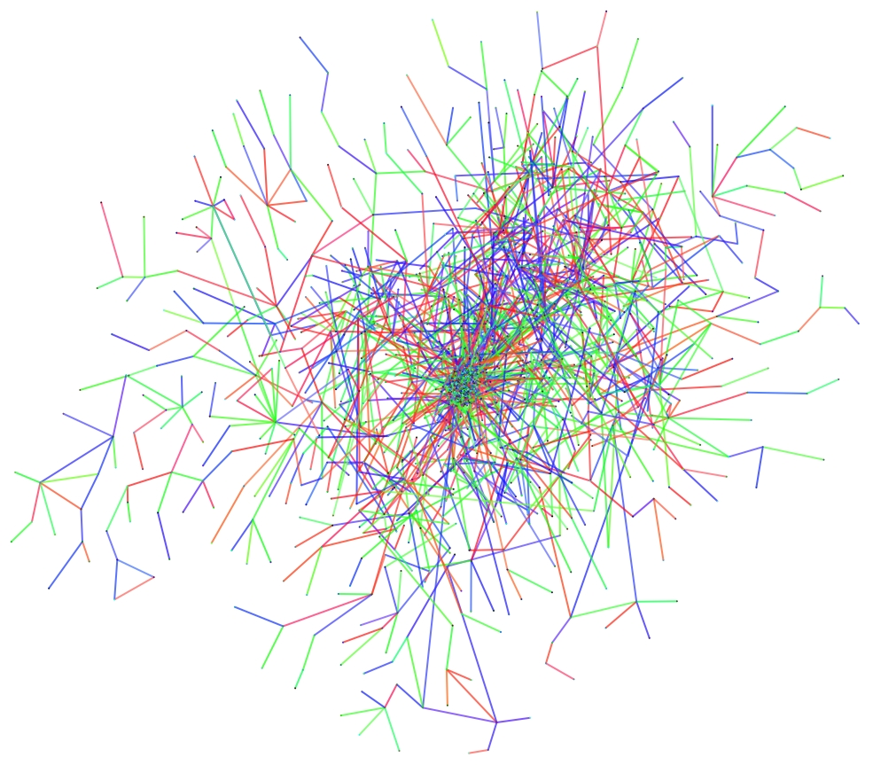
ucsd.edu

Slide 22
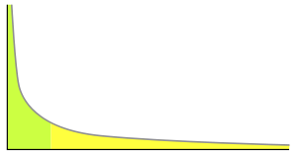
wikicommons

Slide 23
Logic: how it forms
Structure: measures
Function: what it does

Slide 24
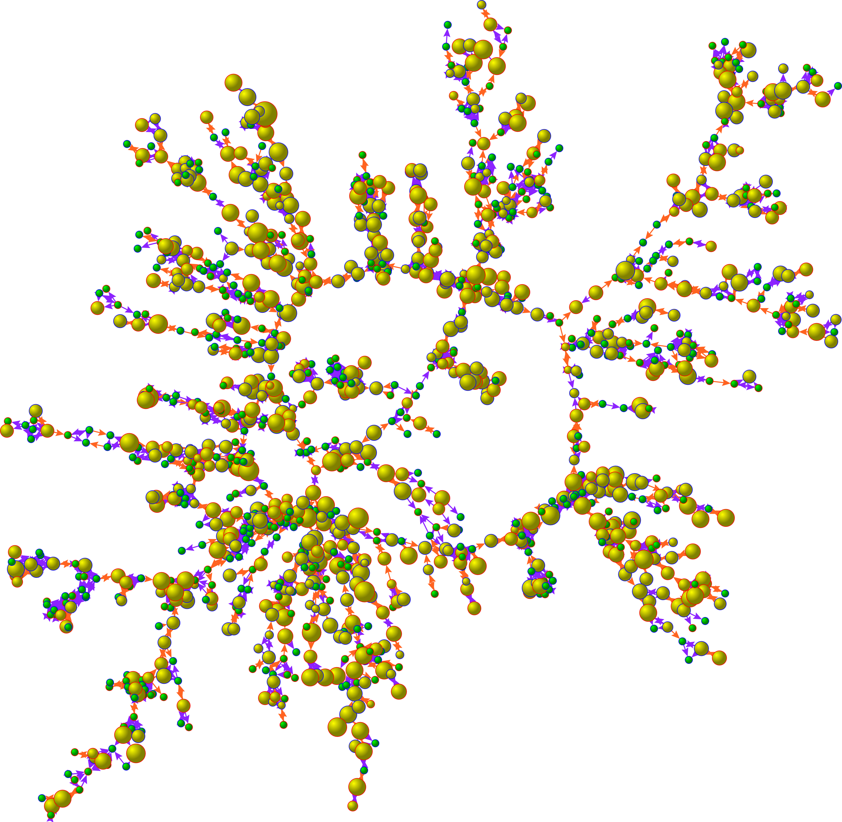
Graph: James Fowler UCSD
Notes:
. Each circle (node) represents one person. Circles with red borders denote women, and circles with blue borders denote men. The interior color of the circles indicates the person's cigarette consumption (yellow denotes ≥1 cigarette per day, and green denotes no cigarettes). The size of each circle is proportional to the number of cigarettes consumed. The colors of the ties between the circles indicate the relationship between them: orange denotes a friendship or a marital tie, and purple denotes a familial tie. For more details, see: N.A. Christakis and J.H. Fowler, "The Collective Dynamics of Smoking in a Large Social Network

Slide 25
Model Thinking
Scott E Page

