Slide 1
Model Thinking
Scott E Page

Slide 2
Networks

Slide 3
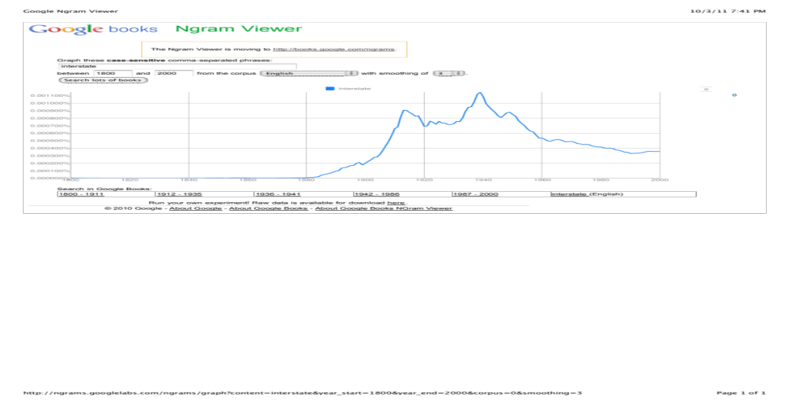

Slide 4
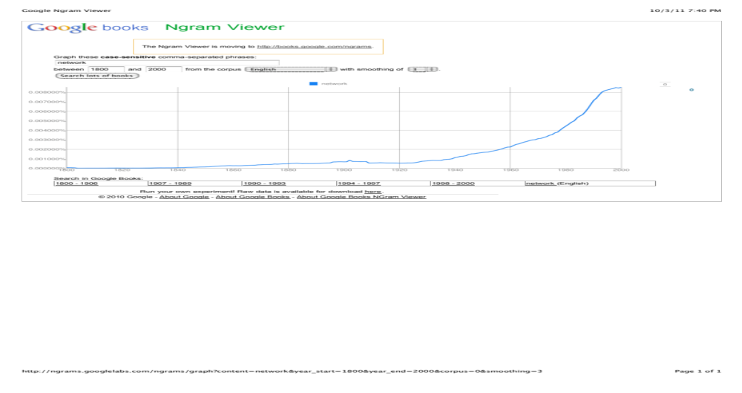

Slide 5
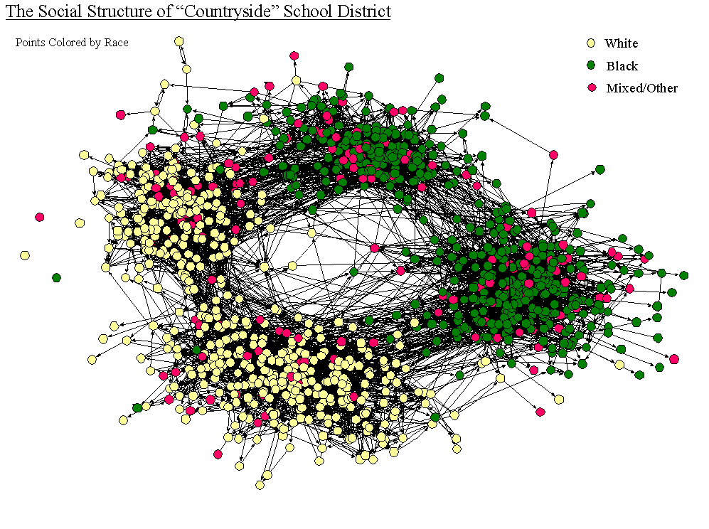
Graph: James Moody OSU

Slide 6
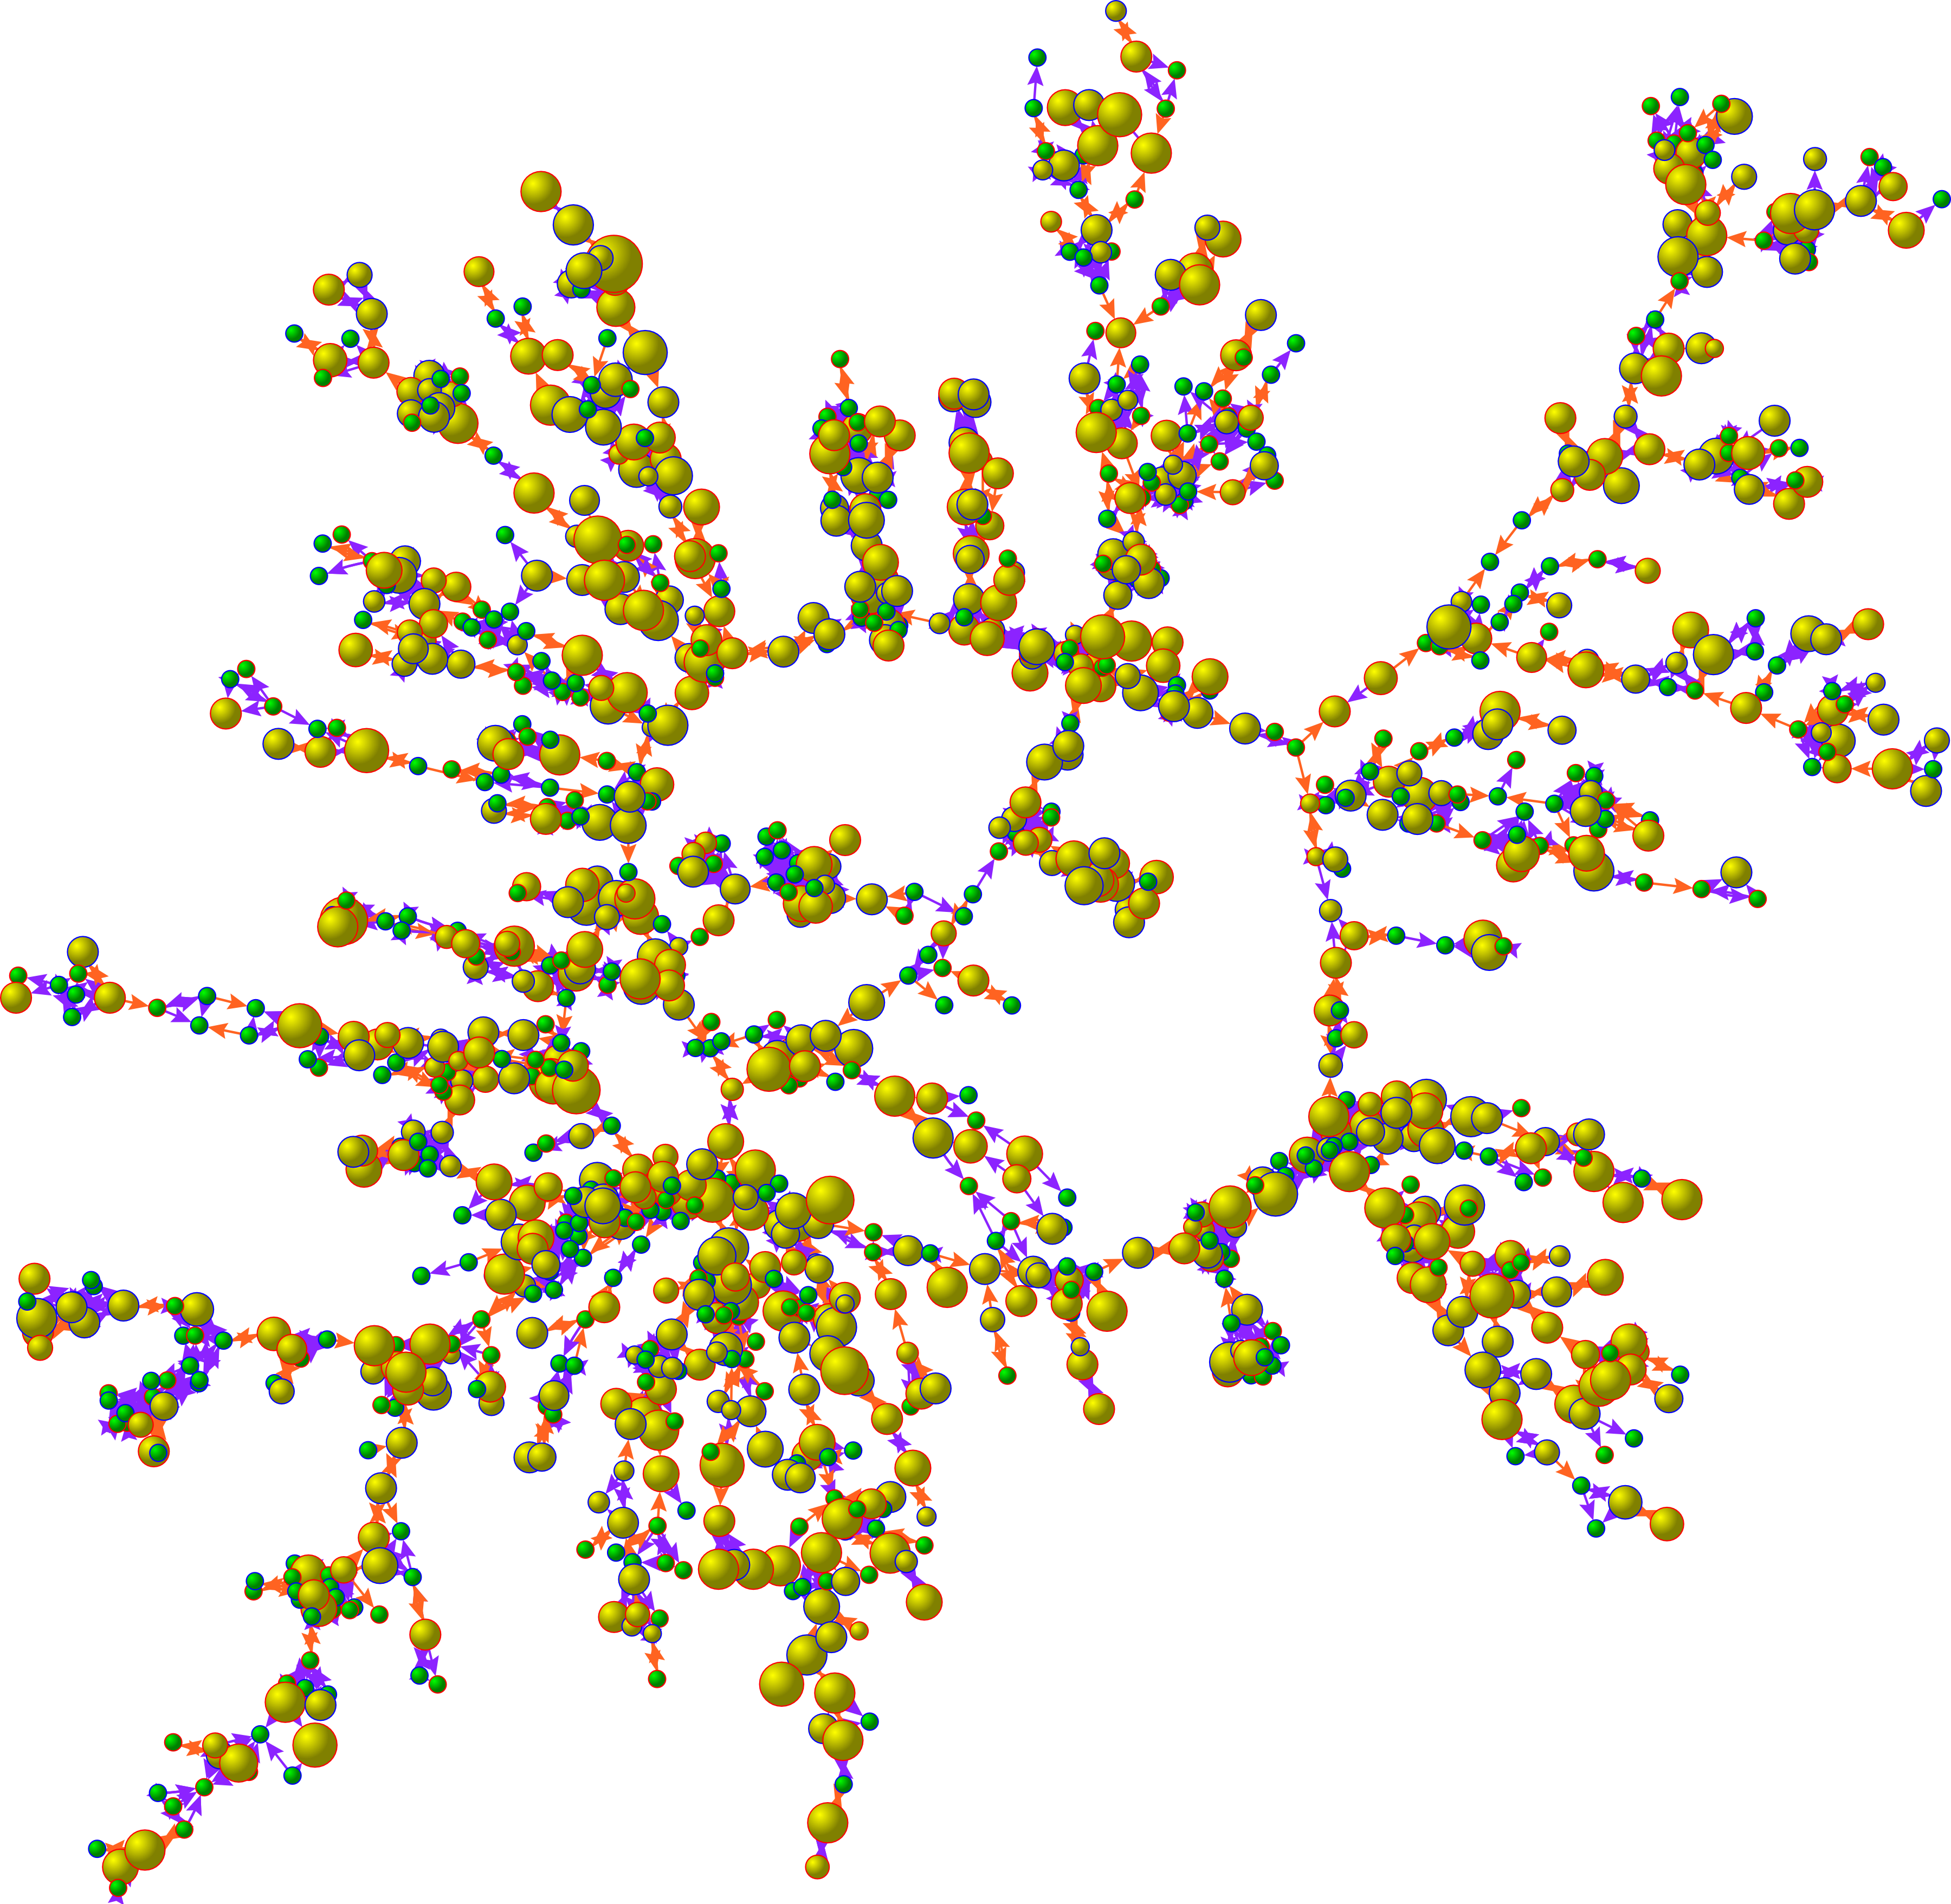
Graph: James Fowler UCSD
Notes:
. Each circle (node) represents one person. Circles with red borders denote women, and circles with blue borders denote men. The interior color of the circles indicates the person's cigarette consumption (yellow denotes ≥1 cigarette per day, and green denotes no cigarettes). The size of each circle is proportional to the number of cigarettes consumed. The colors of the ties between the circles indicate the relationship between them: orange denotes a friendship or a marital tie, and purple denotes a familial tie. For more details, see: N.A. Christakis and J.H. Fowler, "The Collective Dynamics of Smoking in a Large Social Network

Slide 7
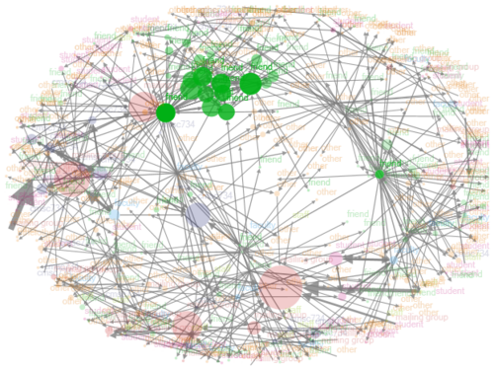
www.cscs.umd.edu

Slide 8
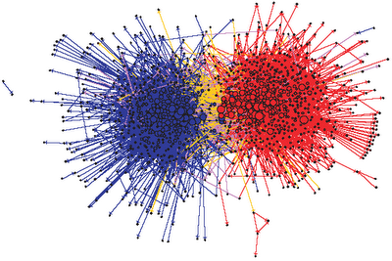
676 liberal (blue)
659 conservative (red)
Blue links connect liberal
Red connect conservative Yellow liberal to conservative,
Purple conservative to liberal.
Source: Lada Adamic

Slide 9
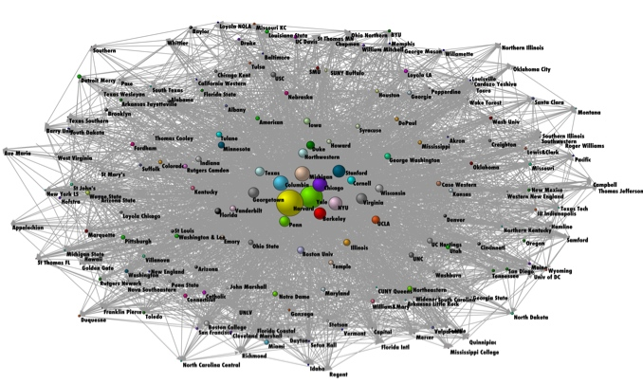
www.cscs.umd.edu
Empirical Legal Studies

Slide 10
Logic

Slide 11
Structure

Slide 12
Function

Slide 13
Six Degrees

Slide 14
Emergent

Slide 15
Logic: how it forms
Structure: measures
Function: what it does

Slide 16
Structure
Logic
Function

Slide 17
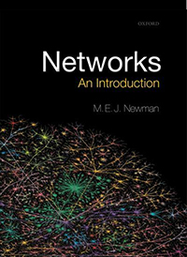

Slide 18
Model Thinking
Scott E Page

