Slide 1
Model Thinking
Scott E Page

Slide 2
Path Dependence

Slide 3
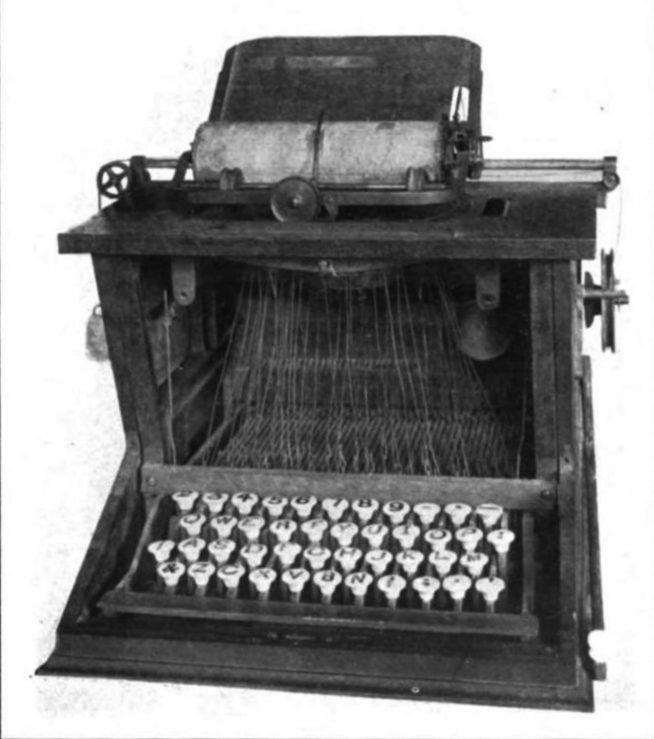
Wikicommons.org

Slide 4
Path Dependent: Outcome probabilities depend upon the sequence of past outcomes.

Slide 5
“History Matters”

Slide 6
Technology
Common Law
Institutional Choices
Economic Success

Slide 7
Ann Arbor: Largest public university
Jackson: Largest four walled prison

Slide 8
Jackson
1910 31,433 24.8%
1920 48,374 53.9%
1930 55,187 14.1%
1940 49,656 −10.0%
1950 51,088 2.9%
1960 50,720 −0.7%
1970 45,484 −10.3%
1980 39,739 −12.6%
1990 38,303 −3.6%
2000 36,316 −5.2%
Ann Arbor
1910 14,817 2.1%
1920 19,516 31.7%
1930 26,944 38.1%
1940 29,815 10.7%
1950 48,251 61.8%
1960 67,340 39.6%
1970 100,035 48.6%
1980 107,969 7.9%
1990 109,592 1.5%
2000 114,024 4.0%

Slide 9
Increasing Returns

Slide 10
Chaos: ESTIC

Slide 11
Markov Process

Slide 12
Model Thinking
Scott E Page

