Slide 1
Model Thinking
Scott E Page

Slide 2
Lyapunov Functions

Slide 3
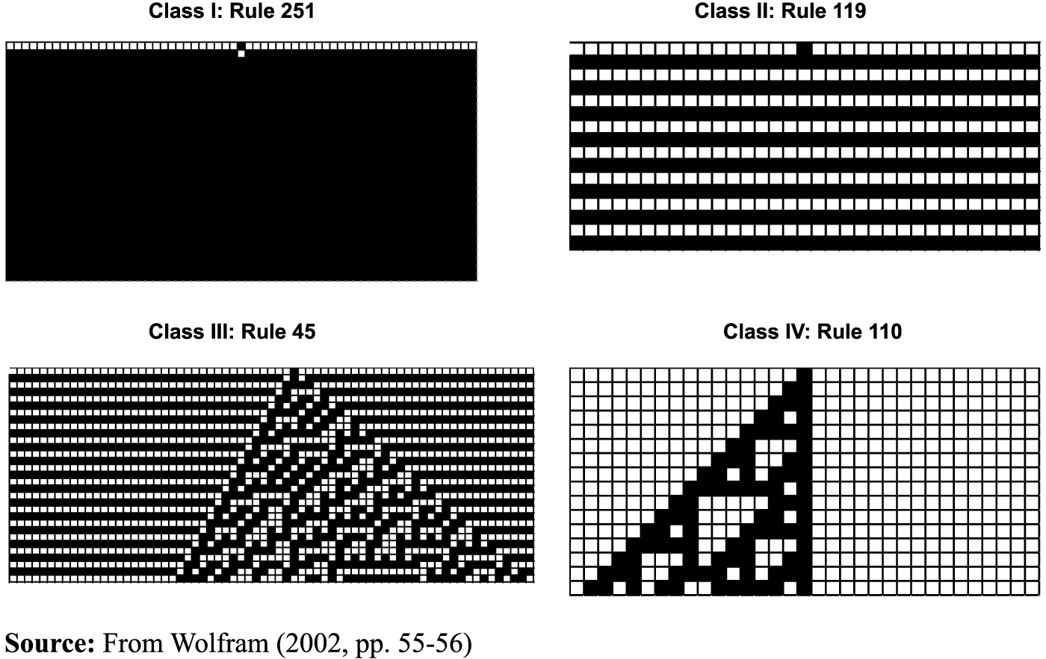
Wolfram.com

Slide 4
Physics

Slide 5
Economics

Slide 6
F(x), a Lyaponuv function
A1: has a maximum value.
A2: There is a k > 0 such that if x_{t+1} ≠ x_{t}, F(x_{t+1}) > F(x_{t}) + k
Claim: At some point x_{t+1} = x_{t}

Slide 7
Zeno’s Paradox

Slide 8
F(x), a Lyaponuv function
A1: has a maximum value.
A2: There is a k > 0 such that if x_{t+1} ≠ x_{t}, F(x_{t+1}) > F(x_{t}) + k
Claim: At some point x_{t+1} = x_{t}

Slide 9
Bonus: How Fast

Slide 10
The Hard Part: Constructing the Lyapunov function.

Slide 11
Model Thinking
Scott E Page

