Slide 1
Model Thinking
Scott E Page

Slide 2
Markov Models

Slide 3
Idea
States
Entities move between those states according to transition probabilities

Slide 4
Alert Bored

Slide 5
Free Not Free

Slide 7
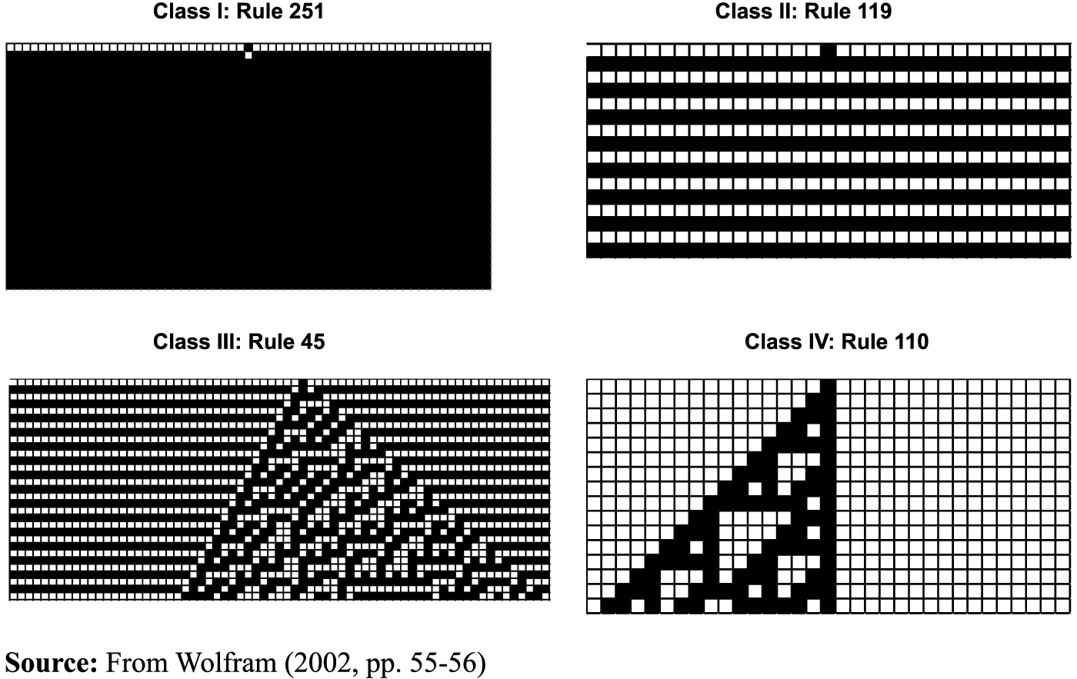
Four Classes of Behavior

Slide 8
Markov Convergence

Slide 9
Matrices

Slide 10
Exaptation

Slide 11
Model Thinking
Scott E Page

