Slide 1
Model Thinking
Scott E Page

Slide 2
Recombination

Slide 3
1 2 3 5 _ 13

Slide 4
1 4 _ 16 25 36

Slide 5
1 2 6 _ 1806

Slide 6
How many ways to pick three objects from ten?

Slide 7
52*51*50*49…*33
20*19*18*…*2*1

Slide 8
52*51*50*49…*33
20*19*18*…*2*1
Approximately 125 trillion

Slide 9
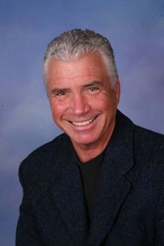
Recombinant Growth
Martin Weitzman
Harvard.edu

Slide 10
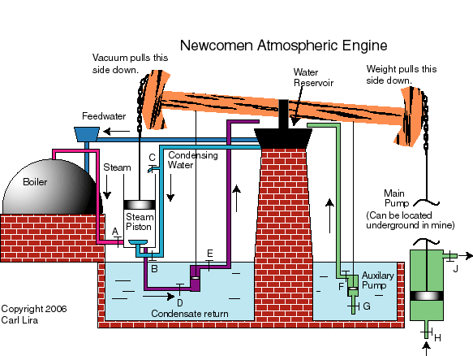
msu.edu

Slide 11
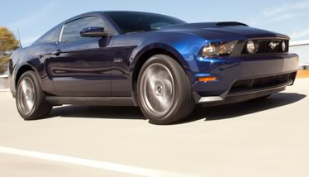

Slide 12
Exaptation

Slide 13
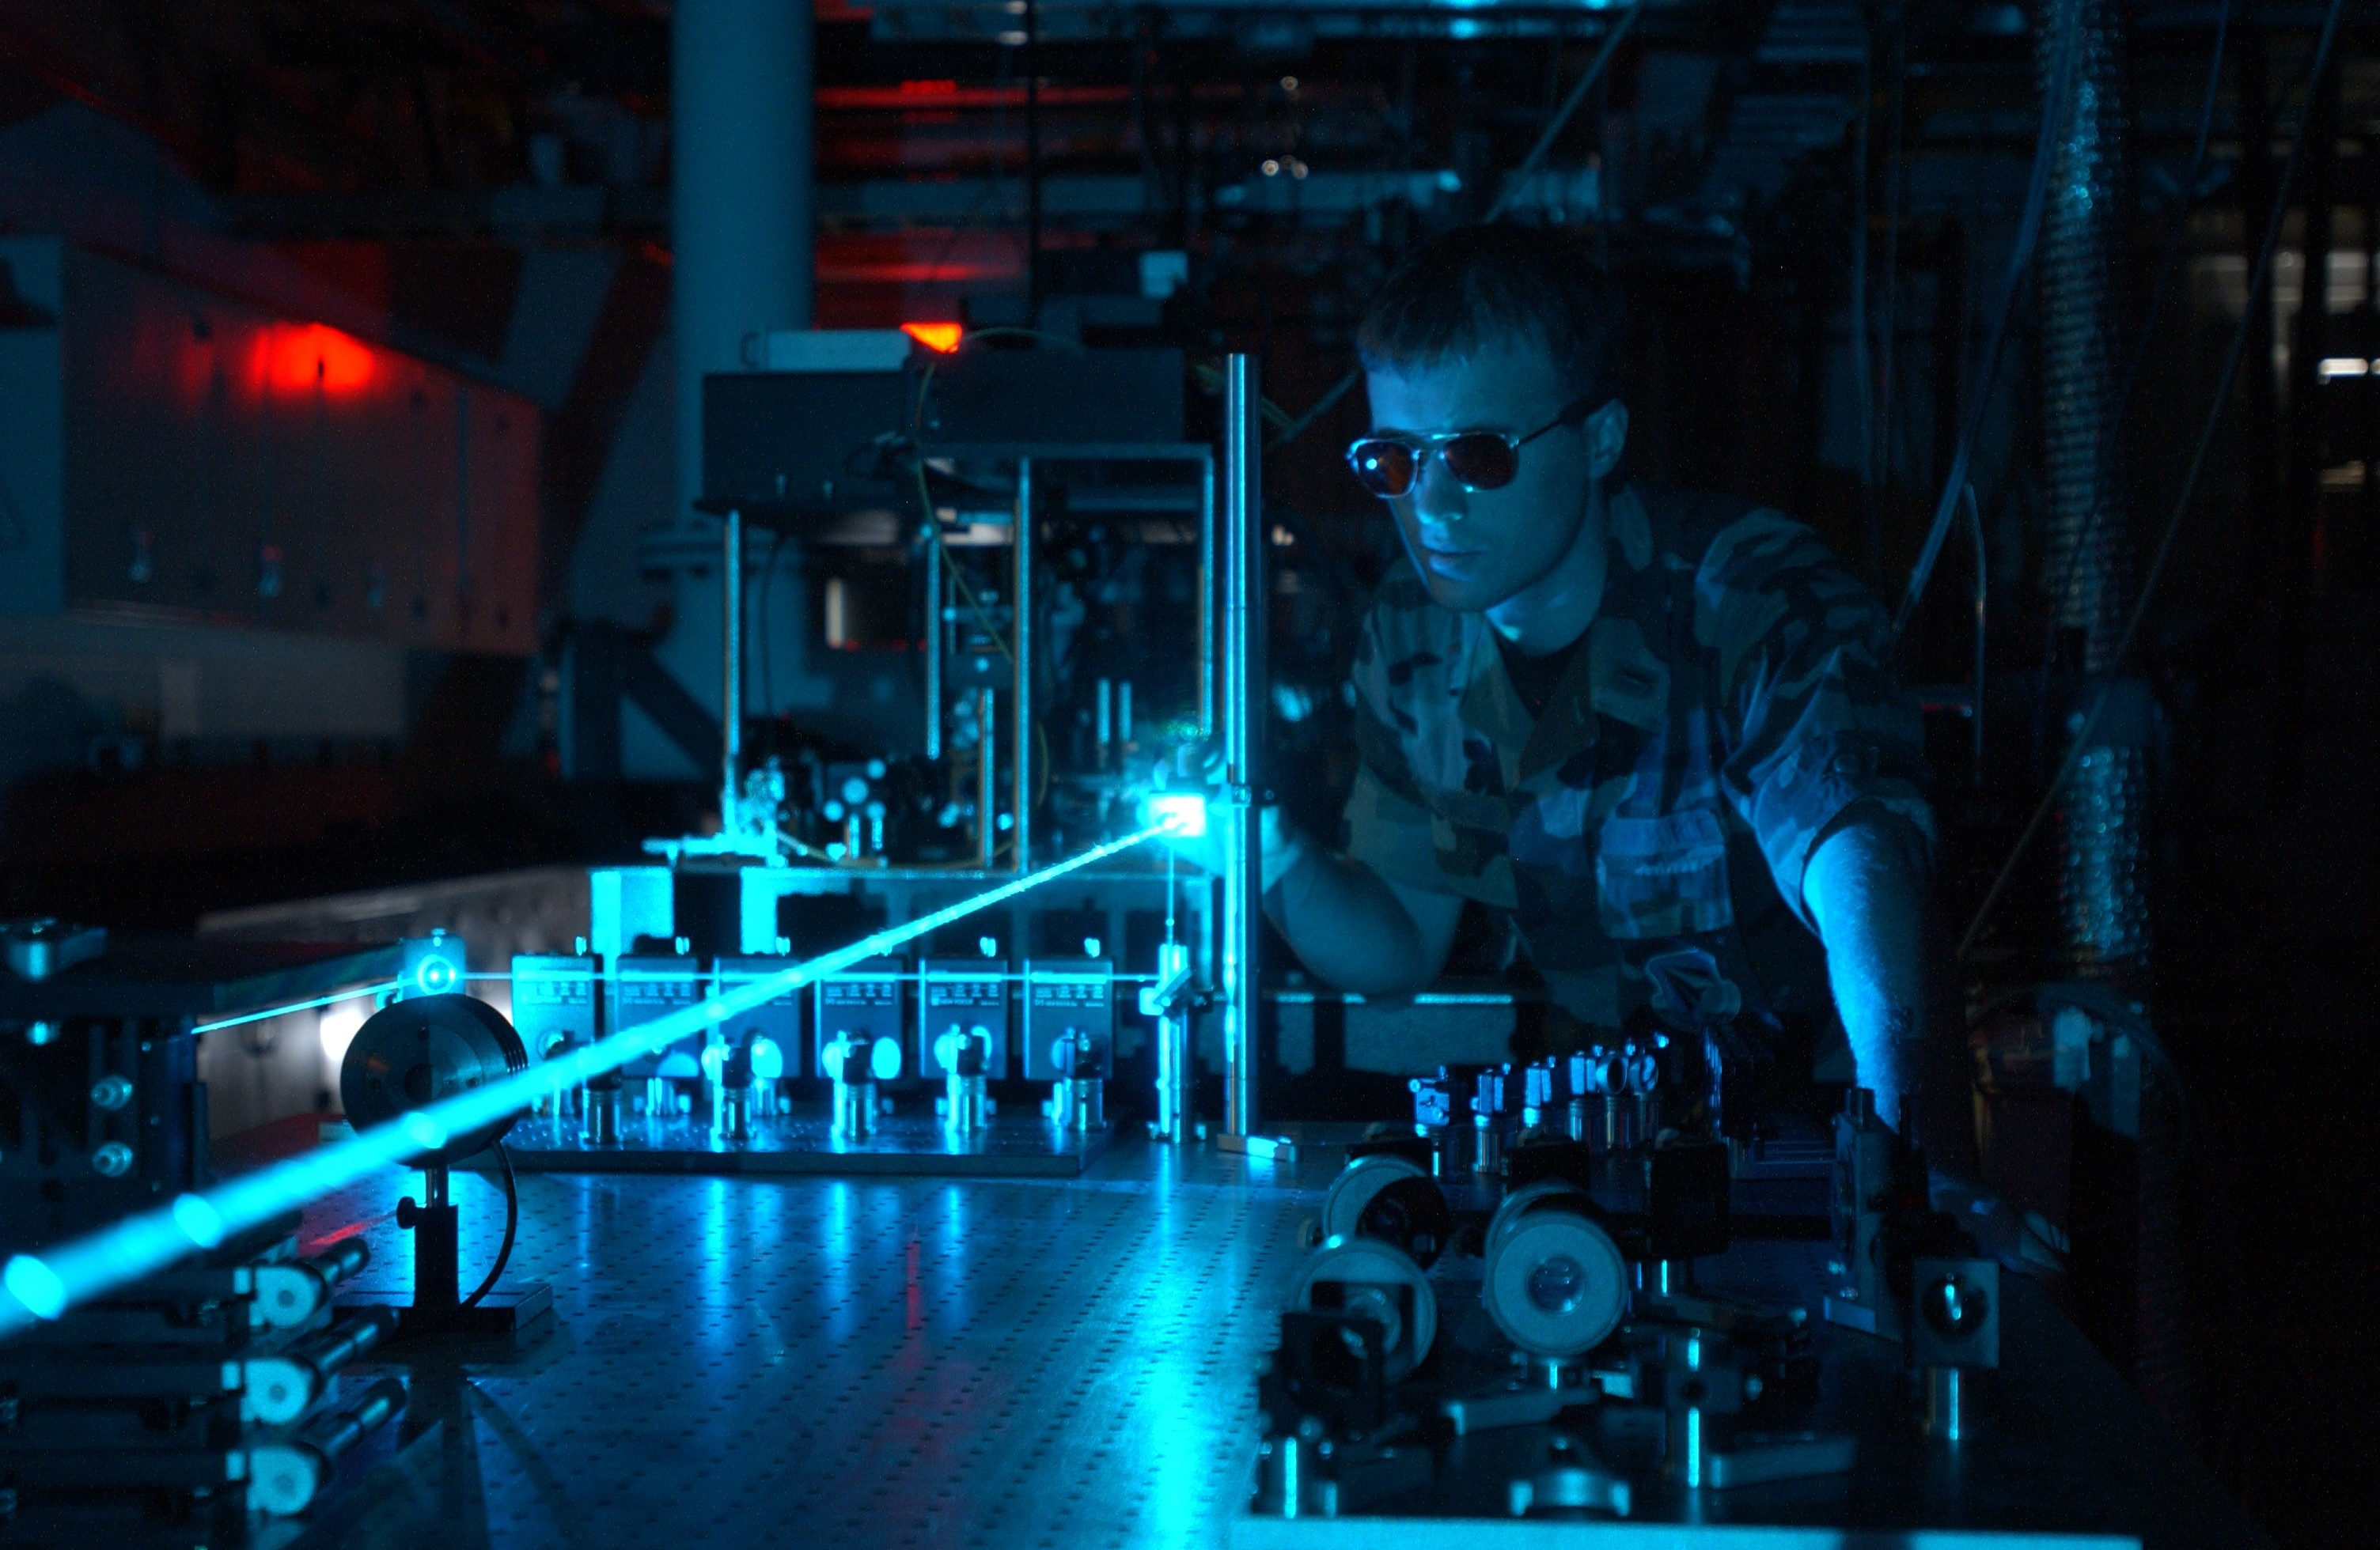
Photo: usairforce

Slide 14
Masticity Landscape
A
B
D
F
E

Slide 15

Gifts of Athena
Joel Mokyr
Northwestern.edu
Notes:
He argues that the growth explosion in the modern West in the past two centuries was driven not just by the appearance of new technological ideas but also by the improved access to these ideas in society at large--as made possible by social networks comprising universities, publishers, professional sciences, and kindred institutions

Slide 16
Model Thinking
Scott E Page

