Slide 1
Model Thinking
Scott E Page

Slide 2
Simple Growth Model

Slide 3
Workers
Coconuts
Picking Machines
Machines wear out

Slide 4
L_{t} = Workers at time t
M_{t} = Machines at time t
O_{t} = Output of Coconuts at time t
E_{t} = Number consumed at time t
I_{t} = Number invested at time t
s = savings rate
d = Depreciation rate

Slide 5
Assumption 1: Output is increasing and concave in labor and machines
O_{t} = √L_{t}√M_{t}
Assumption 2: Output is consumed or invested
O_{t} = E_{t} + I_{t} I_{t} =sO_{t}
Assumption 3: Machines can be built but depreciate
M_{t+1} = M_{t} + I_{t} - dM_{t}

Slide 6
Concave means that the first machine is worth more than the second, the second more than the third, and the third more than the fourth.
Economists call this diminishing returns to scale.

Slide 7
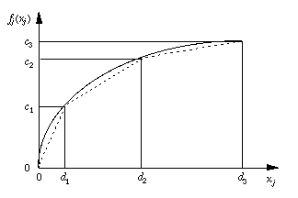

Slide 8
Simplification: L_{t} =100
O_{t} = 10√M_{t}

Slide 9
Example: d = 0.25, s= 0.3
Year 1: 4 Machines
Output = 10 √4 = 20
Investment =
Depreciation =
Year 2 Machines =

Slide 10
Example: d = 0.25, s= 0.3
Year 2: 9 machines
Output = 10 √9 =
Investment =
Depreciation =
Year 3 Machines =

Slide 11
Example: d = 0.25, s= 0.3
Year 3: 16 machines
Output = 100 √16 = 40

Slide 12
Coconut GDP
Year 1: 200
Year2: 300
Year 3: 400

Slide 13
d = 0.25, s= 0.3
400 Machines?
Output = 10 √400 =
Investment =
Depreciation =
Machines =

Slide 14
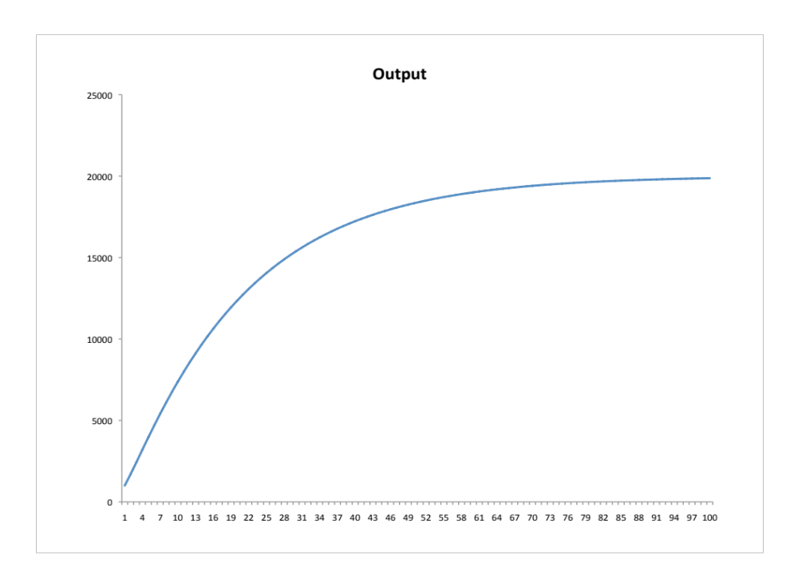

Slide 15
Long Run Equilibrium:
Investment = Depreciation

Slide 16
Output = 10√M
Investment =
Depreciation =

Slide 17
Output = 10√M
Investment = 0.3 × 10 √M = 3√M
Depreciation = 0.25M
Investment = Depreciation
0.25M = 3√M
M = 12√M
M = 144

Slide 18
d = 0.25, s= 0.3
144 Machines
Output = 10 √144 =
Investment =
Depreciation =
Machines =

Slide 20
The Irony of the Growth Model

Slide 21
Depreciation: linear
Output: concave

Slide 22
Innovation

Slide 23
Model Thinking
Scott E Page

