Slide 1
Model Thinking
Scott E Page

Slide 2
Compounding
Exponential Growth
Rule of 72

Slide 3
X dollars
r% interest

Slide 4
G = GDP
r% growth

Slide 5
Year | 2% | 6%
0 | 1000 | 1000
1 | 1020 | 1060
10 | 1219 | 1791
35 | 2000 | 7686
100 | 7245 | 339,302

Slide 6
Rule of 72: Divide the growth rate into 72 and it tells you (approximate) time for GDP to DOUBLE.

Slide 7
Rule of 72

Slide 8
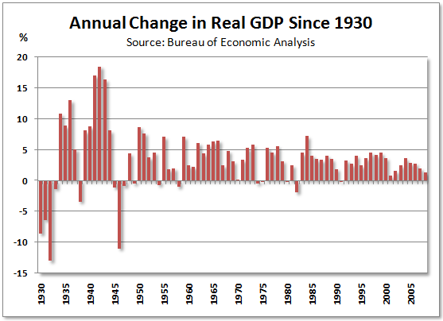

Slide 9
Continuous Compounding

Slide 10
Lim _{n ➔∞}(1+r/n)^{nt} = e^{rt}

Slide 11
Linear
Exponential

Slide 12
Model Thinking
Scott E Page

