Slide 1
Model Thinking
Scott E Page

Slide 2
Growth Models

Slide 3
Exponential Growth
Economic Growth
Solow’s Growth Model
Extensions

Slide 4
Gross Domestic Product (GDP): Total market value of all goods and services.

Slide 5
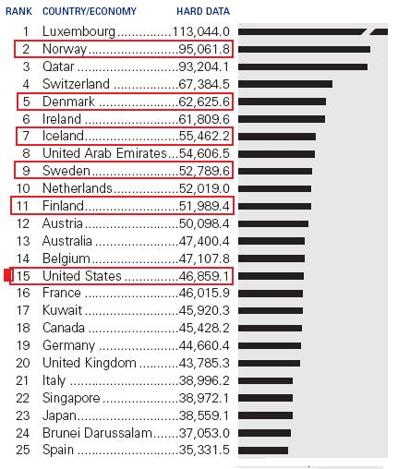
Newsbird.files.wordpress.com

Slide 6
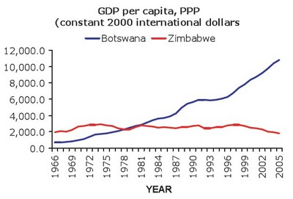
www.american.com

Slide 7
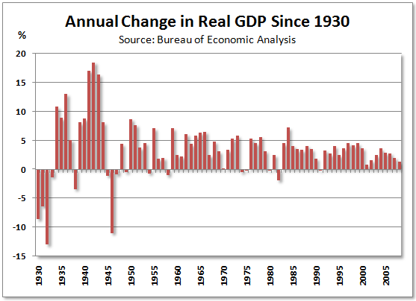

Slide 8
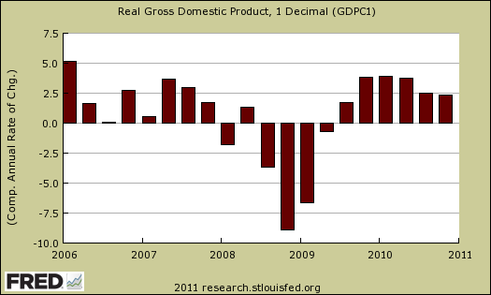

Slide 9
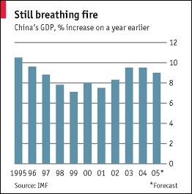

Slide 10
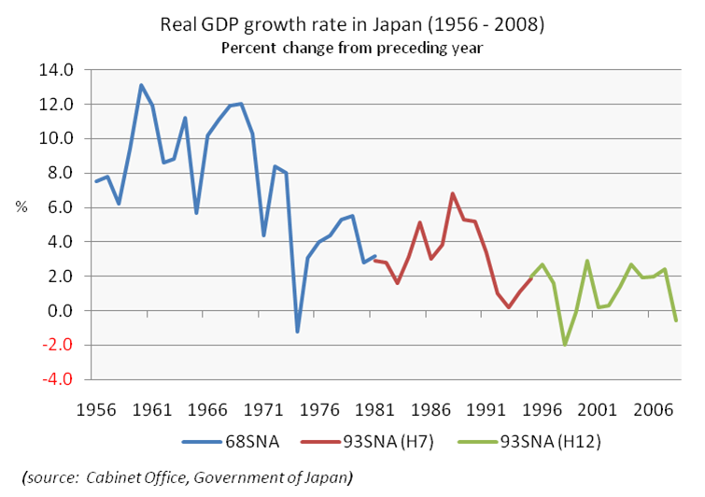

Slide 11
Exponential Growth

Slide 12
Economic Growth

Slide 13
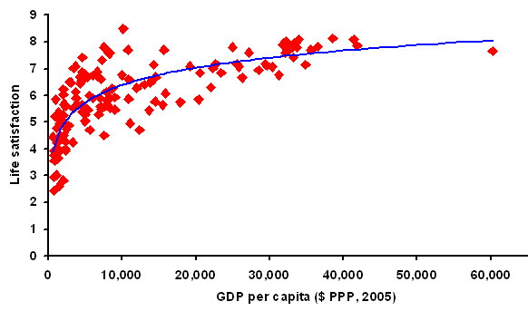

Slide 14
Model Thinking
Scott E Page

