Slide 1
Model Thinking
Scott E Page
Notes:
Big thing is that we learned to think better.

Slide 2
Probability

Slide 3
Axiom 1:
Probability of an outcome in [0,1]

Slide 4
Axiom 2:
Sum of all possible outcomes equals 1

Slide 5
Axiom 3:
A subset of B, then Prob(B) ≥ Prob(A)

Slide 6

http://en.wikipedia.org
Classical

Slide 7
Prob(4) =
Prob(Even) =
Prob(Odd) =
Notes:
Talk about how probabilities satisfies all three axioms

Slide 8
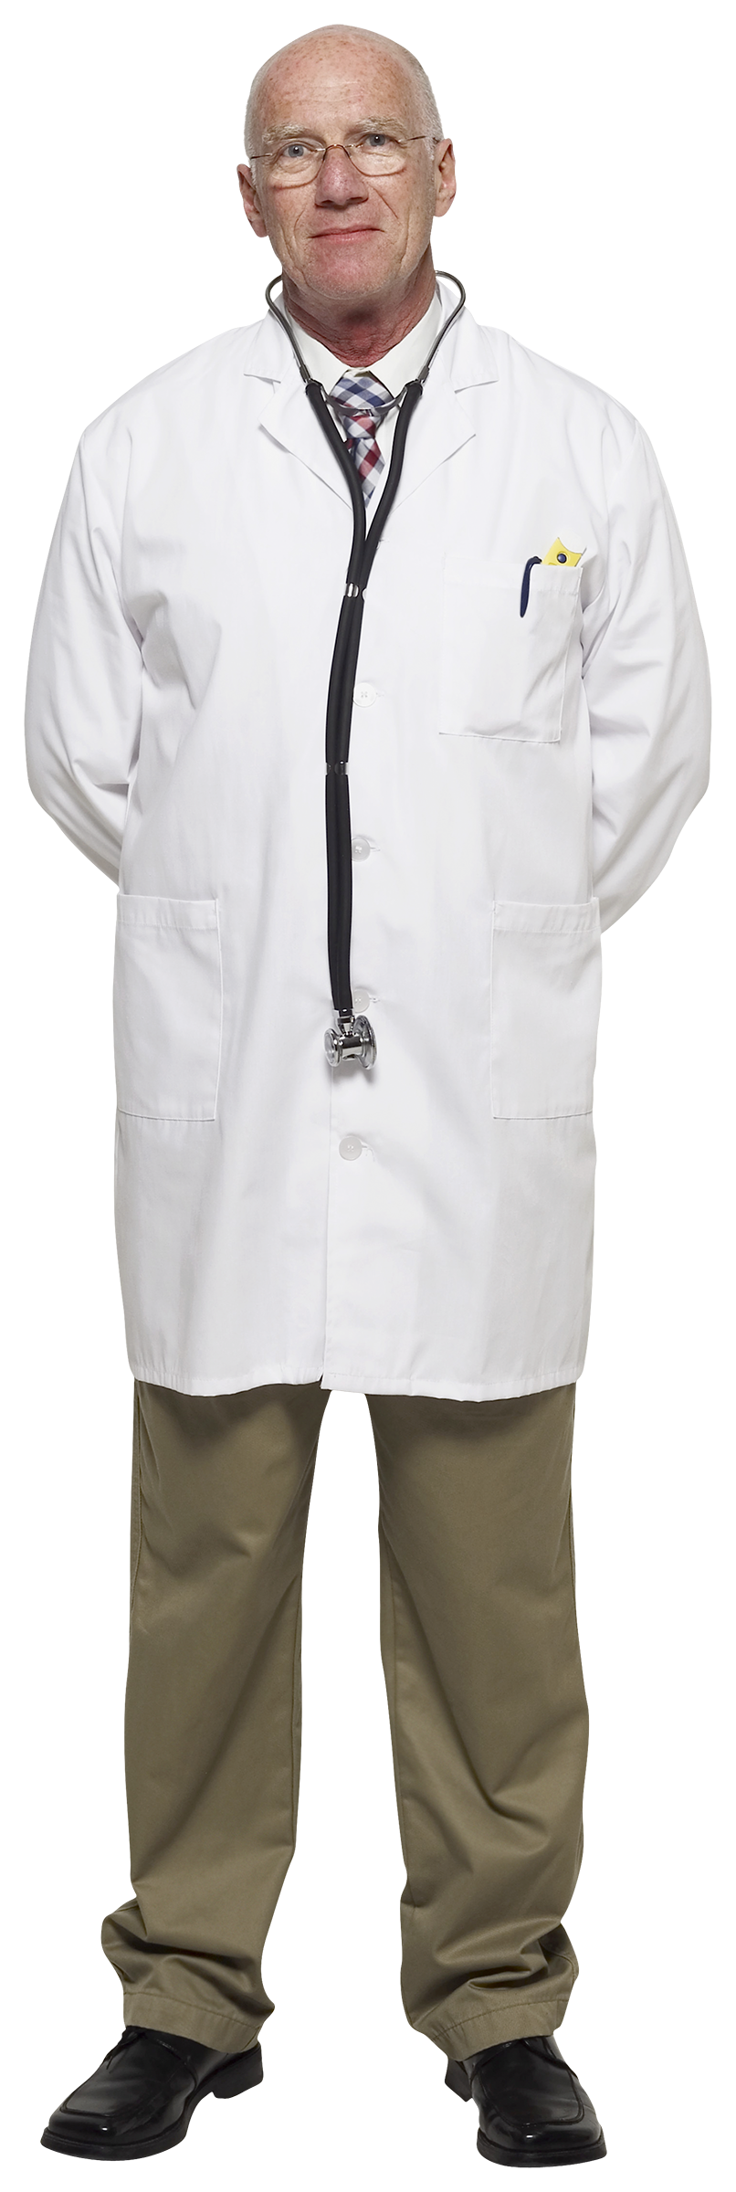
Frequency

Slide 9
Do more words begin with r or have r as their third letter?
Notes:
Stationary

Slide 10
Rain Next June 7th?
Notes:
Find out probability it’s a boy

Slide 11
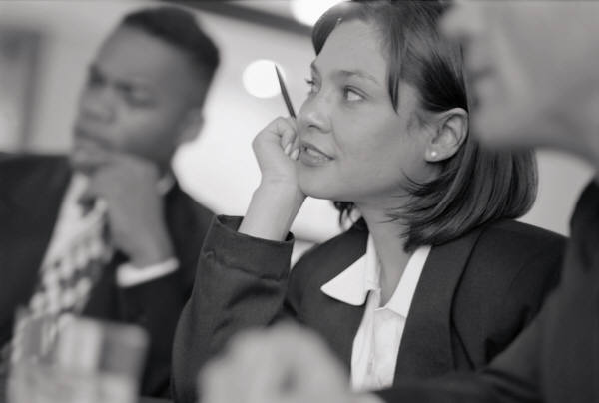
Subjective

Slide 12
Shelly majored in political science and was very involved in the college republicans. Write down probabilities for the following events:
Event A: Flight Attendant
Event B. Blogger
Event C. Flight Attendant while finishing her MBA
Event D. Medical Field

Slide 13
Axiom 1?
Axiom 2?
Axiom 3?

Slide 14
Event A: Flight Attendant
Event C. Flight Attendant while finishing her MBA

Slide 15
Will housing prices go up this year?
Notes:
Model?

Slide 16
Frequency
Or
Subjective?
MODEL
Notes:
Stationarity!!!

Slide 17
Model Thinking
Scott E Page
Notes:
Big thing is that we learned to think better.

