Slide 1
Model Thinking
Scott E Page
Notes:
Big thing is that we learned to think better.

Slide 2
Spatial Choice Models

Slide 3
H
C

Slide 4
L
R

Slide 5
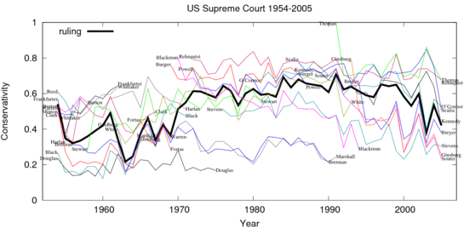
Source: Andrew Gelman

Slide 6
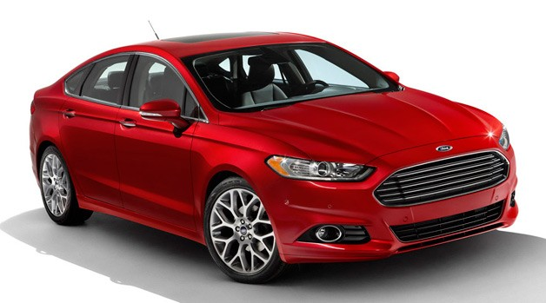
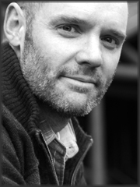
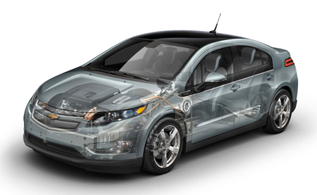

Slide 7
Attribute | IDEAL
Cheese Slices
Patties
Tomatoes
Ketchup (TBSP)
Mayo (TBSP)
Pickles

Slide 8
Attribute | IDEAL
Cheese Slices | 2
Patties | 2
Tomatoes | 2
Ketchup (TBSP) | 4
Mayo (TBSP) | 4
Pickles | 4

Slide 9
Attribute | IDEAL | Big Mac
Cheese | 2 | 2
Patties | 2 | 2
Tomatoes | 2 | 0
Ketchup | 4 | 3
Mayo | 4 | 3
Pickles | 4 | 6

Slide 10
Attribute | IDEAL | Big Mac | |DIFF|
Cheese | 2 | 2
Patties | 2 | 2
Tomatoes | 2 | 0
Ketchup | 4 | 3
Mayo | 4 | 4
Pickles | 4 | 6

Slide 11
Attribute | IDEAL | BKW | |DIFF|
Cheese | 2 | 2
Patties | 2 | 1
Tomatoes | 2 | 2
Ketchup | 4 | 3
Mayo | 4 | 4
Pickles | 4 | 4

Slide 13
Attribute | IDEAL | Big Mac | BKW
Cheese | ? | 2 | 2
Patties | ? | 2 | 1
Tomatoes | ? | 0 | 2
Ketchup | ? | 3 | 3
Mayo | ? | 4 | 4
Pickles | ? | 6 | 4

Slide 14
Attribute | IDEAL | Big Mac | BKW
Cheese |  | 2 | 2
Patties | ? | 2 | 1
Tomatoes | ? | 0 | 2
Ketchup |  | 3 | 3
Mayo |  | 3 | 4
Pickles | ? | 6 | 4

Slide 15
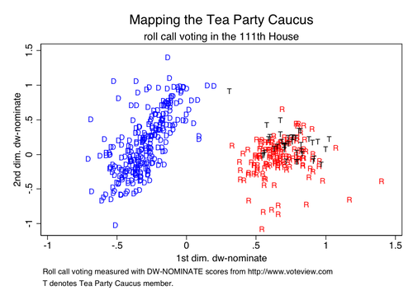
Source: Michael Tofias

Slide 16
Model Thinking
Scott E Page
Notes:
Big thing is that we learned to think better.

