Slide 1
Model Thinking
Scott E Page

Slide 2
Multi-Criterion Decisions

Slide 3
Qualitative

Slide 4
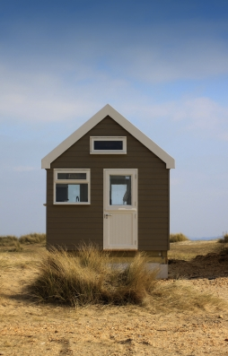
Photo: Simon Howden

Slide 5
Criteria
Square feet
# Bedrooms
# Bathrooms
Lot Size
Location
Condition

Slide 6
Criteria | House 1 | House 2
Square Feet
# Bedrooms
# Bathrooms
Lot Size
Location
Condition
TOTAL

Slide 7
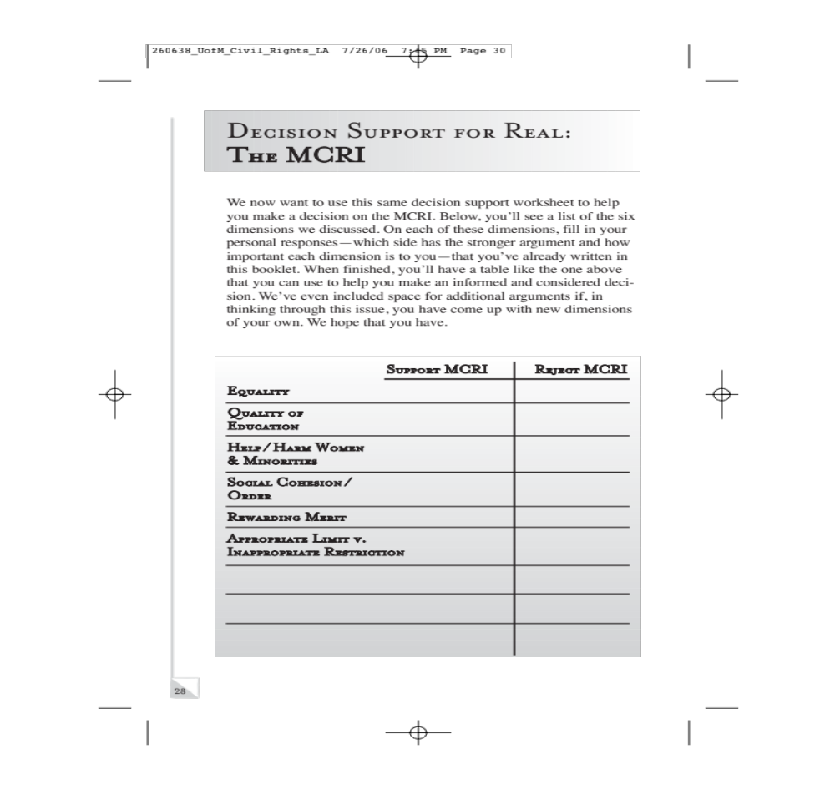

Slide 8
Photo: Simon Howden
Notes:
What if you don’t like your answer?

Slide 9
Criteria | House 1 | House 2
Square Feet
# Bedrooms
# Bathrooms
Lot Size
Location
Condition
Basement
TOTAL

Slide 10

?
Notes:
Know thyself?

Slide 11
Quantitative

Slide 12
Criteria | Wgt | H1 | H2
Square Feet
# Bedrooms
# Bathrooms
Lot Size
Location
Condition
Basement
TOTAL

Slide 13
Model Thinking
Scott E Page
Notes:
Big thing is that we learned to think better.

