Slide 1
Model Thinking
Scott E Page

Slide 2
Preference Aggregation

Slide 3



Slide 4
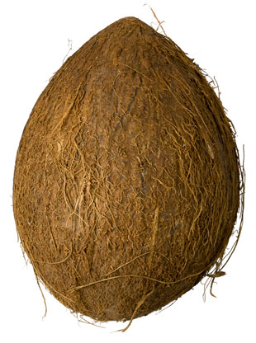

Slide 5
How Many?
>
>
<

Slide 6
>
>

Slide 7
How Many?
>
>

Slide 8


>
>
>
>

Slide 9
>
>
>
>
>
>

Slide 10
>
>
>
>
>
>

Slide 11
>
>
>
>
>
>
vs
vs
vs

Slide 12
>
>
>

Slide 13
Condorcet
Paradox
Each Person Rational
Collective NOT

Slide 14
>
>
>
>
>
>

Slide 15
>
>
>

Slide 16
Model Thinking
Scott E Page

