Slide 1
Model Thinking
Scott E Page

Slide 2
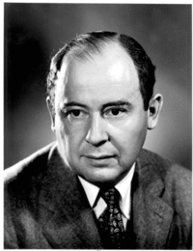
1D Cellular Automata

Slide 3
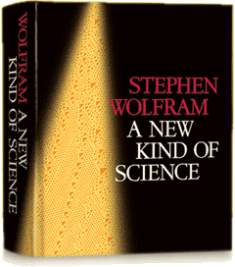
1D Cellular Automata
Notes:
1280 pages!!! What does he mean. He means that mathematics
Has limits and we need to also explore computational models.

Slide 6
X

Slide 7
X X

Slide 8
X X

Slide 9
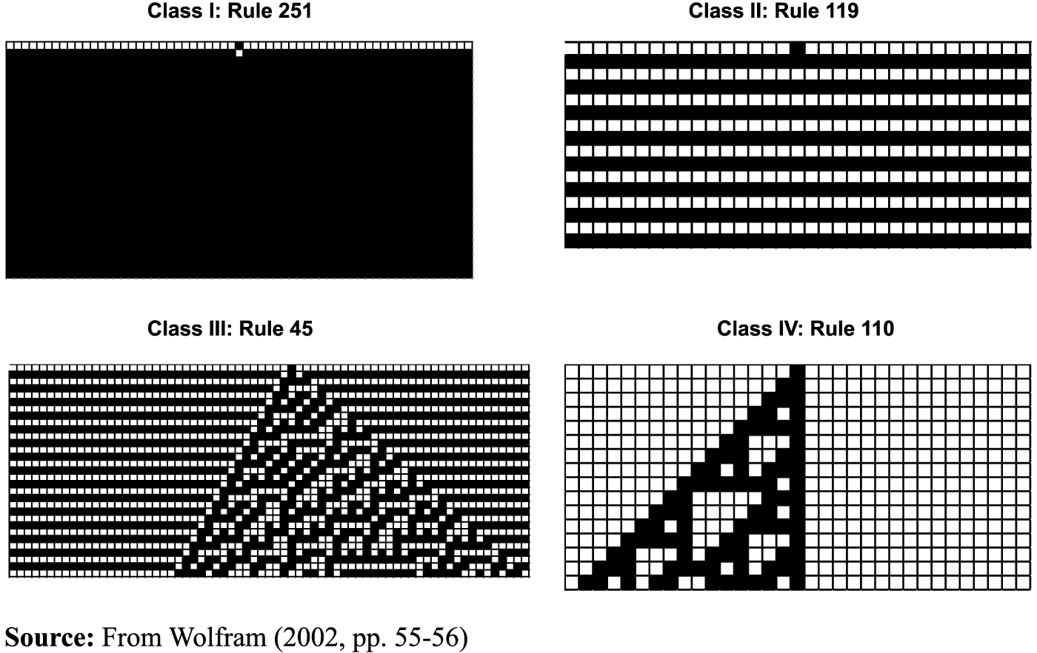
Four Classes of Behavior

Slide 10
X X
Notes:
2 times 2 times 2 -- 256

Slide 11
X X
Notes:
1 2 4 8 16 32

Slide 12
X X
Notes:
Co

Slide 13
2
4
8
16
Sum = 30

Slide 14
Netlogo

Slide 15
2
4
8
32
64
Sum = 110

Slide 16
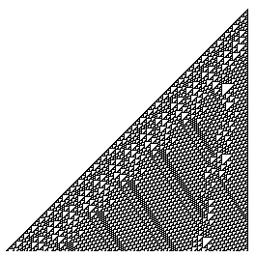
Source: wolfram.com

Slide 17
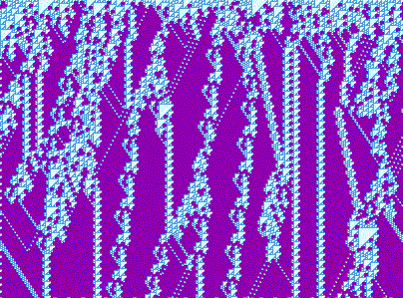
Source: /uncomp.uwe.ac.uk

Slide 18
Four Classes of Behavior

Slide 19
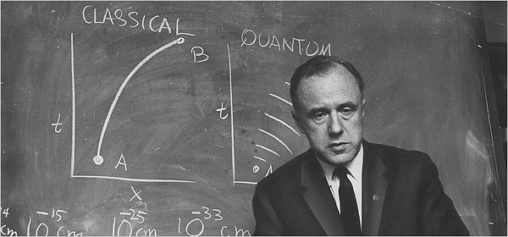
“It From Bit”
Notes:
It from bit. Otherwise put, every 'it'—every particle, every field of force, even the space-time continuum itself—derives its function, its meaning, its very existence entirely—even if in some contexts indirectly—from the apparatus-elicited answers to yes-or-no questions, binary choices, bits. 'It from bit' symbolizes the idea that every item of the physical world has at bottom—a very deep bottom, in most instances—an immaterial source and explanation; that which we call reality arises in the last analysis from the posing of yes–no questions and the registering of equipment-evoked responses; in short, that all things physical are information-theoretic in origin and that this is a participatory universe. (John Archibald Wheeler 1990: 5)

Slide 20
Langton’s λ

Slide 21
Langton’s λ
X X

Slide 22
X X

Slide 23
X X

Slide 26
λ | ALL Rules | Class III | Class IV
0 | 1 | 0 | 0
1 | 8 | 0 | 0
2 | 28 | 2 | 0
3 | 56 | 4 | 1
4 | 70 | 20 | 4
5 | 56 | 4 | 1
6 | 38 | 2 | 0
7 | 8 | 0 | 0
8 | 1 | 0 | 0

Slide 27
Notes:
Nothing very interesting happens white groups stay white but then they get destroyed from the edges

Slide 28
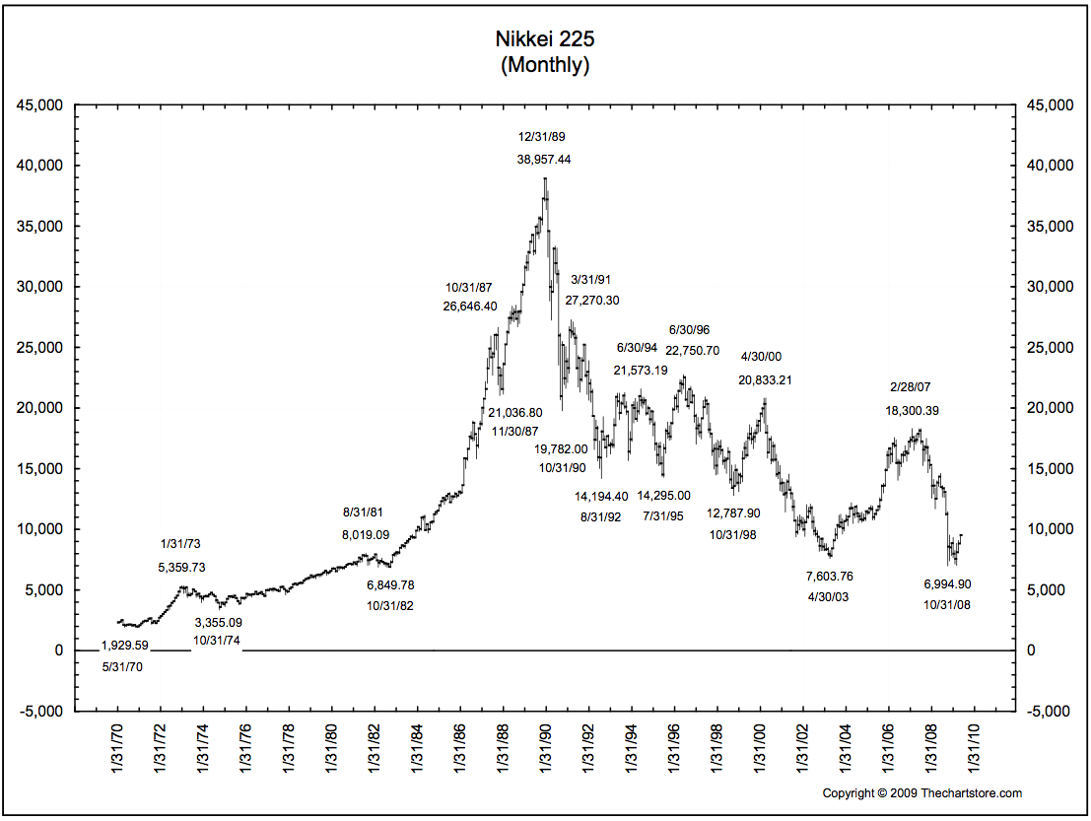

Slide 29
Simple rules combine to form anything
“it from bit”
Complexity and randomness require interdependency

Slide 30
Model Thinking
Scott E Page

