Slide 1
Model Thinking
Scott E Page

Slide 2
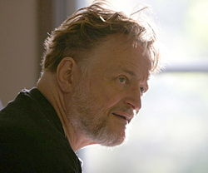
Game of Life

Slide 3
1 | 2 | 3
4 | X | 5
6 | 7 | 8

Slide 4
Rules
If off you turn on if
3 neighbors on
If on stay on if 2 or
3 neighbors on

Slide 5
1 | 2 | 3
4 | X | 5
6 | 7 | 8

Slide 6
1 | 2 | 3
4 | X | 5
6 | 7 | 8

Slide 7
1 | 2 | 3
4 | X | 5
6 | 7 | 8

Slide 14
Beacon

Slide 15
Figure 8

Slide 16
F-Pimento

Slide 17
Netlogo

Slide 18
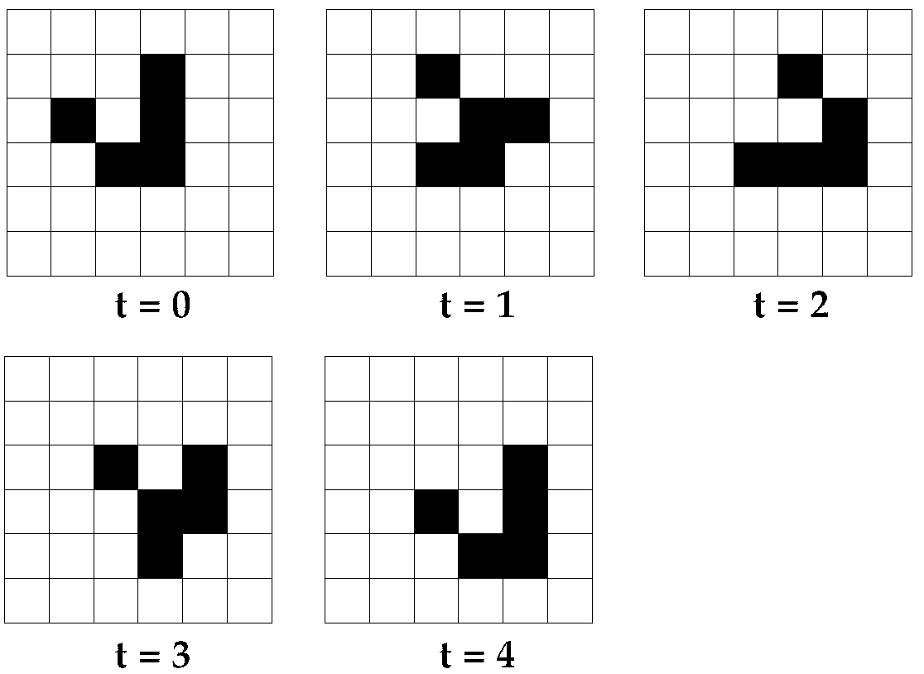

Slide 19
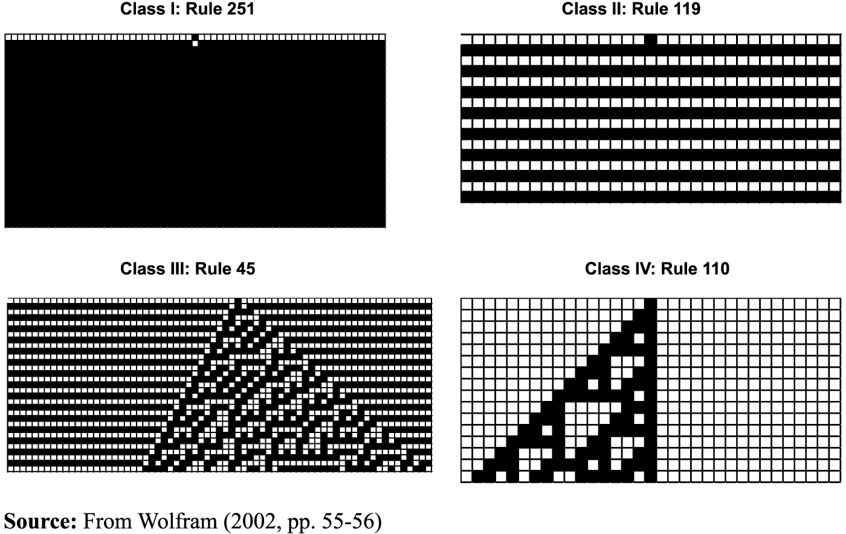
Understand Class of Outcome

Slide 20


Slide 21
Self Organization:
Patterns appear without
a designer

Slide 22
Emergence
Functionalities appear:
gliders, glider guns
counters, computers

Slide 23
Logic Right:
Simple rules produce
incredible phenomena

Slide 24
Model Thinking
Scott E Page

