Slide 1
Model Thinking
Scott E Page

Slide 2
Probability Distribution

Slide 3
Central Limit Theorem

Slide 4
Flip a Coin 2 Times
Notes:
2 heads ¼
1 head one tail ½
2 tails 1/4

Slide 5
Flip a Coin 4 Times
Notes:
2 heads ¼
1 head one tail ½
2 tails 1/4

Slide 6
Flip a Coin N Times
Notes:
2 heads ¼
1 head one tail ½
2 tails 1/4

Slide 7
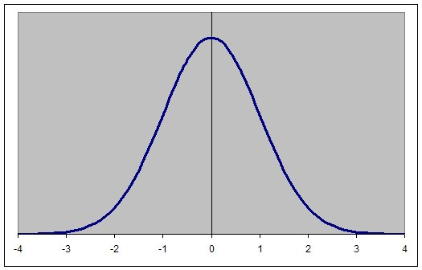
Bell Curve
N/2

Slide 8
Binomial Distribution
Mean = pN

Slide 9
Bell Curve
pN

Slide 10
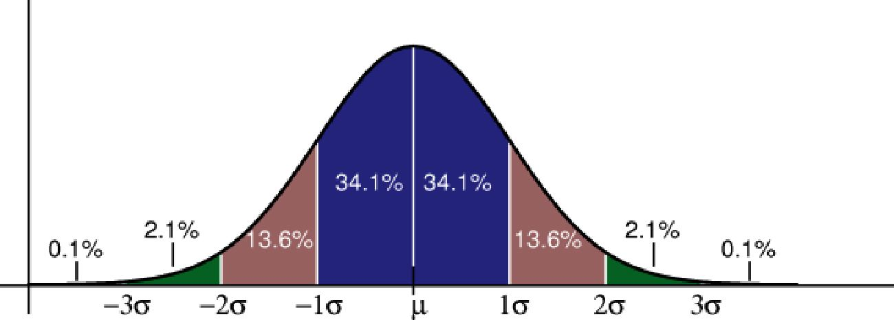

Slide 11
±1 s.d. 68%
±2 s.d. 95%
±3 s.d. 99.75%

Slide 12
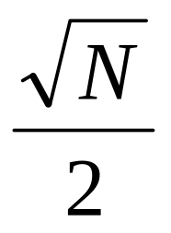
Binomial Distribution P=1/2
Mean = N/2
S.D. =

Slide 14
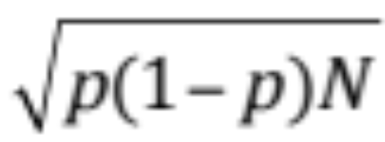
Binomial Distribution
Mean = pN
S.D. =

Slide 15
Boeing 747: 380 seats
90% show up rate
Sell 400 Tickets

Slide 16
Mean = pN
S.D. =

Slide 17
342 348 354 360 366 372 378

Slide 18
Number people on plane
Total weight of bags
Number of snack boxes buy
Total Age

Slide 19
Central Limit Theorem:
Add random variables
independent
finite variance
Sum to a normal distribution

Slide 20
Bimodal Distribution

Slide 21
Model Thinking
Scott E Page

