Slide 1
Model Thinking
Scott E Page

Slide 2
Aggregation

Slide 3
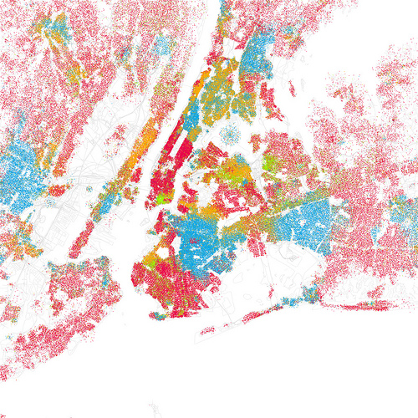
New York

Slide 4
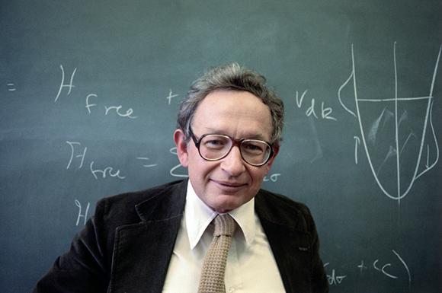
“More Is Different”
Notes:
1280 pages!!! What does he mean. He means that mathematics
Has limits and we need to also explore computational models.

Slide 5

“More Is Different”
Notes:
1280 pages!!! What does he mean. He means that mathematics
Has limits and we need to also explore computational models.

Slide 6
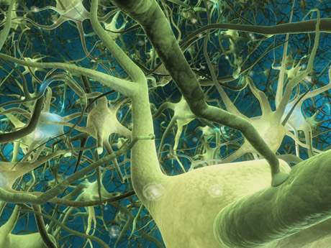
“More Is Different”
Source: scientopia.org
Notes:
1280 pages!!! What does he mean. He means that mathematics
Has limits and we need to also explore computational models.

Slide 7
Aggregation
Actions
Single Rule
Family of Rules
Preferences

Slide 8
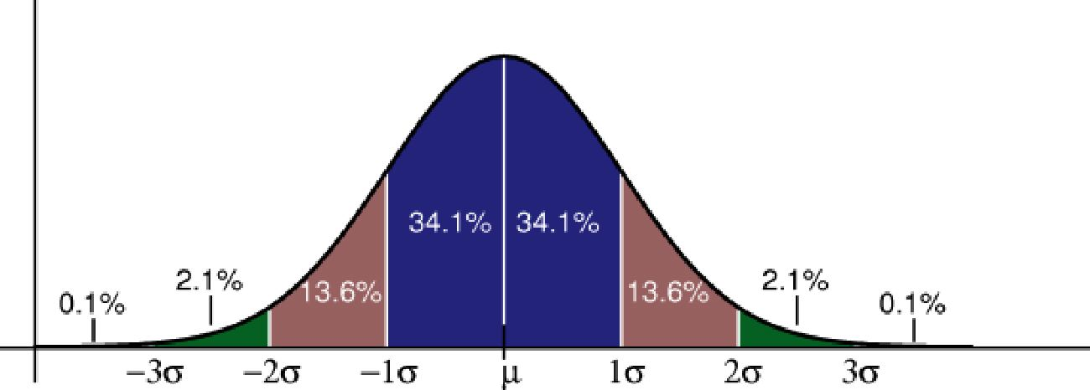
Predict Points
Understand Data

Slide 9
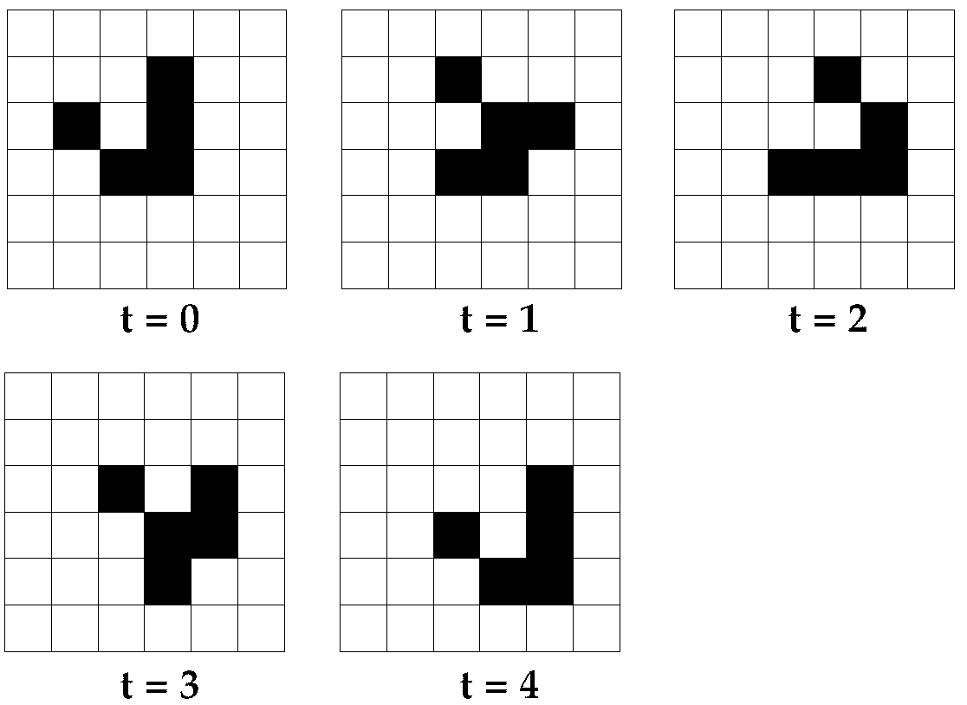
Understand Patterns

Slide 10
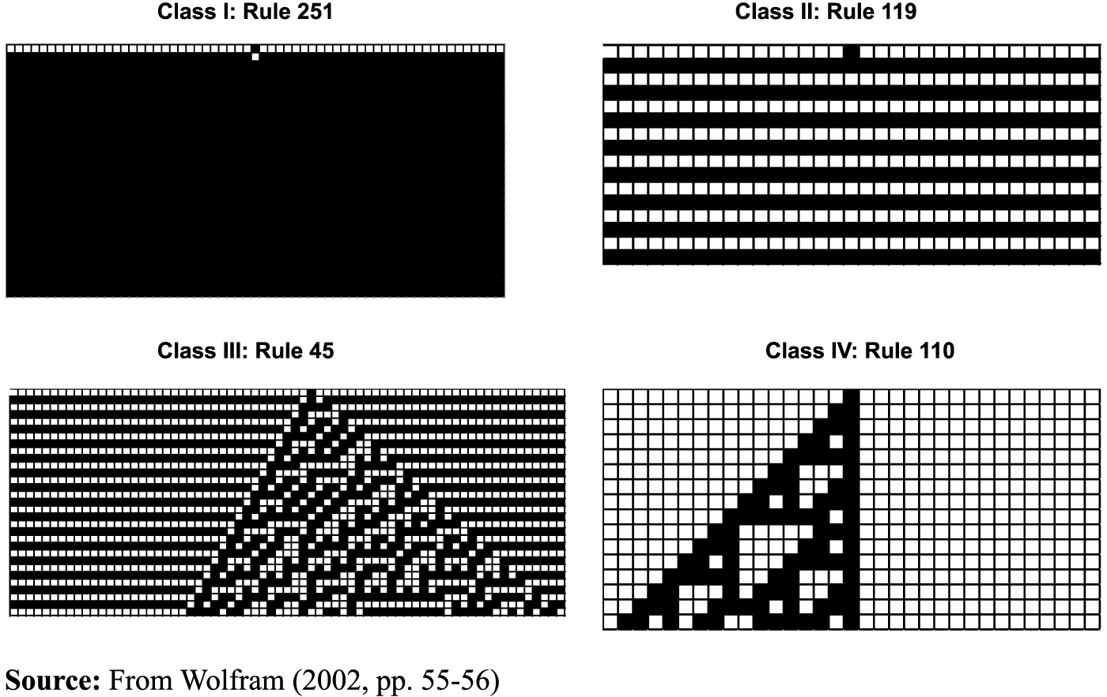
Understand Class of Outcome

Slide 11

Source: /uncomp.uwe.ac.uk

Slide 12


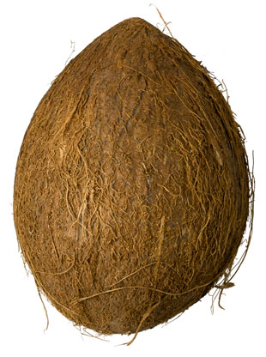
>
>
>
>
>
>
Work Through Logic

Slide 13

www.mylot.com
Scott E Page

Slide 14
Model Thinking
Scott E Page

