Slide 1
Matplotlib Architecture
Backend
  Deals with the rendering of plots to screen or files
  In Jupyter notebooks we use the inline backend

Slide 2
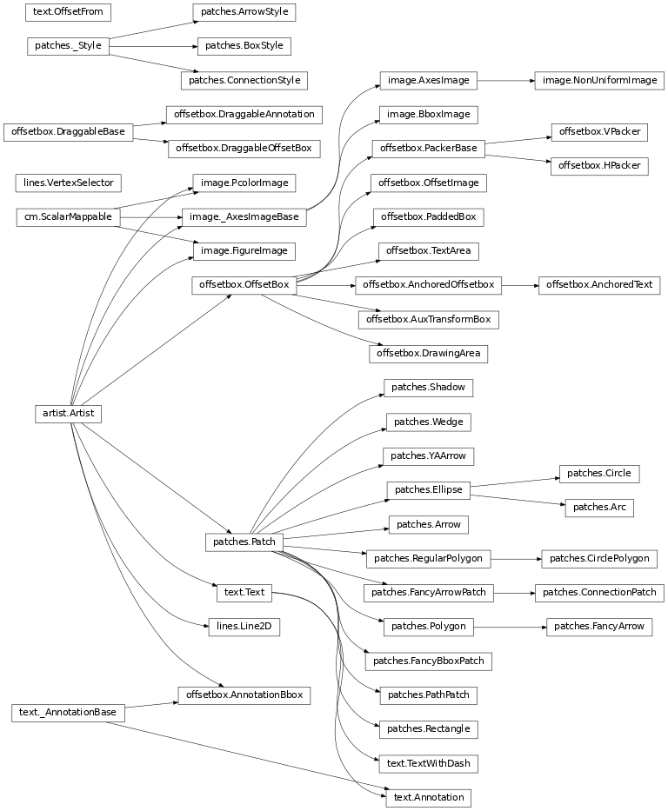
Notes:
The matplotlib architecture that shows the numerous kinds of artists available on the artist layer. The artists object has many child objects, some of which also have their own child objects. Patches.patch is one of the child objects of the artists object.
Source: http://matplotlib.org/api/artist_api.html

Slide 3
Matplotlib Architecture
Backend Layer
  Deals with the rendering of plots to screen or files
  In Jupyter notebooks we use the inline backend
Artist Layer
  Contains containers such as Figure, Subplot, and Axes
  Contains primitives, such as a Line2D and Rectangle, and collections, such as a PathCollection
Scripting Layer
  Simplifies access to the Artist and Backend layers

Slide 4
Acknowledgements
Slide 2
  Hunter, J., & Droettboom, M. (2012). matplotlib in A. Brown (Ed.), The Architecture of Open Source Applications, Volume II: Structure, Scale, and a Few More Fearless Hacks (Vol. 2). lulu.com (Licensed under CC)

